Slide 1
Internal Auditing
Notes:
Whether auditing or being audited, the experience is not always pleasant - particularly for the person being audited.
Both parties need to know not only what to do, but also what NOT to do.

Slide 2
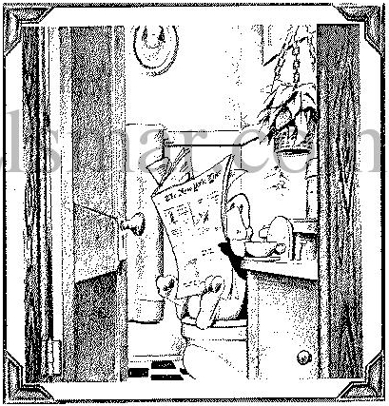
Did I Catch You Unaware?
Notes:
Don’t be caught with your pants down! Run your business as if there will be an audit every day.
It is my humble opinion that well run businesses do not need audits. However, then comes the real world. I must admit that I cannot remember having been a business where audits were not beneficial - WHEN DONE CORRECTLY.
I give credit to scheduled audits (at least in some companies) for ensuring a ‘certain’ level of discipline in performance.

Slide 3
Auditing Presentation Notes
This powerpoint file is formatted to be read and printed in the ‘Notes’ view. Many explanations and details are contained in the ‘Notes’ portion of the presentation. While not all slides have text in their Notes’ window, many have some relevant info. If you do not see the ‘notes’ below this slide you are not using the ‘notes’ view.
The Notes panes can also be used to take notes.
Marc T. Smith
Cayman Business Systems – Elsmar.com
8466 Lesourdesville-West Chester Road
West Chester, Ohio 45069-1929
Notes:
This is the notes pane. Notes and commentary will be found for many slides in their notes pane.

Slide 4
Course Objectives
To Develop an Understanding of What is Required of a ‘Quality’ System Auditor
To Review the Guidelines for Internal Auditing of ‘Quality’ Systems
To Develop Auditing Techniques
To Utilize these Concepts through Actual Audits
Understanding How to Respond to an Auditor
Notes:
This course would help the auditors to explore the concepts above described, as well as to know which qualifications are required to be a good auditor, but just practice, proper monitoring and feedback would guarantee that a trained auditor becomes a competent auditor.

Slide 5
Related ‘Stuff’ We Will Be Covering
Understanding the General Structure of Quality Systems
Review Documentation Hierarchy
Understanding Auditing Techniques
  Planning Schedules
  Creating Check Lists
  Audit Plan
  Auditing
  Audit Findings/Observations
  Preparing Audit Reports
Notes:
Even though here are defined most of the basics for auditing, it is strongly recommended to read also the ISO 19011 “Guidelines for Auditing Quality Systems”

Slide 6
Caution
Whilst some of you may be using this guide for internal auditing, in general it addresses auditing as a third party just as the ASQ's CQE (Certified Quality Auditor) course and exam does. This is to say much of the material is aimed at folks who will be dealing with companies they do not work in. This said, you will see I take a formal approach at times. Most classes on auditing do. For example, we will talk about introductory meetings. Obviously these can be very formal and long (up to an hour or more), whilst for some companies doing internal audits the formality is very limited.
So - as you go through the guide, recognize that the amount of formality will be dependent upon your specific situation.
Notes:
If you are using this material for training of your company’s internal auditors, perhaps you would like to remove some of the pages in order to make the content “less formal” or “less complicated” from the regular internal auditor standpoint

Slide 7
Caution II
This guide is not intended to address specific interpretation(s) of ISO 9001, TS 16949 or any other specific standard or customer requirement. It is *assumed* that anyone auditing will have the appropriate background / experience / education in that which s/he is auditing.
For purposes of being practical, when ISO 9001 is mentioned, it means we are referring to the version 2008 of the standard.
It is *assumed* that we all know you cannot audit anything you do or are responsible for. Conflict of Interest is the phrase.
Notes:
For example, if you are doing a process audit and part of the process includes taking SPC (Statistical Process Control) data, you can audit whether or not the operator/technician is taking the data. But - you cannot determine whether the operator understands SPC and what s/he is doing unless your knowledge of SPC is sufficient.
One of the typical expectations in internal auditor courses, much like lead auditor courses, is the expectation that you understand ISO 9001 (and/or TS 16949) and can interpret it with respect to your company. But - more about this later.
The bottom line is if you don’t know about what you’re auditing the effectiveness of your audit will be limited.

Slide 8
Auditing - The Program

Slide 9
The Goal Of An Audit
To Collect
Objective Evidence
To Permit An
Informed Judgment
About The
Status Of The Systems or Product Being Audited
Notes:
This definition applies exactly the same for all kind of Audits (Accounting, Quality System, Government or regulatory Audits and so on).
All those are intended to OBTAIN OBJECTIVE EVIDENCE about how the system being audited is working.

Slide 10
Basic Types of Audits
Internal (First Party, Self)
  This type includes audits by your company employees, consultants and contractors.
External
  Supplier Audit
    Second Party
      This is where: 1. Customer employee(s) audit your company or where 2. Your employee(s) audit a company which supplies your company with a product or service.
  Independent Organization
    Third Party - Registrar
      1.- A customer wants an audit of your company but wants your company to pay for it. 2.-Your company wants to be certified even if it is not a customer requirement but rather a business strategy.
      This type of audit is described as independent.
Notes:
These definitions are the most commonly used within the Auditors’ world, sometimes with different wording, but almost exact meaning.
It is very important to teach the internal auditors about these definitions, as it could help them understand their own role –and boundaries- within the auditing structure (their place in the food chain)

Slide 11
Audit Sub-Types
Compliance (do we comply with the standard)
  Example: Desk audit of high level systems
System (the theory)
  Example: Audit of Document Control
Process (the actual practice)
  Example: Audit of an assembly or fabrication ‘station’
  Note to service industries: you DO have comparable processes, as
    the hotel’s front desk check-in station,
    the kitchen in a restaurant,
    the x-ray station in a hospital or
    the initial visit/evaluation of a consultant for a service quotation
Product (the result)
  Example: Dock Audit
    A breakdown of the final product. Verify paperwork trail, inspection and test results, for each item of the product. Verify key characteristics meet dimensional requirements.
Notes:
These definitions are as well valid, but less used as subtypes, they are rather used as “auditing techniques” or auditing approaches.
The fact that ISO 9001:2008 focuses on process approach, has changed dramatically the meaning of “process audit”, and also changing it from a kind-of-optional audit method to a “must”

Slide 12
Audit Types
Compliance Audit
System Audit
System Audit
Process Audit
Process Audit
Product Audit
Product Audit
Notes:
Audit types visually explained

Slide 13
A Typical Audit System
Notes:
A Typical Audit System

Slide 14
Definitions: “Who”
Auditor: A person who has the appropriate qualifications and performs audits.
Client: A person or organization requesting the audit. For internal audits, this is the Management Representative.
Auditee: An organization,facility or person being audited.
Notes:
Remember, we are not limiting ourselves to internal audits in this guide!

Slide 15
Definitions: “What”
Quality System: The organizational structure, responsibilities, procedures, processes and resources for implementing quality management.
Observation: A statement of fact made during an audit and substantiated by objective evidence. However, this definition is changing over time to include opinions: E.g.: “Opportunities for Improvement”
Objective Evidence: Qualitative or quantitative information, records or statements of fact pertaining to the quality of an item or service or to the existence and implementation of a quality system element, which is based on observation, measurement or test and which can be verified.
Nonconformity: The nonfulfillment of specified requirements.
Notes:
Also see “Master Glossary.xls”. It is a list of approximately 100 common definitions.

Slide 16
Phases of Auditing
Planning and Preparing for the audit
Execution of the audit plan
Reporting the audit results
Close out of corrective actions
Notes:
Steps to be followed, preferably in that order. Working backwards, like documenting the plan once the audit is being done or already finished, not just shows the lack of planning but also the lack of commitment with the Audit process itself.

Slide 17
The ‘Standard’ Four Phases
Notes:
These are the four basic phases of an audit broken down with their sub-processes.
Preparation
Performance
Reporting
Follow-up

Slide 18
The Part People See
Opening Meeting
Collection of Information
Record and Grade Nonconformances
Evaluation of Number and Significance of Nonconformances
Assessment of Compliance to Requirements
Preparation of Findings
Closing Meeting Review
Notes:
While a lot is said about preparation and other aspects of auditing, most people only see this part of the picture. Planning for the audit is seldom thought about because it is rarely seen. However, preparation for the audit may take as long as the audit itself. This is less of an issue with registrar audits and even less so with small companies. But when you have a large company, pre-audit coordinating, for example, can be a nightmare.
Making up check lists can also be a problem, and also take up some time. But for most companies doing internal audits, once a check list is made up, with consideration to the company’s audit system, it will not change very often so the issue is typically one of being time consuming only prior to the first round of audits.

Slide 19
Quality Audit
One Definition
A systematic and independent examination to determine whether quality activities and related results comply with planned arrangements and whether these arrangements are implemented effectively and are suitable to achieve the stated objectives.
Notes:
The ‘formal’ definition.

Slide 20
Objective Evidence
It exists and is ‘retrievable’
Not influenced by emotion or prejudice
Based on observation
Verbal or documented
Verifiable
May be quantitative
Within the systems being audited
Take Detailed Notes!!!
Notes:
Folks, auditing is ALL about Objective Evidence. As in a police investigation, you have to have evidence and it has to be objective. I cannot say this often enough.
It should be noted that at times there will be a question as to whether or not the auditor’s ‘finding’ is, in fact, a nonconformance. Typically it is written up and a determination of its validity made later.
At the time of the finding, the most important part is that everyone agree on the facts and evidence which are in the spot light. I have seen many instances where a finding was written up only to be later ‘dismissed’. It may be an interpretative issue. Something may be ‘found’ which ‘clarifies’ why something was done as it was. Many things can invalidate a finding - every ‘finding’ is different so there is no way to list them all here.

Slide 21
Objective Evidence II
By signing here you should only be agreeing to what was found / observed. You should NOT be agreeing that there is definitely a nonconformance.
Notes:
You will also see me rant on several places about making the Objective Evidence retrievable. Let’s say you are auditing and find that employees are not signing off on their operation on a traveler. Typically a number from the job will do, but many auditors will also take a photo-copy of one or more samples found as evidence to accompany their report. This is very common in financial, military manufacturing and other ‘high risk’ situations. As I believe we all know, more than once a document (or situation) has been changed after the auditor has left. Some folks call this fraud, which sounds serious. Ummmm, well it is fraud. The situation will determine how serious it is.
The reason auditors ask for a signature on the finding at the time the nonconformance is identified and recorded is to ensure all agree to the evidence.
Most of the time, whether or not there is a nonconformance will be indisputably evident at the time of the finding. However, this depends upon many things including how ‘blatant’ the findings are, but also - you may have a real ‘hard butt’ auditor. (The above is from Registrar_NC_Record.xls)

Slide 22
The Audit Must Be
Open, Honest, and Constructive
The Person or Activity Being Audited Always Gets the Benefit of the Doubt.
Notes:
Audit is, and Always should be, to demonstrate compliance. This is the focus both the Auditor and Auditee should have in mind while working in the process of audit

Slide 23
Validation
Random Basis
Auditor Chosen
Permission
Factual Agreement
Objectivity
Be Polite
Be Professional
Notes:
There is nothing worst than an auditor “biased” toward or against an area, element or process.

Slide 24
Auditors Are Not….
Inquisitors
Fault Finders
Rock Throwers
Avenging Angels (Biased For or Against)
Dishonest
Overactive
Notes:
Times have changed. The fear should be changed for trust in the Auditor and the audit’s results.

Slide 25
Why A Formal Audit Program?
To ensure the documented systems meet specified requirements.
To ensure the documented systems are practical, understood, and followed throughout the business.
To maintain records of audit activity including areas audited, nonconformances, and corrective and preventive actions.
Notes:
These are the most widely cited reasons for audits and a having a formal audit ‘program’. I do find interesting the word practical in the second bulleted list item. Think subjectivity.

Slide 26
Internal Audits
Notes:
Internal Audits Section

Slide 27
Reasons For Internal Audits
One Purpose of Audits
Is To Remove Bear Traps
Audits, both internal and external, should be cited as a part of your company’s Preventive Action program. They are in part meant to detect problems early. Identified nonconformances typically should trigger an investigation.
Notes:
Audits are like going to the doctor, it’s better to do it as part of a planned annual check-up than because of a broken leg, a hearth attack or any other critical situation.

Slide 28
More Reasons For Internal Audits
ISO 9001 and TS 16949 Require Them
A Control Mechanism Used By Management
Tool For Continuous Improvement
Correct Nonconformities In Systems
Helps Assure Ongoing Systems Operate As Intended
Notes:
Every book you read on auditing will list some common and some unique reasons as justifications for audits. What this boils down to is there are a number of reasons one can cite for an audit (read Purpose).
Products are ‘fit for use’.
Adequate written procedures exist and are being followed.
Conformance to specification.
Determine effectiveness of use of company resources.
Identify and reduce risks.
These are just a few of the often cited reasons for audits. I’m sure, with a little imagination, you, too, can come up with some excellent reasons for audits.

Slide 29
The Internal Audit
The Systematic Investigation
of the Intent, Implementation, and Effectiveness
of Selected Aspects of the Systems
of an Organization
or One or More of Its Departments
Notes:
The Internal Audit
Sound familiar?
It is the exact translation of the generic Audit definition, adapting it to “the internal eyes within the organization”

Slide 30
IIA’s Definition Of Internal Audit
Definition according to the Institute of Internal Auditors (IIA)
  http://www.theiia.org
"Internal auditing is an independent, objective assurance and consulting activity designed to add value and improve an organization's operations.
It helps an organization accomplish its objectives by bringing a systematic, disciplined approach to evaluate and improve the effectiveness of risk management, control, and governance processes."
Notes:
My personal opinion is internal auditing is being brought into the world of ‘specialties’. The question will become, is your company large enough to need a professional auditor?
Nor I do believe internal auditing should be a ‘consulting’ activity. In addition, there is a lot of ‘talk’ about auditing as a ‘value added’ event. We can justify anything, I suppose.
When we review this definition, it is really aimed at an Audit Professional such as someone who works for a registrar. As such, it will justify its existence as fully as possible leading to phrases such as those espoused in the second paragraph.

Slide 31
Internal Audit System Base Requirements
Documented system
  Remember 8.2.2 in ISO 9001 and TS 16949
You must have a Schedule
  Preferably 1.5 year minimum
Effective Corrective Element
  Including An Escalation ‘Trigger’
Verification of Corrective Action
  You CAN NOT close an audit out until the effectiveness of the corrective action is verified and validated!
Input of results into Management Review
  This must include any specific problem areas as this is the highest level in the escalation feature of your system.
‘Inclusion of working environment’ (TS 16949)
Notes:
Audit is a process itself, and should be performed using Process approach.
It is highly recommended to have the analysis of this process documented for guidance of the auditors. Inputs, Outputs, Resources and records identified. This is not just because it is one of the six mandatory procedures in ISO 9001, but also because it could be used as a training and guidance tool for the internal auditors (and to respond the external auditor when auditing this element)
Remember: the most easy the process to be understood, the most probably to be followed.

Slide 32
Internal Audit System Base Requirements - 2
There are several very important features to bear in mind:
  It is important to consider whether the identified nonconformance is a ‘repeater’ (recurrent).
  Particularly in internal auditing, disagreements arise which must be resolved by the audit program manager (or the equivalent).
  Not every nonconformance identified requires a formal corrective action.
  Some require a ‘minimum’ corrective action.
  Some require a serious, in-depth investigation following the 8-D format or any other method specified by customer or the organization itself.
Notes:
The decision whether or not to require a corrective action and, if so, how far to go is often a management decision. Typically in registrar auditing, any nonconformance found (major or minor) will require a corrective action. However, within a company, sometimes the ‘infraction’ is so minor that a decision may be made not to require one. This will have to be addressed in your company’s auditing procedure.
In you company internal auditing procedure you should well define what is a ‘major’ finding and what is a ‘minor’ finding - if you make that distinction. There are some companies which do not even make a distinction of ‘major’ vs. ‘minor’. But - most do because it is ‘convention’ to do so.

Slide 33
Role of the Internal Auditor
A Catalyst
An Interface Between Different Groups
An Advisor
A Reporter of Fact(s)
Notes:
This is the IDEAL focus

Slide 34
Internal Quality Auditing
Is NOT a Police Force
Is NOT an Inspection of Products
Is NOT an Interrogation Task Force
Notes:
The internal auditor doesn’t have the truth on everything… in fact, he has to discover enough hints to figure out the facts, but in the nicest way possible. Generating discomfort or anger in the auditee won’t help to the Audit process

Slide 35
Key: Box colour / line weight indicates responsibility
Example Internal Audit System
Audit
Manager
Schedule Follow Up
Formulate Yearly Audit Schedule
Yes
Assigned
Auditor
On Time?
No
Escalate
Determine Appropriate Follow Up Audit Date
Schedule Audit
And Assign Auditor
Track Follow Up
Audit Plan Exists?
Contact Auditee - Agree on Follow Up Audit Date
Plan Individual Audit
No
Perform Audit Ensuring Implementation Of and Effectiveness Of Reaction
Yes
Contact Auditee - Agree on Date, Time, Scope of Audit
Nonconformance / Corrective Action Report
No
OK?
Yes
Yes
Nonconformance?
Close Audit & File Results
Update Audit Schedule
Management Review Input
Perform Audit
No
Notes:
An internal audit system should include:
Schedule - at least 1 year, preferably 2 or more years.
Trained auditors (can be internal training or such). A better word might be ‘Qualified’ auditors.
The response to a nonconformance should go through a system like a corrective action system. Many companies use one database to track nonconformances from all areas. That is nonconformances found in audits (internal and external), production, customer complaints, etc. all are tracked in 1 database. The key to this methodology is well thought out ‘defect’ categories. But I digress. A method of escalation when findings are not acted on must be present. Sometimes the Management Review meeting is where this takes place.
Can only be closed out after an evaluation of effectiveness is performed.
Note that many companies make up audit check lists (audit plan) and reuse them every year - revising them only when an applicable procedure / system changes.

Slide 36
Compliance Audits

Slide 37
Compliance Audits
It should be noted that, in fact, broadly speaking, every audit is, in one way or another, a compliance audit.
Even a product audit is assessing conformance (compliance) against something - a drawing, an inspection sheet - something.
When you see the words Compliance Auditing, you should bear in mind the context.

Slide 38
Compliance Audit
A Compliance audit is typically an audit which compares a company’s defined systems against those required by the standard being audited against.
  May be extensive such as with a TS 16949 audit, or may be a customer audit which is very limited in scope.
Typically you look at the requirements of the standard or requirement and contrast them against the company’s systems.
Typically a Compliance (Conformance) Audit is done as a ‘Desk’ audit. This is verification of compliance.
When a registrar does a Quality Manual Review prior to the pre-assessment audit (usually at US$750 to US$1500), for all intents and purposes they are doing a Compliance Audit (does the manual address every line item of the standard being audited against).
Notes:
There is an interesting thread in which these issues are addressed:
http://Elsmar.com/Forums/showthread.php?t=2381

Slide 39
Compliance Audit
This is an example of a matrix used in a systems compliance audit against QS 9001, ISO 9001:1994 and VDA 6.
The yellow cells indicate where the company (SAA) complies with each ‘requirement’.
The scope of the audit should define exactly what will be audited.

Slide 40
Systems Audits

Slide 41
Systems Audit
Is an audit where high level company systems are reviewed. In general terms we are talking about Level II procedures which form the backbone based upon the Quality Systems Manual.
It usually probes the interactivity (communication) of the inter-related company systems and as such often cross ‘functional’ area ‘boundaries’.
Typical Systems Audits:
  Document Control
  Nonconformance
  Control of Measuring and Test Equipment
Thus, it is very common to carry them out in multiple departments. For example, if one decides to audit Document Control, one must audit a number of departments where that function is executed.
Notes:
There is an interesting thread in which some of these issues are addressed:
http://Elsmar.com/Forums/showthread.php?t=2381
A full systems audit is typically the largest and most extensive of audits. Registration audits are for all intents and purposes systems audits where all systems are sampled. Depending upon a company’s size, it may encompass 5 or more auditors over a week or more. Typical companies in the 100 to 250 range are about 5 to 8 man-days. See the file Audit_Man days.doc (included) for an idea what you’re looking at.

Slide 42
Systems Audit
Systems
Notes:
In this example, each of the ‘maps’ listed is a system. In a systems audit, you take one or more maps and follow them through. A registration audit will sample every major system and most sub-systems.
Note that in a system audit, you will be looking at sub-systems. These may be called processes or procedures. Typically, procedures describe processes. The size and complexity of the company will determine how complex an issue this will be. In smaller companies, a ‘system’ may provide all the information necessary while in larger companies there is extensive complexity.
An example of a document control system in a small company, for example, may be addressed in a single ‘process map’. If you start talking a Motorola sized business, the document control system is going to be quite complex, as you can imagine.
This becomes very important in planning an audit and in considering sample size. But - more about that later.

Slide 43
Example Training System - A Support System
On The Job
Individual Needs Assessments
Department
Manager
Determine Job
Affecting Quality
Assign New or
Existing Employee
To Job
Determine Individual
Training Needs
Supervisor
Determine Qualifications
and/or Training Necessary
To Perform Job
Training Needs
Documented
Supervisor
Document
Requirements
In Job Description
& Job Posting
OJT - New Hire Schedule
Employee
Trained?
Yearly
Review
Yes
Employee
Trained?
Yes
No
No
Supervisor Or Specialist
Trains Employee
Employee Performs
Assigned Job
Employee
Scheduled For
And Attends
Training
Departmental Manager
Updates
Training Record
Not all systems are manufacturing systems. There are support systems which you may be auditing as well.
Notes:
Note that there are different types of training. You must address all types. The ‘typical’ Big Five are:
Orientation - Basics given when someone starts their employment.
On-The-Job - An example would be training on how to run a machine.
Systems / Procedure Changes - Whenever a procedure or system is trained, this has to be ‘communicated’.
Individual Needs - Generally training which will help in the future. An example would be managers training for someone
Elective
Records: No records, it never happened. Training records and their control is absolutely a top priority and will, not maybe, WILL be assessed during the registration and subsequent audits.

Slide 44
Process Audits

Slide 45
Process Approach to Audit Plans
Based on processes that achieve organization’s objectives
Requires auditor to know what the processes are prior to conducting audit
  ISO/IEC 17021 (Stage 1 and Stage 2)
  Code of Practice for Registrars

Slide 46
Defining Processes
Common processes, for example:
  Business management
  Marketing and sales
  Resource management
  Purchasing
Product / service realization processes are different for each organization
Plan shows audit trail through business processes and across department boundaries

Slide 47
Process Approach to Checklists
Common processes, for example:
  Business management
  Marketing and sales
  Resource management
  Purchasing
Product / service realization processes are different for each organization
Plan shows audit trail through business processes and across department boundaries

Slide 48
Process Approach to Audit
Start with top management and business management processes
Continue with resource management processes, establishing linkages
  Effective resource management processes will provide competent employees and capable equipment to other processes
Continue with other processes from marketing to delivery

Slide 49
Process Audit
A Process Audit is where the company’s procedures are validated and also is a requirement of ISO 9001 and TS 16949 (8.2.2, 8.2.3)
Processes are sub-parts of a system. As such, they are typically a part of a system audit.
  Process audits are almost always a part of a larger system(s) audit. This is not to say that process audits are only performed as a part of a larger systems or registration audit. An internal audit may indicate the need to perform a specific process audit, for example.
Almost always, one or more other process(es) will interact with any given process. One very important issue to consider is the effectiveness of communications between systems and/or processes as well as the effectiveness and efficiency of the process itself.
Notes:
There is an interesting thread in which these issues are addressed:
http://Elsmar.com/Forums/showthread.php?t=2381

Slide 50
Process Audits
There are several ways to Audit a process. The method to be used would depend upon the defined way the company used to map their processes.
In general terms the mapping could be done by:
  following the process flow chart steps,
  using the “turtle” or “football” model to identify inputs, outputs and resources required (prior to start following the steps of process flow chart)
  Using layered audits to key parts of the processes (by the ay this addresses the LPA automotive customer specific requirement, mandatory for GM and DCX suppliers, but also recommended by the other automakers)

Slide 51
Blank Turtle Diagram
 |  |  | PROCESS CHARACTERISTICS
1 | OWNER |  | QA |  |  |  |  |  | 4 | LINKAGES ESTABLISHED
2 | DEFINED |  | Y |  | RELATED PROCEDURES & FORMS |  |  |  | 5 | MONIOTRED |  | N
3 | DOCUMENTED |  | Y |  |  |  |  |  | 6 | RECORDS MAINTAINED |  | Y
WITH WHAT? |  |  |  |  |  |  |  |  | WITH WHO?
MATERIALS & EQUIPMENT |  |  |  |  |  |  |  |  | COMPETANCE/SKILLS/TRAINING
HAVE |  | NEED |  |  |  |  |  |  | HAVE |  | NEED
INPUTS |  |  |  |  | PROCESS |  |  |  | OUTPUTS
HOW? |  |  |  |  |  |  |  |  | WITH WHAT KEY CRITERIA?
PROCEDURES/METHODS/TECHNIQUES |  |  |  |  |  |  |  |  | MEASUREMENT/ASSESSMENT
HAVE |  | NEED |  |  |  |  |  |  | HAVE |  | NEED
NOTES

Slide 52
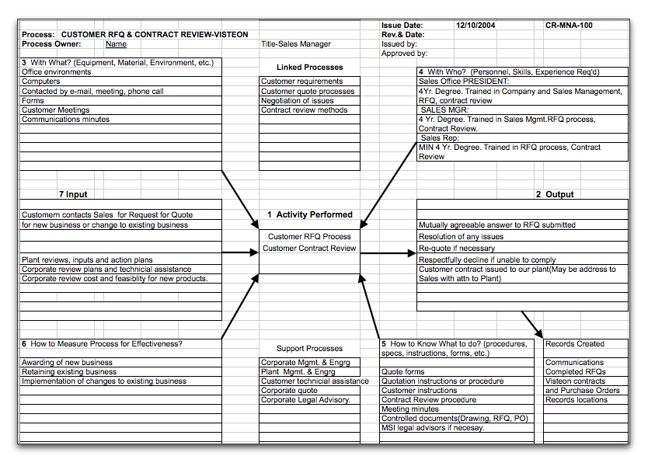
Turtle Diagram Example

Slide 53
Another Blank Turtle Diagram Form

Slide 54
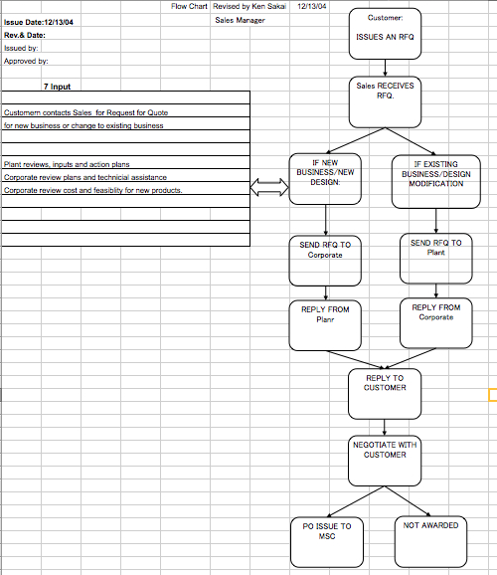
System Flow Chart

Slide 55
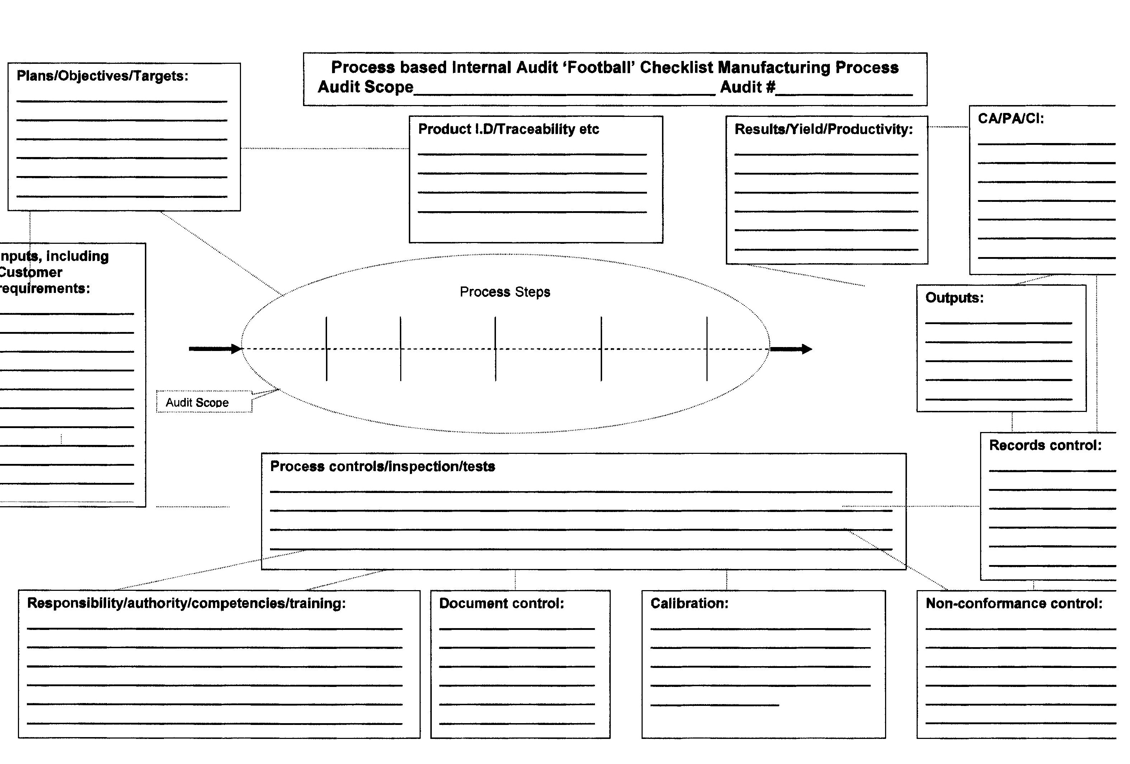
Using a “Football” diagram to map and Audit processes
Notes:
This is a different way to perform the Audit, and has been polished since the ISO 9001 got its last revision in year 2008, as a consequence of the need to assure all elements interacting in the process are being considered and actually audited as well. No black holes or “unmentioned processes” are allowed anymore.

Slide 56
Process Audit Worksheet
Process Audit Work Sheet
Process: ___________________
Date: ________________
Plans / Objectives
/ Targets
Product ID,
Traceability, Etc.
Results, Yield,
Productivity
CA, PA, CI
Process Steps
Inputs,
including
Customer
Requirements
Outputs
Audit Scope
Process Controls /
Inspections / Tests
Records
Control
Responsibility, Authority,
Competencies, Training
Document Control
Calibration
Nonconformance
Control
Notes:
Process Audit Work Sheet

Slide 57
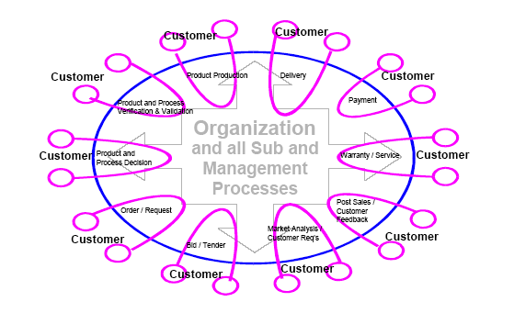
Plexus Octopus Chart

Slide 58
Example of Process Mapping with a Process Flow Chart
Stock
A Typical Series Of Manufacturing Processes
You may choose to examine 1 or more of the processes. This should be defined within the stated scope of the audit.
Remember interacting processes. The Inspection Instruction here is a possible example.
It is not typically part of the manufacturing process instructions. However, some MRP and other systems do include inspection instructions.
Traveler
Kit
Work Instruction
Assemble
Inspection Instruction
Inspection
Notes:
This technique is the most well know while auditing processes for years. Mainly because is the logical and it involves the verification step-by-step of the overall process. The advantage in this technique is that most of manufacturing companies have some kind of process flow diagrams already for their own control purposes, so the Auditor would only need to obtain a copy and follow the path there described.

Slide 59
When using this method to Audit , Identify Process White Space Issues
<----------------------- Do Any Corporate Procedures Apply ???? ------------------------->
Process 1
Process 2
Process 3
Final Pack
Receiving
Ship
Control Plan & FMEA
Ctrl Plan & FMEA
Ctrl Plan & FMEA
Ctrl Plan & FMEA
Responsibility
=
FAB
Responsibility
=
FAB
Responsibility
=
ASSY
Control Plan & FMEA
Responsibility
=
Materials?
SQA?
White Space Issue
Customer
Warehouse
Don’t forget about ‘white space’ issues. White spaces are places where you might not think of procedures existing. Example - Typically materials management is involved.
Notes:
As mentioned in the previous slide and footnotes, here the key is to make sure the process is followed as described, and identify opportunities during that verification, as could be the identification of wastes, accumulations that could lead to mixed material, lack of traceability on non-conforming materials and so on.
This is the way the Auditor verifies the proper follow-up of all the related procedures and systems while auditing directly one single process.

Slide 60
Automotive Layered Process Audits
What is a Layered Process Audit? (LPA)
Tool developed by Automotive Industry leaders (DCX, GM) is an ongoing system of process checks that verify proper methods, settings, operator craftsmanship, error proofing devices and other inputs are in place to ensure a defect free product.
LPA’s assure that defined methods and work instructions are utilized, problem solving solutions are held in place, and all process issues are identified and quickly corrected.
AIAG Guide CQI-8 “Layered Audits Guidelines” addresses the basic rules of LPA
Notes:
Using Layered Process Audits
What is a Layered Process Audit? (LPA)

Slide 61
Using Layered Process Audit
Two types of LPAs
Auditing the Process itself
  Use of a checklist with key points to verify (see example in next page)
Auditing the Error Proofing
  Also using checklist, example in the page after the following one
Notes:
Using Layered Process Audits
Two types of LPAs

Slide 62
LPA – Process Audit
Notes:
LPA – Process Audit

Slide 63
LPA – Error Proofing Audit
Notes:
LPA – Error Proofing Audit

Slide 64
Facts in Layered Process Audits
How Long is a LPA?
  On average 15 minutes
What is needed to perform a LPA?
  A pen or pencil
  A Checklist
  Knowledge of the Process
  (A sense of humor helps)
  Commitment for success
Notes:
Facts in Layered Process Audits

Slide 65
LPA Frequency Plan
Plant Manager-once a week
Area Managers-once a week
Production Supervisors-once a shift
This Proposed Frequency Should :
Encourage Management Involvement
Establish Operator Feedback
Establish Accountability
Recommended starting point:
At the highest point of risk.
Notes:
LPA Frequency Plan

Slide 66
Product Audits
Notes:
Product Audits

Slide 67
Product Audit
A product audit is an assessment of the final product or service and it’s ‘fitness for use’ evaluated against the intent of the purpose of the product or service. I.e.: Does it meet requirements?
May be performed by:
  One of your customers.
    Also see 7.4.3 in ISO 9001:2008 and TS 16949.
  Internally as a ’Final Inspection’, ’Dock Audit’ and others
    Also see 8.2.4 in ISO 9001:2008 and TS 16949
External product audits are typically oriented to a specific customer.
In military manufacturing this used to be called ‘Source Inspection’.
Notes:
Technically there are internal and external ‘product’ audits. External audits are not normally described as audits, but they can be called audits. Especially in service companies.
Examples include:
Door to door surveys
Product mail response forms
Telephone surveys
Location surveys (grocery stores, shopping malls, etc.)

Slide 68
Product Audit - A Brief Review
Product audits are most commonly done by a company on its supplier. In some product audits dimensional, electrical or other measurements may be taken. Test results may be reviewed.
Internal audits do not typically include product audits in and of themselves. More typically you will be reviewing a product audit performed by someone as a function of auditing the Product Audit Procedure.
TS 16949 does have a very specific Product Audit requirement (8.2.2.3). See the Notes below.
Notes:
Thoughts: From TS 16949:1998
8.2.2.3 Product audit
The organization shall audit products at appropriate stages of production and delivery to verify conformity to all
specified requirements, such as product dimensions, functionality, packaging and labeling, at a defined frequency.
NOTE: These activities, also known as “inspections”, is based upon sampling. Where customer PPM requirements are met, the frequency of Final Product Audits may be reduced.

Slide 69
What Will YOU Will Be Auditing?

Slide 70
Basic Audit Focus?
Desk Audit:
  Are your systems compliant with the standard(s) (such as ISO 9001 or ISO/TS 16949) you are auditing against?
  Do your systems address customer requirements? Federal, state and local requirements?
Process Audit:
  Do employees know their process’ inputs and outputs?
  what procedures ‘affect’ them?
  Are employees following procedures?
  Are the required resources available to execute the process?

Slide 71
Internal Audits - Focus
If your situation is that of internal auditor, your company should choose a method which suits your company.
Most internal auditing courses approximate a Lead Auditor course which focuses on compliance audits. As we know, compliance audits typically involve interpretation of compliance to ISO 9001 [or other standard(s)] by the auditor. Make sure you want that level of expertise and depth.
Notes:
My biggest problem with compliance interpretation in internal audits is that interpretations vary widely. Sending someone to a 5 day internal auditor course does not prepare that person for the myriad of interpretations that arise in a typical audit.
I suggest you take a read through http://Elsmar.com/Forums/showthread.php?t=2381 for some insight on opinions regarding internal auditing.

Slide 72
Reasons To NOT Address Compliance In Internal Audits
Typically, over time, compliance is determined by high level procedures.
As in the ‘standard’ document pyramid, it is evident that lower level procedures - all the way to the level of work instructions and defined On-The-Job training will be compliant if they follow the higher level procedures which are supposed to be defining the parameters of the lower level documents and systems.
Notes:
Reasons To NOT Address Compliance In Internal Audits

Slide 73
Reasons To NOT Address Compliance In Internal Audits
If your high level procedures are compliant, your lower level procedures ‘must’ be as well.
Every time your registrar ‘visits’, it chooses a sample of your systems and verifies, among other things, compliance to the standard.
Theoretically, every year they should cover every compliance element at least once.
And every 3 years they are supposed to (although it appears this practice is dying) they are (were?) supposed to go through - well, essentially a ‘thorough’ (complete?) audit like the registration audit.
It seems more and more registrars are admitting that the ‘3 year blowout audit’ isn’t really much more than a money maker. It doesn’t accomplish much when you’re there every 6 months to a year anyway.
Notes:
More Reasons To NOT Address Compliance In Internal Audits

Slide 74
Reasons To NOT Address Compliance In Internal Audits
So - your registrar and your Quality Manager should be watching your systems compliance pretty closely.
Your registrar will tell you any ‘significant’ change to your quality manual has to be submitted to them for approval and may require a re-audit of the change.
Your Quality Manager is internally typically the one who is supposed to be ‘watching the systems’.
Your secondary line if defense is in your document control system. Changes are supposed to be reviewed and approved by ‘appropriate’ people.
In your company, who is ‘appropriate’? In many companies it’s one person. In larger companies there are typically many people who can review and approve documents.
Notes:
A few more Reasons To NOT Address Compliance In Internal Audits

Slide 75
Reasons To NOT Address Compliance In Internal Audits
The question becomes: Who can review and who can approve (yes, it can be one person who does both) new and changed procedures (systems included).
And the answer is not always simple in larger companies. But again to cite the famed document pyramid, in larger companies there are layers and functional areas which address issues they are responsible for. There are supposed to be ‘suitable’ reviews and approvals.
The bottom line is no procedure, new or changed, should change compliance to standards, customer requirements or other such requirements such as legal, federal, state and local regulations.
If this is not the case, your document control system, and probably other systems (e.g. Design) is (are) not compliant.
Notes:
The last of the list -- Reasons To NOT Address Compliance In Internal Audits

Slide 76
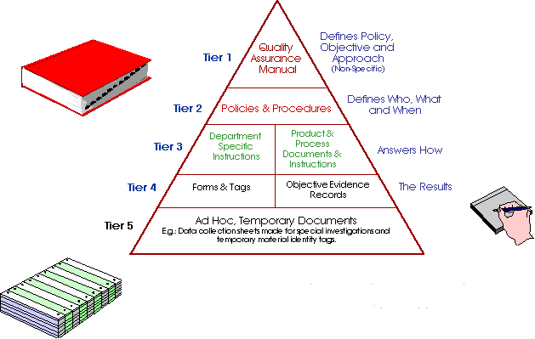
The Famed Document Pyramid
Notes:
The Famed Document Pyramid

Slide 77
4.2.3 Control of Documents
Base System
Identify Document / Data Affecting Quality and Location(s) Requiring Access
Proposed
Document
Proposed
Revision
Identify Need for a Change to an Existing Document / Data Affecting Quality
Any employee may recommend a new procedure or a revision to an existing procedure.
Produce Document
In Personal Space
Using Appropriate
Template
From the Q Drive
If Electronic, Copy to Personal Space From Q Drive
Revise Document
Review
This is a COMPLIANCE CONTROL feature. It may be one or more people.
Approve
Copy Old Document from the Q Drive to
Appropriate S Drive Directory or File Hard
Copy to Maintain History.
Document ‘Owner’
Upload Document to Appropriate
Q (Secure) Drive Directory
Communicate and Implement
Yearly review in accordance with local procedure.
Notes:
The above is an example of where a company had a simple control system. Masters are kept on a protected drive. Each person responsible for a document ‘owns’ a directory which only s/he can write to. Control is, obviously, very decentralized.
Companies control documents in many was. Some use canned software. Some smaller companies have everything on paper. The position of the computer today makes paper systems very rare, but there are some that still exist.This is only to say that your system has to meet some basics but the variability makes it impossible to predict.
Important elements of your system should include:
Approval
Review - during initial construction, when changed and “…on a regular basis…” (which may be yearly).
Change control
Availability

Slide 78
Another Document Control System
Request to Create (Add), Change
or Obsolete a Controlled
Document
Does
Document
Exist?
Requestor
Create Document
According to Defined
Rules
This is a COMPLIANCE CONTROL feature.
No
Yes
R-05001B
Requestor
Notify Appropriate
Personnel, Train and
Distribute Document
Requestor
(Review and Approval Loop)
Obtain Appropriate
Review(s)/Approvals
Appropriate Personnel
Document Control Clerk
Update Master Listing
Is Document
Being Obsoleted?
Yes
Document to Trash
or History File
As Defined
Document Control Clerk
Change/Release
Document
Document Control Clerk
Document Control Clerk
or
Appropriate Personnel
No
Record Change,
Release or
Obsolescence
(History)
Document is Implemented
Document Control Clerk
Notes:
Another Document Control System

Slide 79
Audit Types - A Brief Review
Compliance Audit
System Audit
System Audit
Process Audit
Process Audit
Product Audit
Product Audit
Notes:
Audit Types - A Brief Review

Slide 80
A Quality Management System?
The following slides are meant to give you an idea of different ways to look at a company. You may be looking at it from a ‘macro’ view or you may be looking at it in a ‘micro’ view.
Remember that a company is a complex collection of interacting processes.
Always bear in mind the Scope of the audit.
Notes:
A Quality Management System?

Slide 81
A Quality Management System?
From ISO 9001:2008
3.1.1: Quality: Degree to which a set of inherent characteristics (3.5.1) fulfils requirements (3.1.2)
3.1.2: Requirements: Need or expectation that is stated, generally implied or obligatory.
3.2.2: Management System: System (3.2.1) to establish policy and objectives and to achieve those objectives.
3.2.3: Quality Management System: Management system (3.2.2) to direct and control and organization (3.3.1) with regard to quality (3.1.1)
3.3.1: Organization: Group of people and facilities with an arrangement of responsibilities, authorities and relationships.
3.5.1: Characteristics: Distinguishing features

Slide 82
ISO 9001 and TS 16949
Quality Management Systems
Both are based in the same logic:
Document What You Do, Perform to Your Documentation. The basic saying was “Say what you do and do what you say”
Use a process approach throughout the organization. Identify the key processes and their interactions.
Record the Performance of those processes as well as the company overall, monitor, analyze, correct where needed and improve it
Notes:
Performance is the key word. It is not enough anymore to have the documented system, if the performance of the company is not showing a good trend (or at least compliance!)

Slide 83
Documented Systems
Say What You Do, Do What You Say
ISO 9001 & TS 16949,
Systems Manual, SOPs, Processes maps, WIs, Forms and Records
Internal Practices
Check What is Done!
Notes:
Documented Systems
Say What You Do, Do What You Say

Slide 84
Many Requirements
ISO 9001, TS 16949
Customer Specific Requirements
Contract Requirements
Company System Requirements
(Policy, Procedures, Instructions)
OSHA
EPA
Federal and State Regulatory
Notes:
Many Requirements

Slide 85
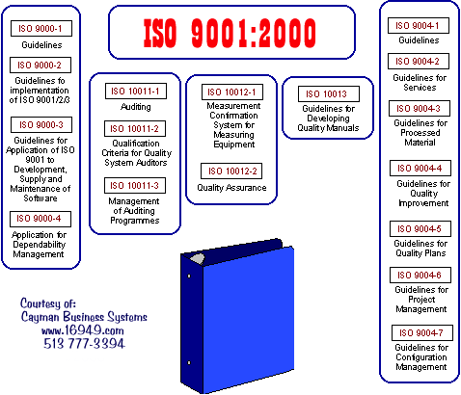
The ISO Standards

Slide 86
Specifically for the Automotive Industry:
TS 16949 Document Origins
Ford Q1
GM Targets for Excellence
Chrysler Pentastar
QS 9000
Automotive
Customer
Specific
Requirements
www.iaob.org
ISO
9001
TS 16949
+
Current
Interpretations
AIAG
FMEA, APQP,
PPAP, MSA, SPC
Calls Out
FAX In Questions to the ‘Interpretations Committee
Notes:
Specifically for the Automotive Industry:
TS 16949 Document Origins

Slide 87
Documentation Hierarchy
Notes:
Documentation Hierarchy

Slide 88
Quality
System
8
Measurement,
Analysis and
improvement
Document & Data Control
Continuous Improvements
4
Quality
Management
system
Internal Audits
Management
Review
Statistical Techniques
Statistical Techniques
7
Product
realization
Training
Corrective & Preventive
Action
5
Management
responsibility
Quality Records
6
Resource
management
Notes:
Needs update

Slide 89
Typical Operations Flowchart
Account
Management
Sales /
Marketing
Order
Receipt
Order to
MFG.
Procure
Material
Build
Product
Ship
Product
Bill
Customer
Collect
Money
Mrkting Process
Sales Process
Quote Process
Credit Approval
Order Review
Gen. Doc.
Acknowl. Order
Notify Mfg.
Verify Inputs
Plan the Job
Release for Purch 7
Mfg.
Review Reqmts
Make vs. Buy
Select Supplier
Issue RFQ
Place Orders
Eval. Incoming Matls
Material Dispo.
Autorize Supp. pay
Review Doc. Pack.
Kit Materials
Set up Equip.
Mfg. per Route Card
Package
Send to Finish goods
Confirm Date
Create Pack. Docs.
Create / Dist Invoice
Sched. Carrier
Generate Ship. Docs.
Pass to shipper
File Paperwork
Mail Invoice
Receive Payments
Resolve Disputes
Support Processes
Management
Processes
Results / Forecasts
Business Plan
Mgmnt Mtgs.
Quality
Systems
Internal Audits
Procedures &
Standards
Document
Control
Training
Facilities
Processes
Material
Stocking
Control of Test
Equipment
Personnel
Processes
Corrective
Action
Financial
Processes
Design
Engineering
Supplier
Approval
Data Security
Customer
Complaints
Customer
Services
Preventative
Maintenance
Notes:
4
Typical Operations Flowchart

Slide 90
The Bottom Line
The Documented System
  vs. The Requirement(s)
    What the standard and/or other requirement states.
  vs. Objective Evidence
    What is actually happening.
Notes:
The Documented System

Slide 91
The Details
Let’s Start From The Top
Notes:
The Details

Slide 92
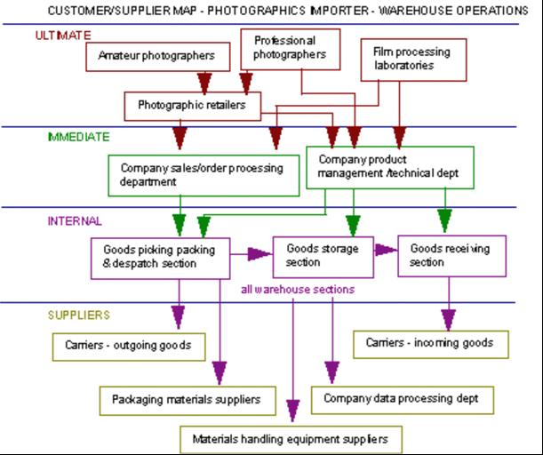
Complex Trade Relationships
Remember that a company does not operate in a vacuum. Just as there are inter-dependencies within a company, there are external forces at work throughout.
Be sure to consider these influences.
Notes:
On the highest level, you can look at your company in terms of how it fits into a trade scheme. Your company is a part of a complex relationship with many other companies and individuals. This is a simple diagram. It does not address issues such as feedback loops. Here we’re interested in getting the high level flow. As you will see, we can take any high level system and break it down into it constituent parts.
With the rise in specialization throughout the centuries, the role any given company has, as with workers, increasingly specialized. If you map out your company and its interactions the implementation process will be very much easier.
If used correctly, these high level maps, like your process maps, can also be used as the backbones for problem solving. Use your maps to lay out the backbone for a cause-and-effects diagram any time trouble arises. While the discussion of cause-and-effects diagrams is beyond the scope of this guide, suffice it to say I personally see cause-and-effects diagrams to be a very important part of problem solving.

Slide 93
An Organization As A Collection of Systems
Account
Management
Sales /
Marketing
Order
Receipt
Order to
MFG.
Procure
Material
Build
Product
Ship
Product
Bill
Customer
Collect
Money
Mrkting Process
Sales Process
Quote Process
Credit Approval
Order Review
Gen. Doc.
Acknowl. Order
Notify Mfg.
Verify Inputs
Plan the Job
Release for Purch 7
Mfg.
Review Reqmts
Make vs. Buy
Select Supplier
Issue RFQ
Place Orders
Eval. Incoming Matls
Material Dispo.
Autorize Supp. pay
Review Doc. Pack.
Kit Materials
Set up Equip.
Mfg. per Route Card
Package
Send to Finish goods
Confirm Date
Create Pack. Docs.
Create / Dist Invoice
Sched. Carrier
Generate Ship. Docs.
Pass to shipper
File Paperwork
Mail Invoice
Receive Payments
Resolve Disputes
Support Functions / Processes
Management
Processes
Results / Forecasts
Business Plan
Mgmnt Mtgs.
Quality
Systems
Internal Audits
Procedures &
Standards
Document
Control
Training
Facilities
Processes
Material
Stocking
Control of Test
Equipment
Personnel
Processes
Corrective
Action
Financial
Processes
Design
Engineering
Supplier
Approval
Data Security
Customer
Complaints
Customer
Services
Preventative
Maintenance
Notes:
This is a representation of a ‘typical’ company. Notice the flow, but also note what are defined as support functions. Most companies align to this basic representation to a large degree. Even service companies when you come to think about it. The most common problem in service implementations is to associate these functions with a company’s actual functional departments. One service client had a position titled Process Improvement Manager. That position was responsible for ‘quality’ related functions in the organization. Initially, one might have heard the title and equated it with a ‘production manager’ or similar.
You may not find a direct equivalence in your company with each function in the above. For example, if you are a service company you may (or may not) have equipment to calibrate. If you do repair work, you may not immediately notice it, but material stocking will probably be applicable.

Slide 94
What is a System?
Collection of interacting parts functioning as a whole.
Collection of subsystems that support the larger system.
Collection of processes oriented toward a common goal.
The organization as a system.
Notes:
5
What is a System?

Slide 95
System vs. Process
System
  Pronunciation sI stEm
  Definition A group of related things or parts that function together as a whole.
  Examples The school system in your city. The human body
Process
  Pronunciation pra sehs
  Definition A systematic sequence of actions used to produce something or achieve an end.
  Example An assembly-line process. The digestive process in a body
A System is made up of one or more Processes
Notes:
System vs. Process

Slide 96
Systems Responsibilities
NOTE: This is a partially completed matrix. Your company has to define how YOUR functional departments fit in.
This is an example of a Responsibility Matrix. (See Responsibilities_by_Dept.xls - included with this guide).
As you can see, to audit 4.2.4 you can choose from any department because all departments have records of one kind or another which require ‘control’.
On the other hand, if you want to audit 5.4, you don’t have much choice from which to ‘sample’.
Notes:
When you want to verify a system, you should think about how far to go. You can go to the extreme of auditing every procedure and every system in every department yearly. Ask yourself whether you have the resources (human) to do this and whether it makes sense. There is no requirement that every last procedure be audited.
It is my opinion that the vast majority of companies over audit!
When looking at a system, say document control, if you ‘sample’ the system in 3 out of 8 departments, will that give you a sense of security that the system is sound? Or will you only be satisfied if that system is audited in every department which is responsible in some way for compliance with it? I use document control because in almost every company EVERY department has a responsibility to document control. Control of Quality Records is much the same.

Slide 97
Systems Responsibilities II
NOTE: This is a partially completed matrix. Your company has to define how YOUR functional departments fit in.
This is another example of Responsibilities defined for specific high level internal procedures (systems).
Note that at this point there comes the question: What is a system and what is a procedure?
Don’t read too much into the definitions. Procedures describe system details.
Notes:
In a small company auditing every procedure may not pose a significant problem. But as the size of the organization increases, one might find auditing every single procedure is a daunting task unless you have auditors who only audit. (See notes on previous slide)
Consider this when you define your audit scope.

Slide 98
The Organization as a System, Subsystems, and Processes
Yes
No
No
Yes
Every company is made up of systems / processes. These interact. And they extend beyond the company ‘walls’.
Notes:
Every high level system can be broken down into sub-systems. Soon we will talk about distinguishing between what is a system and what is a process. I want to warn you now that the distinction is as much a part of what resolution you are looking at as anything else. This is to say that if you are looking at a system and its sub-systems, often times those sub-systems are referred to as processes. If you go to the next detail level, what was referred to as a process now looks is the ‘system’ and ITS sub-systems are now the ‘processes’.
My point here is to say do not get wrapped up in trying to label what is a system and what is a process. To some degree, they are the same thing.
We should also note that many peoples idea of a process is where something is being physically changed. For example, if I plate a part I am processing it. If I take a piece of metal plate and form it in a press I am processing it. This is a narrow interpretation of the word process. In English it is a verb: To process something.

Slide 99
Systems and Subsystems
Army
System
for
Defense
Marines
Air Force
Navy
y
n
There are high level systems and low level systems. High level systems are composed various sub-systems.
Notes:
This is a brief example of ‘exploding’ a sub-system for a more detailed look at the various interactions.

Slide 100
Extending Outside the Organization
Systems
Your Product(s)
S
END
US
E
RS
U
P
P
L
I
E
R
S
Sub-System
Process (or Sub-Sub-System) Within a System
Notes:
This is another way of looking at the extended system with a focus on the details of your company and it’s internal systems and processes.
As is evident on the right side of the system, your end users are the product recipients.

Slide 101
An Extended System
Process Within the System
Sub-System
System
Environment
Environment
Yes
No
Suppliers
End-user
Short-term
Feedback
Short-term
Feedback
No
Yes
Internal
Long-term
Long-term
feedback
feedback
Notes:
As mentioned earlier, if you look at a system or a process, there will be other systems and/or processes acting in concert with it. That these links work and that communication is effective is an important factor.
Here we add several ‘influences’ on the company systems, including feedback loops. The feedback loops become important in ISO 9001. To most companies this is already a given. Feedback is historically important to most companies. While we can always cite examples of companies we believe do not care about any feedback (telecos, public utilities and government agencies are always being accused of not caring about customers), the truth is most companies are looking for and evaluating feedback. Sales is looking for information about their customers and what people want. Internally, manufacturing is always feeding back information to the design folks.

Slide 102
Measures In The Extended System
Systems / Processes
Machines
Methods
Outputs
Inputs
Outcomes
Product
Supplier
or
End-user
Service
People
Material
Environment
Convert to Measurables When None Exist
Notes:
The biggest problem in the feedback loop is effectiveness of communications. As an internal example, I have seen very high walls between departments. Design and manufacturing and quality all often have very high walls. Manufacturing feeds back to design problems the have or are encountering where they think a design change should be evaluated and design says “Tough. We have our own problems.” Sometimes this is the result of a lack of resources but typically it’s a combination of that and a failure to work as a team. I believe this is one reason Japanese manufacturing works so well. My experiences with Mexican companies has also been that there is more of a team work atmosphere.
No matter what extended systems exist in your company, it is important that it is understood that feedback has to be evaluated. To do that, in 99% of the cases, some type of measurables have to be evolved. For example, in your quality policy you are required to state quality objectives. In addition, they qualify their requirement by requiring that objectives must be measurable. The logic is simple. If they are not measurable you cannot know if you are meeting your goals.

Slide 103
CAUTION!
As you go through an audit and you see links to other systems, you must be careful. Make sure you stay within the scope of the audit. I have seen auditors start to run to other departments to follow up on paperwork and such.
If the scope of your audit is limited, don’t go running around to other departments with a “Surprise! We’re here to check out some of your paperwork to see if it agrees with ….” If you do this you WILL make enemies! If that is your intent, which it sometimes will be, then give that department or person advance notice and formally include them in the scope of the audit.

Slide 104
What is a Process?
A series of operations or steps that results in a product or service.
A set of causes and conditions that work together to transform inputs into an output.
Processes are not a matter of magic or faith: what gets in WILL determine what would be going out.
Notes:
What is a Process?

Slide 105
Examples of Processes in Manufacturing Environment
Loading ordnance
Dropping anchor
Arranging travel
Preparing a report
Processing payments
Admitting patients
Starting propulsion equipment
Machine Maintenance
Purchasing supplies
Plating metal
Metal Forming
Machining
Training people
Preparing a budget
Transporting hazardous materials
Welding
Notes:
There are two ways in English to use the word. You can process something, such as physically processing a material, and there are methods of doing something. We discussed this in an earlier slide.

Slide 106
Quality Through Process Improvement
Process Feedback
Machines
Methods
Product or
Service
Customer
People
Material
Environment
Customer Feedback
Feedback is a cornerstone, so to speak, of ISO 9001. The implication throughout the standard is that you will manage with data. When auditing, make sure you consider this.
Notes:
Only through the evaluation of feedback can one learn and thus improve. Rarely does improvement come through chance. Evaluation requires measurables. No measurables, no evaluation. So - we need to think DATA!

Slide 107
Significant and Critical Processes
Significant Processes
  Are processes by which the mission-essential work of the organization is accomplished.
  Contribute directly to meeting the needs and requirements of customers.
  Can be traced from output (to external customer) back to input (to the organization).
Critical Processes
  A stage within a significant process.
  One that is deemed as most important for control and improvement.
Notes:
Significant and Critical Processes

Slide 108
Responsibilities
Notes:
Responsibilities

Slide 109
Client’s Responsibility
Determine the need for and the purpose of the audit and initiates the process
Determine the auditing organization/department
Determine the general scope of the audit, such as what quality system standard or document to audit against
Receives the audit report
Determine what follow-up action, if any, is to be taken, and informs the auditee of it
Notes:
Client’s Responsibility

Slide 110
Auditor’s Responsibility
Comply with applicable audit requirements
Communicate and clarify audit requirements
Plan the audit and carry out assigned responsibilities effectively and efficiently
Document the observations
Report the audit results
Verify the effectiveness of corrective actions taken as a result of the audit
Retain and safeguard documents pertaining to the audit:
  Submitting documents as required
  Ensuring documents remain confidential
  Treating privileged information with discretion
Notes:
Auditor’s Responsibility

Slide 111
Auditee’s Responsibility
Inform relevant employees about the objectives and scope of the audit
Appoint responsible members of staff to meet with members of the audit team
Provide all resources needed for the audit team in order to ensure an effective and efficient audit process
Provide access to the facilities and evidential material as requested by the auditors
Co-operate with the auditors to permit the audit objectives to be achieved
Determine and initiate corrective actions based on the audit report
Notes:
Auditee’s Responsibility

Slide 112
Auditor Qualifications
Education
Experience
Training
Proficiency
Competence
Communication
Notes:
Auditor Qualifications

Slide 113
Education, Training & Experience
Education:
  Candidates should demonstrate competence in clear and fluent oral and in written concepts and ideas
Training:
  Knowledge and understanding of the standards, systems and/or procedures audited
  Assessment techniques of questioning, evaluating and reporting
  Audit management audit skills such as planning, organizing, communicating and directing
Experience:
  Candidates should have four years full-time workplace experience
Notes:
When considering the above for consideration in qualifying an auditor, one should bear in mind it really depends upon the intent of the auditor. This is to say, if you want to be an RAB Lead Auditor you are going to need more than if the intent is for internal auditing.
For the individual company, the important part is that you define your minimum requirements. In some companies it is as simple as having attended an internal auditing course. One of my clients sent their QA Manager to a Lead Auditor course. He then used my ‘Guide’ files to train his own internal auditors. This passed muster in their ISO 9001 audit. He has added a ‘training’ audit where another ‘qualified’ auditor observes the first audit the ‘new’ auditor performs.

Slide 114
Auditor Personal Qualities
Communication Skills
Tactfulness
Flexibility
Persistence
Objectivity
Integrity
Notes:
The personal nature of auditing makes these qualities desirable. On the other hand, the reality is not everyone has all of these qualities. What I am trying to say here is that there are people who are good auditors who are not ‘perfect’ in accordance with the above (and many following) attributes.
In addition, to a large degree auditing is as much an art as it can be a profession. That said, there are good plumbers and there are bad plumbers. Both may be professionals, but that doesn’t mean they are equally qualified and competent.
I go to a dentist in Midway, KY - over 100 miles away. My brother is a dentist with an office about 20 miles from me. Both men are good, but my Midway, KY dentist is a true artist. Even my brother, who has seen me from time to time, comments on John’s excellent work. Yes - John is an artist in so far as dentistry goes - especially bridges and crowns.

Slide 115
Personal Attributes
Auditors should:
Be open-minded and mature
Possess sound judgement
Have analytical skills and tenacity
Have the ability to perceive situations in a realistic way
Understand complex operations from a broad perspective
Understand the role of individual units within the overall organization

Slide 116
Applying Auditor Attributes
Auditors should apply these attributes in order to:
Obtain and assess objective evidence fairly.
Remain true to the purpose of the audit without fear or favour.
Evaluate constantly the effects of audit observations and personal interactions during an audit.
Treat concerned personnel in a way that will best achieve the audit purpose.
Perform the audit process without deviating due to distraction
Commit full attention and support to the audit process.
React effectively in stressful situations.
Arrive at generally acceptable conclusions based on audit observations.
Remain true to a conclusion despite pressure to change that is not based on evidence.

Slide 117
Audit Preparation
Preparing for the Audit
Time Is A Most Critical Factor
Notes:
Preparing for the Audit

Slide 118
Planning The Audit
Objective
Scope
Team and Leader
Audit Duration
Contact Company / Department(s)
Establish Date & Time
Check List
Team Briefing
Notes:
Planning The Audit

Slide 119
Audit Scope
Compliance to requirements or company procedures?
Entire organization? Specific area? Depth? Duration?
The client makes the final decisions on which quality system elements, physical locations and organizational activities are to be audited within a specified time frame. If appropriate, the auditee should be contacted when determining the scope of the audit.
The scope and depth of the audit should be designed to meet the client’s specific information needs.
Standards or documents within the auditee’s system should be specified by the client.
Sufficient objective evidence should be available to demonstrate the operation and effectiveness of the auditee’s quality system.
The resources committed to the audit must be sufficient to meet its intended scope and depth.
Stay within your scope - Do NOT wander about! (e.g. Calibration)

Slide 120
The Audit Plan
The audit plan is approved by the client and communicated to the auditors and auditee. Create a flexible audit plan which allows the audit team to track-down audit trails yet ridged enough to ensure on-time completion. The plan should include:
The audit objectives and scope
Identification of the individuals having significant direct responsibilities regarding the objectives and scope
Identification of reference documents (ISO / TS standards, QM, SOPs, Processes’ Maps and WIs)
Identification of audit members
Date, expected completion time and place for the audit
Meeting schedule for department members
Confidentiality requirements
Schedule of planned future audits
Notes:
The Audit Plan

Slide 121
Audit Failure Modes
Scope too wide for time allotted.
Plan is too specific for time allotted.
Sample sizes inappropriately large.
Inadequate or no check list.
Failure to follow check list.
Failure to adhere to schedule.
Notes:
Audit Failure Modes

Slide 122
A Second Auditor
The problem, if there is one, with a second auditor is that now there is another person in the ‘gang’.
You want to keep the ‘gang’ as small as possible.
The bigger the ‘gang’, the more discontinuity will interfere with the audit.
Impartial
Watcher
Listener
Timekeeper
Note Taker
Corroborator
Special Expertise
Training
Notes:
Most internal audits do not require a second (or third or more) auditor. These are more common in larger audits with a wide scope. Company size also plays an important part. In this Guide package, you will find a document named Audit_Man-days.doc which gives guidelines for Man-Days.
Recently a client was told by a registrar that the requirement for a company their size (registration audit) was 6 man-days. He said they may send 1 auditor for 6 days, 3 for 2 days or 2 for 3 days. This assumed 1 ‘man’ per ‘team’.
Sometimes it is nice to have a second auditor, but typically it’s a luxury unless it’s a training audit.

Slide 123
Audit Team Assignments
When assigning an auditor to a team or task, the Auditors:
  Need to be independent from the department or element. One cannot audit their own work.
The Auditor should have:
  A general knowledge of the department.
  A good knowledge of the standard requirement.
  A clear knowledge of the element or section in the quality standard.
Notes:
Audit Team Assignments

Slide 124
Audit Frequency
The need to perform an audit, as well as frequency, is determined by the client.
Determining frequency should take into account:
  Results of previous audits.
  Status & Importance of the Activity.
  Specified or regulatory requirements.
  Significant changes in management, organization, policy, techniques or technologies.
  Changes to the system itself.
Internal audits may be organized on a regular basis for management or business purposes.
Notes:
Again, one should note that scheduling of audits is dependent upon your specific company and the type of audit. Those working for registrars are more consistent because of guidelines set up within Guide 62 and related documents.

Slide 125
ISO 9001 Requirements for Internal Audit 8.2.2
NOTE: There are no new requirements in Internal Audit from the 1994 version.
The company shall conduct internal audits at planned intervals to determine whether the quality management system
  a) Conforms to the planned arrangements (see 7.1), to the requirements of ISO 9001 and to the quality management system requirements established by the company, and
  b) Is effectively implemented and maintained.
An audit program shall be planned, taking into consideration the status and importance of the processes and areas to be audited, as well as the results of previous audits. The audit criteria, scope, frequency and methods shall be defined. Selection of auditors and conduct of audits shall ensure objectivity and impartiality of the audit process.
Auditors shall not audit their own work.
The responsibilities and requirements for planning and conducting audits, and for reporting results and maintaining records (see 4.2.4) shall be defined in a documented procedure.
The management responsible for the area being audited shall ensure that actions are taken without undue delay to eliminate detected nonconformities and their causes. Follow-up activities shall include the verification of the actions taken and the reporting of verification results (see 8.5.2).
NOTE See ISO 19011for guidance.
Notes:
8.2.2 correlates to the old 8.2.2 of ISO 9001:1994. The new standard states that your company must plan and conduct periodic internal audits to determine whether your quality management system:
a) Conforms to the ISO 9001 standard, and
b) Has been effectively implemented and maintained.
Your company may take into consideration the status and importance of the activities and areas to be audited and the results of previous audits when planning your audit program. You must define the audit scope, frequency and methodologies. Your audits must be conducted by someone other than the personnel who perform the activity being audited.
You must also have a documented procedure that includes the responsibilities and requirements for conducting audits, ensuring the audit is independent, recording the results of the audit and reporting the results of the audit to management.

Slide 126
ISO 9001 Requirements Summary
Internal Quality Audits are required to ensure that the quality system is working effectively and is in conformance with the ISO 9001 standard. Internal Audits are a key component of your QMS, they provide a means for measuring, analyzing and improving your management system. Audits are also a very important input to the Management Review process. The accuracy, scope and reporting of the results of your internal audits are critical in enabling your management to identify the need for corrective actions and preventive action.
The ISO 9001 standard has helped to clarify the auditing requirement. ISO 9001:94 was a little vague when it called for audits to "determine the effectiveness of Quality System". The new standard now is more prescriptive, pointing to the purpose of the audit as to "determine whether the quality management system a) conforms to the requirements of this (ISO 9001) International Standard, and b) has been effectively implemented and maintained." The use of check lists is still a valuable tool for auditing.
Notes:
You must define the audit scope, frequency and your audit method, in doing this you must place into consideration the importance of activities and areas within your company to be audited, obviously placing the most importance on the areas having the most effect on quality. This is not a new requirement of ISO 9001.
When choosing your auditor you must select an individual other than one who performs the activity being audited. The Internal Quality Audits are often assigned to the financial manager. however the quality manager, as the management representative, will usually maintain responsibility for the development of, and implementation of the quality audit activity. Internal quality auditors will require training; in addition those performing audits can start their activity during development and implementation, to ensure that the quality system reflects reality and is being deployed effectively.

Slide 127
TS 16949 Internal Audit Requirements
8.2.2.1 Quality management system audit
The organization shall audit its quality management system to verify compliance with this Technical Specification and any additional quality management system requirements.
8.2.2.2 Manufacturing process audit
The organization shall audit each manufacturing process to determine its effectiveness.
8.2.2.3 Product audit
The organization shall audit products at appropriate stages of production and delivery to verify conformity to all specified requirements, such as product dimensions, functionality, packaging and labeling, at a defined frequency.
8.2.2.4 Internal audit plans
Internal audits shall cover all quality management related processes, activities and shifts, and shall be scheduled according to an annual plan.
When internal/external nonconformities or customer complaints occur, the audit frequency shall be appropriately increased.
NOTE Specific checklists should be used for each audit.
8.2.2.5 Internal auditor qualification
The organization shall have internal auditors who are qualified to audit the requirements of this Technical Specification( see 6.2.2.2).
Notes:
TS 16949 requires that the entire ‘quality system’ be audited yearly.

Slide 128
Internal Audit Schedule Example
Notes:
This audit schedule is one from an implementation project. In it, you can see where I and M are supervised to help bring new auditors ‘up to speed’.
The scope of the audits was the entire department against all relevant documentation. Understand that the purpose for these ‘internal audits’ was in large part to drive ISO 9001:1994 implementation in the company.
You might also have noticed that this schedule is one based upon departments of the company. This is one way to do it. This ‘schedule’ was used in conjunction with a responsibilities matrix (see next slide).

Slide 129
Example Responsibilities Matrix
NOTE: This is a partially completed matrix. Your company has to define how YOUR functional departments fit in.
In the previous slide, you saw that the schedule was by department. In planning, a responsibilities matrix like this one was used to determine what, exactly, was to be audited. Take Design Engineering, for example. If you look at the column heading and follow the column down, you will see that there are quite a few maps which they are responsible for understanding and complying with.

Slide 130
A Sample Compliance Audit Schedule
Notes:
The above is a sample compliance audit. An important consideration here is to notice that this is an audit by one person. This is why there is no column for “Auditor”. In situations where there is more than 1 auditor, you will want to include an “Auditor” column.
In addition, you many have noticed, for the same reason, there are no scheduled auditor conferences. During multi-auditor audits it is common to have several “Auditor Conferences”. Some use part of the lunch break or just before or after lunch. Some do not Some do and also have an ‘end of the day’ conference. It is in these conferences where they alone discuss their findings and ‘where to go from here’.
One last consideration is that there is no ‘numbering’ of the compliance elements. Many companies do structure around the element numbering scheme of ISO 9001 or TS 16949. Registrar audits almost always cite the specific ‘section’ or ‘paragraph’ they are addressing.

Slide 131
Check Lists
Define the Sample
Must Be Representative

Slide 132
Check Lists
Organizes audit planning and approach
Assures thoroughness and consistency
Identifies essential points to be examined
Identifies necessary evidence / samples
Cross references to standards identified
Maintains audit direction
Keep It Simple
Keep to the Requirements/Facts
Look at Something
Look for Something
  Approvals
  Tolerances
  Identification
Notes:
Check Lists

Slide 133
Check List Benefits
Keeps Objective On Track
Shows Evidence of Planning
Maintains Pace and Continuity
Reduces Potential Bias
Decreases Workload and Time Requirement
Records Audit Sample
Exhibits Professionalism

Slide 134
Check List Preparation
Organization
Responsibility/Authority
Qualification/Training
Control of Documentation
Nonconformance Control
Calibration (if appropriate)
Records or Other Evidence
Notes:
Check List Preparation

Slide 135
In-Process Audit Check List Example
This is part of a company’s check list.
Notes:
In-Process Audit Check List Example
A check list may be ‘simple’ such as this, or very complex. You will find that the most important part of planning is time. One can dwell on one thing for hours if one wishes. This is the reason the scope of the audit should be well defined and a good reason for check lists.
This check list is more along the lines of what one might see for an auditor who pretty well knows the process. It is relatively specific to a particular company. On the other hand, it dos not cite specific operator instructions or other specific documents (by number or other specific identifier). I am not trying to say there should be more detail. Or less detail. Most importantly, ask yourself what you are trying to achieve -- and how much time you have to do it in.

Slide 136
Check List Thoughts
Management
  Philosophy
  Organizational Charts
  Authority of the Quality Department
  Management commitment
  Defined quality responsibilities

Slide 137
Basic Questions - 1
Basic questions can apply even though the “specific questions” will be different:
  What are you trying to do?
  How do you make it happen?
  How do you know you are doing it right?
  How do you know it’s the best way of doing it?
  How do you know it’s the right thing to do?

Slide 138
Basic Questions - 2
Business Level – Audit results should make the auditor confident that the organization:
  Knows what it is trying to do
  Knows how to make it happen
  Knows that it is doing the right things
  Knows that it is doing it in the best possible way
  Is managing performance

Slide 139
Basic Questions - 3
Managerial Level – Audit results should make the auditor confident that management:
  Knows what the process aims to achieve
  Knows how to design and cause processes to achieve results
  Knows that it is doing the right things
  Knows that it is doing it in the best possible way
  Is regulating performance

Slide 140
Basic Questions - 4
Managerial Level – Audit results should make the auditor confident that management:
  Knows what the process aims to achieve
  Knows how to design and cause processes to achieve results
  Knows that it is doing the right things
  Knows that it is doing it in the best possible way
  Is regulating performance

Slide 141
Sample Size
Notes:
Sample Size

Slide 142
Sample Size
If you want to do a systems audit of 7.5.1, how do you decide upon a sample? Let’s take as a given that each ‘Map’ must be audited. Take the Process Control Map -- you have 4 departments to choose from. Do you pick all of them or a sub-group? This is a decision you will have to make. You will not use a mathematical (statistical) basis - Neither does your registrar.
Remember: The idea is to ensure the system in general is working and that it is working across departments.
NOTE: This is a partially completed matrix. Your company has to define how YOUR functional departments fit in.
Notes:
Sample Size

Slide 143
Sample Size II
If you ask your registrar what sampling plan they use to determine sample size, you will find them hemmmming and hawwwwing at best.
In their opening comments to your group during the meeting before the audit starts, as well as during the exit meeting, every registrar I have ever witnessed has spoken about how they ‘take a sample’ of your system and (to limit their liability) they will say that just because they did not find something that does not mean there were no nonconformities.
None has ever cited a valid sampling plan, much less sample size (valid = based on something other than speculation/opinion). I guarantee they will NOT cite ANSI/ASQC Z1.4 or the old standby MIL-STD-105.
Notes:
I mention this as you may want to validate my premise that sample size is nothing more than what you feel comfortable with.
But remember - you have to be ready to give your reasoning on why you chose the sample and the size you did. “Duh” or “Well, why not?” does not fly well with auditors.
Key word - REASONING
Key ‘Question’: “Please explain why and how you chose the sample you chose and the size.”

Slide 144
Audit Strategy
Horizontal
Vertical
Upstream
Downstream
Notes:
Audit Strategy – Vertical vs. Horizontal and Upstream vs. Downstream.

Slide 145
Audit Strategies
There are may ‘audit strategies’. Which you use will depend upon your personal methodology as well as the scope and intent of the audit. Take for example Up Stream and Down Stream audits: Both of these audits are simply where one starts at one end and finishes at another.
  Up Stream
    Take a packaged product ready to ship and start working backwards. You can eventually reach the purchase order for that product.
  Down Stream
    Take a request for quote or other ‘early’ document (such as a PO) and follow the process. For example, one might want to start by asking to see evidence of review of the RFQ or the purchase order. Next, let’s see the job registered in the planning system. Etc.
Notes:
One of the things you will find about auditing is that you will develop your own method of approaching an audit. As is noted above, the way you audit will in part be a function of the purpose and scope of the audit. In the case of a customer auditing you (or you auditing a customer) there will probably be a focus on that product and related paperwork alone whilst in an ISO registration audit, the auditor will be most interested in the systems in general. They may track a single product through all the systems, however the focus will be on the systems, not so much any specific product.
On the other hand a product audit may consist only of taking a sample and inspecting them.
Internal audits are another matter entirely.

Slide 146
Internal Audit Strategies
With internal audits there is the main issue of how your company addresses auditing. Many companies are ‘listening’ to courses and folks who believe internal audits should be a major experience and should address compliance to standards. This is one way to do it. I have, and continue to, argue against this method unless you are a very big company where auditors hold that as a primary job position.
Earlier in this presentation, in the section which starts with “What Will You Will Be Auditing?”, I try to state my case for keeping standards interpretations out of internal audits.

Slide 147
Available Information
Quality Manual, Procedures, & Instructions
Management Priorities
Quality Reports (Internal and External)
Previous Audits
Product/Process Information
Auditor Experience and Knowledge
Constraints

Slide 148
Review of Working Documents
Documents to facilitate the auditor’s investigation may include:
  ISO 9001, TS 16949 and other referenced standards relating to element
  Quality Manual, Standard Procedures, Work Instructions relating to element
  Check-lists used for evaluating ISO 9001 or TS 16949 compliance (there is not a QSA checklist anymore, you would need to write your own questions)
  Forms for reporting audit observations
  Forms for documenting supporting evidence
  Corrective Action Reports generated from previous audits
Review documentation against standards
  Document nonconformances against documentation which does not conform to standards
  Develop additional questions from documentation
  Develop list of forms used in area
Notes:
Review of Working Documents

Slide 149
Representative Samples
What is the Department’s Function?
What are It’s Major and Minor Functions?
What Does the Department Do Within It’s Function(s)?
What Does the Department Do When Things Go Wrong?
Notes:
Representative Samples

Slide 150
Pre-Audit Confirmation
Make sure you give the ‘main’ auditee a ‘heads up’. Call a day or two ahead of time to confirm the audit schedule. In some cases a week might be more appropriate.
Ensure everything is ‘on track’
  Are the auditee(s) aware of the need for them to be available?
  Is the scope of the audit understood?
  Is the expected length of the audit understood?
Notes:
Pre-Audit Confirmation

Slide 151
Executing the Audit
Notes:
Executing the Audit

Slide 152
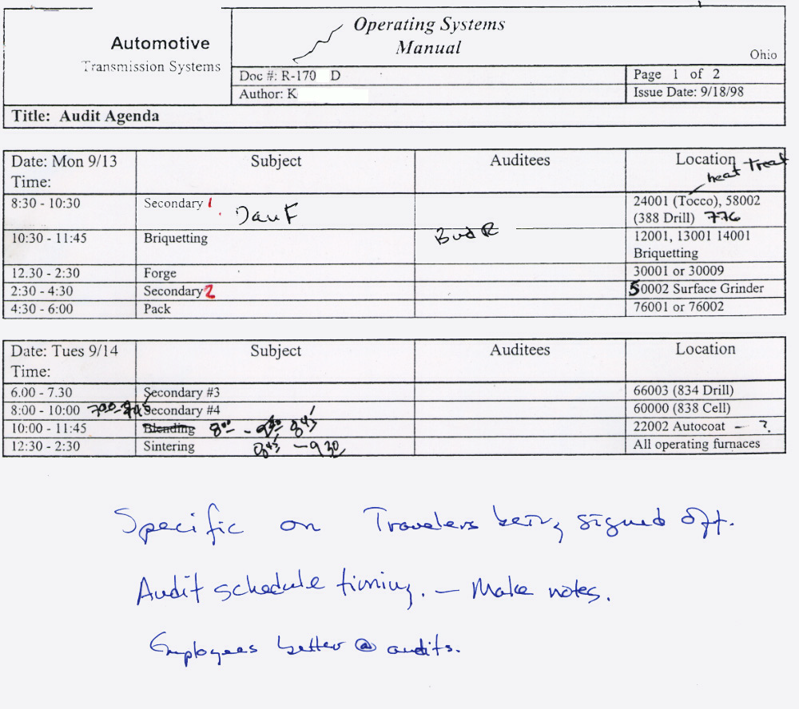
Changes Happen
I have never seen an audit follow a schedule rigorously. It’s in the nature of doing an audit. This is an example of a re-negotiated schedule.
Remember - Take Notes!!!
Notes:
Changes Happen

Slide 153
Opening Meeting
The opening meeting:
Introduces the audit team to the department members
Reviews the audit plan, scope and objectives for the audit
Establishes the official communication link between department representative and audit team
Review findings from document review
Notes:
Your opening meeting, if there is one, will depend upon the audit specifics. If you’re doing an internal audit of a manufacturing area, you might hold the meeting right there - standing - at or in the area. Or - you might want to grab a conference room and more thoroughly go over the agenda and other issues.
The level of formality will depend upon you and your company. And the specifics. If you are doing a third party audit the meeting is typically quite formal. Formal audits almost always have agendas. In the case of an audit by a registrar you will find they have very formal, detailed agendas.

Slide 154
A Registrar’s Opening Meeting ‘Outline’ I
Introduce Individuals
“Registrar X is committed to providing qualified, competent, efficient, affordable, and openly available third party registration and assessment services to various national and international standards in a timely manner with the highest of integrity. Registrar X’s emphasis shall be to provide its customers with the best registration and assessment services possible while helping its customers stay focused on achieving value from their quality systems.
Accredited to ISO/IEC Guide 62 (General requirements for bodies operating assessment and certification/registration of quality systems)
Only approved auditors → ISO 19011 (Guidelines for auditing management systems)
No Consulting
Please sign attendance sheet
Verify Scope and Standard(s)
Notes:
Each line item in this registrar ‘check list’ for the introductory meeting is a discussion topic. Different auditors and registrars handle this differently. I have never seen one without a check list such as this. The biggest difference is how much ‘bull’ the auditor throws in. Some meetings are 20 minutes. I have seen them drag out (quite literally) into 90 minute boredom sessions.
ISO/IEC Guide 62 (General requirements for bodies operating assessment and certification/registration of quality systems)

Slide 155
A Registrar’s Opening Meeting ‘Outline’ II
Confidentiality and Conflict of Interest
All information and reports treated as proprietary
Accreditation body may see reports during their audit
No quality system consulting 24 months before and 12 months after
Auditor agreement for each customer
Any proprietary areas?

Slide 156
A Registrar’s Opening Meeting ‘Outline’ III
Audit Process
Sampling and Objective Evidence
Requirements are found in three and only three places;
  ISO or other standard
  Customer requirement(s)
  Internal Documentation
Use of check list
  Look for compliance
Management style not dictated
Disputes, complaint, and appeal processes
Customer expected to interpret requirements
Services and auditors continually monitored

Slide 157
A Registrar’s Opening Meeting ‘Outline’ IV
Audit Process Continued
Typical Audit Steps / Schedule
Opening Meeting
  Introductions
  Discuss scope
  Review process
Review prior findings
Review of documentation
Sample quality system
Daily auditor meetings
Daily debrief
Closing meeting
  Review findings
  Present recommendation
  Audit summary sheet

Slide 158
A Typical Registrar’s Finding Record
Notes:
A Typical Registrar’s Finding Record

Slide 159
A Registrar’s Opening Meeting ‘Outline’ V
Audit Process Continued
Major Nonconformance
  The absence of, or the failure to implement and maintain, one or more required management system elements, or a situation which would, on the basis of available objective evidence, raise significant doubt as to the quality of what the registration customer is supplying. An assessment team may judge many minor nonconformities against a single quality system element to be a significant breakdown of a quality management system element.
Minor Nonconformance
  Any other non-conformance and is normally easily corrected and verified.
Opportunity (aka Observation)
  Neither a major or minor non-conformance. It is used to document items that the auditor believes may help a customer improve.
Notes:
This is the definition of the audit nonconformance process for this registrar.
For more definitions, see http://Elsmar.com/level2/m-vs-m.html

Slide 160
A Registrar’s Opening Meeting ‘Outline’ VI
Registration recommendation
Audit team to registration manager
  To Register
    No major nonconformities
  Not to register
    Many major nonconformities
  HOLD registration pending corrective action
    Many minors major non-conformities
    May require visit
Completed internal audit covering all elements of quality management system
At least one management review
TS 16949 and TE Supplement where applicable
All majors and minors must be closed before recommended to register.
Notes:
A Registrar’s Opening Meeting ‘Outline’ VI

Slide 161
Other Interpretations
MAJOR NONCONFORMITY
A Major Nonconformity is either:
  The absence or total breakdown of a system to meet the ISO 9001 requirement.
  A number of minor nonconformities against one requirement can represent a total breakdown of the system and thus be considered a major nonconformity.
  Any noncompliance that would result in the probable shipment of nonconforming product.
  A condition that may result in the failure or materially reduce the usability of the products or services for their intended purpose.
  A noncompliance that judgment and experience indicate is likely either to result in the failure of the quality system or to materially reduce its ability to assure controlled processes or products.
Notes:
A Major Nonconformity Interpretation

Slide 162
Other Interpretations
MAJOR NONCONFORMITY
From KPMG:
A nonconformance which is of a serious nature.:
May be a long-standing minor nonconformance from previous assessments, or a collection of similar minor nonconformances indicating a widespread problem;
Established as detrimental to quality delivered to customers; or
A failure or significant deficiency in a significant part of the quality system governed by applicable standards.
From LRQA:
LRQA calls a 'major' finding a HOLD POINT. They discourage talk about 'major' and 'minor' nonconformances.
Notes:
Other Interpretations
MAJOR NONCONFORMITY

Slide 163
Other Interpretations
MINOR NONCONFORMITY
An ISO 9001 nonconformance to that judgment and experience indicate is not likely to result in the failure of the quality system or reduce its ability to assure controlled processes or products.
A failure in some part of the supplier's documented quality system relative to ISO 9001, or
A single observed lapse in following one item of the company's quality system.
From KPMG:
  A nonconformance that is not of the severity indicated by the definition of major nonconformances, above, but which must be actioned.
From LRQA:
  LRQA calls this a Continuous Improvement point. They discourage talk about 'major' and 'minor' nonconformances.
Notes:
Other Interpretations
MINOR NONCONFORMITY

Slide 164
Other Interpretations
OBSERVATION (aka Opportunity for Improvement)
An observation is essentially an OPINION.
Read this thread (http://Elsmar.com/level2/m-vs-m.html) for some thoughts on what an observation is -- If you've never heard of a LOOK ( I hadn't), it's also discussed in the thread.
This thread also has some oblique references. When I see an auditor write up an 'Observation' I ask myself this: "Is this person qualified through experience, etc. to be offering what is no more than their advice to me on my business and/or process(es)?"
Double check with your registrar -- Ask what their expectations are when (if) they write up an Observation. Some say you can ignore it while others expect the Observation to be addressed in some manner. I have heard a registrar tell the client that they expected the observation to be addressed and action implemented by the next visit!
Notes:
From: http://Elsmar.com/level2/m-vs-m.html
There's absolutely nothing in ISO9001 to cover this. It's just one of those things that SLAGIATT (seemed like a good idea at the time), became standard practice, and has grown to be almost axiomatic.
I think it grew from formal auditing practice, where a Major nonconformance was enough by itself to warrant refusal of certification/registration, a Minor was enough to insist on corrective action (and if there were enough minors, refuse certification), and an observation was not one where corrective action was mandatory.
However, given that it had to do with what was allowed and mandated, it has little relevance in any responsible approach to internal auditing or classification of nonconformances. In internal auditing, there are either things that need to be fixed or things that don't: the things that need to be fixed can be regarded as problems, nonconformances, issues, or improvement recommendations. In classification of product/service nonconformances, I suggest only two classifications: acute, where immediate corrective action is warranted (we never want this to happen again), and chronic, where Pareto prioritisation should precede corrective action (this is happening too often).

Slide 165
Conducting The Audit
Arrive and Meet the Department Manager
Explain What You Want to See/Do
Investigate to Necessary Depth
Satisfy the Sample Requirement
  Don’t Over-sample
  Don’t Assume Wrong Exists
  Don’t Worry About “No Problems” Found
Move On

Slide 166
Registrar Audits
In ‘the old days’, an audit for compliance to ISO 9001 was relatively straight forward. There were stated requirements. While there were interpretative issues, the 2000 revision has blurred things quite a bit. The change is from “…show me where you address this and explain the system…” the task is now directed at “…auditing for performance…” I believe we all know how subjective this can be.
Acquisition and use of data has gained significantly in importance. Serious emphasis is now being placed on how you evaluate and determine what and how to continuously improve. Evaluation of system effectiveness and possible ways to reduce costs are focused on.

Slide 167
Registrar Audits II
I have been through many registration audits. Each was a bit different. Some were relatively focused on the stated requirements of the standard. The others were more focused upon ‘performance’.
  “How many times is a quote revised?”
  “Sometimes as many as 2 or 3 times.”
  Is that a lot? Is there any way - shouldn’t you get better or more complete information on customer needs and requirements up front so you don’t have to requote so many times? Requotes cost you money, you know. I mean, if you’re asking the right questions...”
This usually went back and forth for quite a while. The auditor eventually accepted that, with consideration to the company and its products, that everything was being considered.
This is just one example of the difference with one auditor. I have mixed feelings about the difference. With a good auditor, this should not be a serious problem. However -- it leaves open much to interpretation and is - well, it’s very close to consulting.
Notes:
I am bringing this up because during the second audit, from the lead auditor, I kept hearing this statement: “ISO 9001 is all about performance.” He brought into the equation continuous improvement in the sense that you have to improve performance everywhere. The only problem I had with this is it sounded more and more like a consulting session.
At the start, the lead auditor took off like a banshee. He was almost drilling the auditee (this was management). His focus was on whether what the auditee was doing was sensible (as opposed to compliant). While the lead auditor did mellow out, the ‘interview’ remained somewhat contentious.
I have to give credit to the auditee. He was exceptionally bright and took all in stride. He ably answered questions and maintained a good, positive attitude and demeanor.

Slide 168
Registrar Audits III
This is not meant to scare anyone. It is meant to ensure that you understand to each registrar and each auditor is setting their own ‘interpretation’ of the ISO 9001 is about.
Some, like the last one I experienced, would better be called a business consulting visit than an audit. It was an analysis of what the company was doing and questioning whether their systems ‘make sense’. As with the quote process example, it was not so much does your system meet the requirements, it was more along the lines of whether the auditor agreed it was the best way to be doing something. The lead auditor was an ex-DCAS and his approach to the audit was evident.
The second auditor was more traditional, if you will. Followed a check list and the main interest was whether they were meeting the requirements. Secondary focus was continuous improvement.

Slide 169
Audit Hints
Use Your Check List As Your Guide
Audit Trails (Potential) Will Begin To Appear
You Will Make Many Observations. Make Decisions On Each:
  Disregard
  Note For Later Follow-Up
  Follow-Up Now
  Call In Team Leader or “Expert” Assistance

Slide 170
Questions To Ask?
What?
When?
Who?
On Trail
Open Ended
Where?
Why?
How?

Slide 171
Taking Notes As Reference
Please, Please! Take Notes!!!
  For Investigation Now
  For Investigation Later
  For Use By Other Auditors
  For Use On Future Audits
Legibility
Retrievable

Slide 172
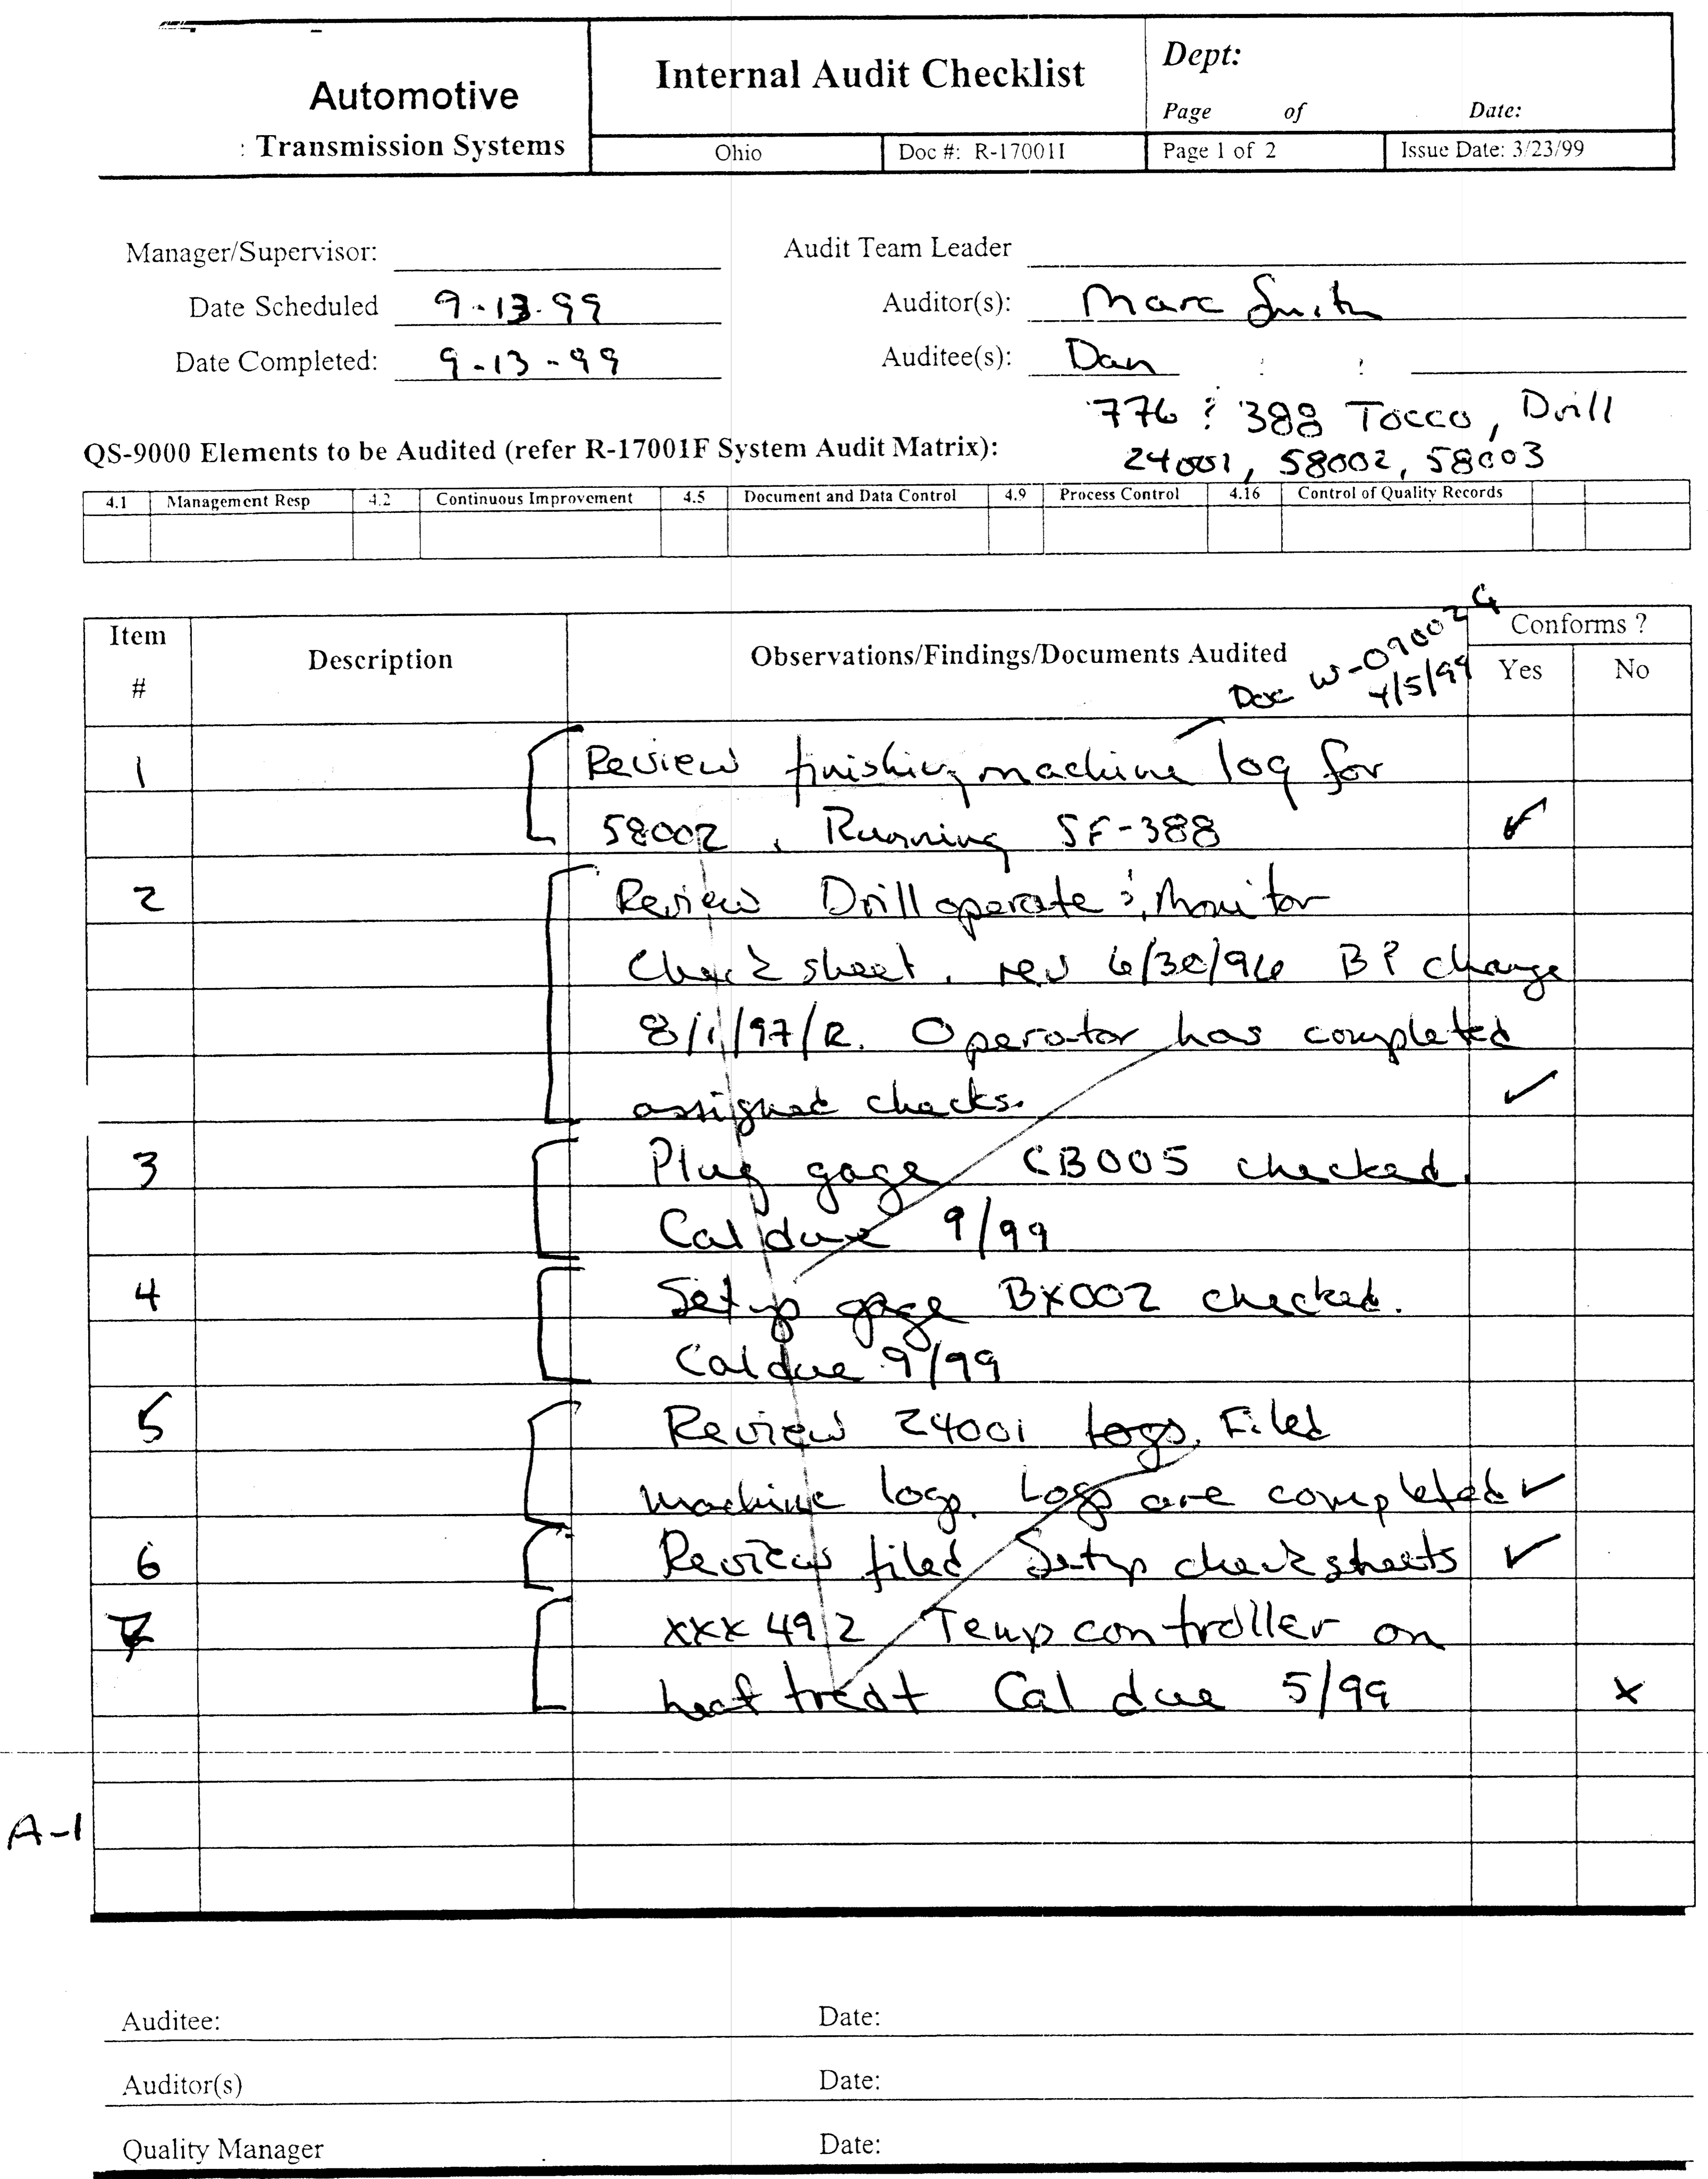
Take Copious Notes!!!!
Most folks have Check Lists which they are auditing by.
Do NOT trust your memory!
Write down the details as you go.
Take your time. Remember this:
Make It Retrievable!
Cite Details!
Document numbers, dates, serial numbers - specifics!

Slide 173
Taking Notes As Evidence
Statements (Admissible)
Document Numbers
Item Identifiers
Revision Information
Names
Locations / Places
Dates
Positions

Slide 174
Avoiding Trouble
Give Advance Notification
  Please - No Surprises!
Ensure Importance is Known
  This is not a drill!
Keep Information Known
  Don’t hide anything. If you observe a potential non-conformance, discuss it first.
Remember, Audits Cause STRESS!

Slide 175
Good Auditing Practices
Ask the right person!
Speak clearly and simply. Use ‘local’ language.
Look at the person - in the eyes!
Rephrase your question if the auditee doesn’t seem to know what you’re asking.
Don’t talk down to anyone.
Smile and be relaxed. We’re all friends!
Be unemotional and impartial.
  Don’t get excited or fix ‘blame’.
Avoid interrupting an auditee.
Don’t look for trouble - Find the facts
Say Thank You!

Slide 176
Keep People Informed
Review Findings Regularly
  “Everything looks good here” is a good phrase to use.
Beat the Grapevine
Keep It Constructive
  Criticism we don’t need!
Show Professionalism
  Be precise, attentive, responsive.
Create Rapport
  Make a friend!
Include Appropriate Personnel
  Talk to all the right people.

Slide 177
Bad Auditing Behavior
Asking too many questions
Asking leading questions
Saying you understand when you don’t
Answering your own questions
Giving insufficient time to answer
Provoking an argument
Subjective opinions
Taking sides
Criticizing Individuals

Slide 178
Expect These Reactions / Emotions
Antagonism
Challenging
Diversionary
Authority
Enlisting Help
Volunteering Information
Internal Conflict
Open and Honest

Slide 179
Interview the Right People
Those Responsible
  Talk to the right people. Don’t ask the inspection folks how receiving does their job.
Those Doing
  These are the people who should know.
Those Being Supplied By the Process
  You can ask those ‘down stream’ about their ‘supplier’.

Slide 180
You’re In The Audit Now!
Collecting evidence
  Interviews with personnel in area
  Examination of documents related to area
  Observations of activities and conditions in area
Document audit observations
  Document conformance
  Document nonconformance, show objective evidence and reference the standard

Slide 181
Recording Nonconformances
Exact observation of facts
Where it was found
Why a nonconformance - cite the specific requirement
Who was there
Use local terminology
Make it retrievable
Make it helpful

Slide 182
Nonconformance Exists Because
The System Does Not Comply With the Standard, Procedure or Other Requirement(s)
Performance Does Not Comply With the System
Performance Is Not Effective

Slide 183
‘Standard’ Nonconformance Categories
Major
  Portion of the standard not addressed
  May lead to shipment of nonconforming product
  Not isolated, consistently found such as a procedure consistently not being followed
Minor
  ‘Significant’ number of minor nonconformances indicating system weakness
  3 to 5 Minors in one element or procedure *MAY* make a Major - but - this is a rule of thumb for companies under 150 folks. Larger companies will typically have more minors than smaller companies. So - this is somewhat subjective.
Finding
  Very minor problem; isolated incident
  Needs to be addressed
Observation
  Opportunity for improvement

Slide 184
Establish The Facts
Get Help From the Auditee or Others
Discuss the Concern or Problem
Collect All of the Evidence Available
  What Did You Observe?
  Why Does It Not Conform?
  Who or What Is It?
  Where Is It?

Slide 185
Facts About Facts
Use Easily Understood Wording
Be Able To Retrieve the Fact(s)
Make It Constructive and Helpful
Make It Concise and To the Point
Be Sure It Is True and Relevant
No Surprises or Blind-Side Attacks
Make Sure Everyone Understands

Slide 186
Things to Consider -- Is It Serious?
What Could Go Wrong In the System if the Nonconformance Is Not Corrected?
What Is the Possibility or Likelihood of Such A Thing Going Wrong?
Is there a possibly non-conforming product could be shipped to a customer?

Slide 187
Assessing Nonconformances
Does what I have found represent a nonconformance?
Confidence in auditor’s judgement?
Sufficient facts?
Critical situation?
Isolated minor discrepancy?
Happening too frequently?
Too many nonconformances?
Formal corrective action versus immediate?

Slide 188
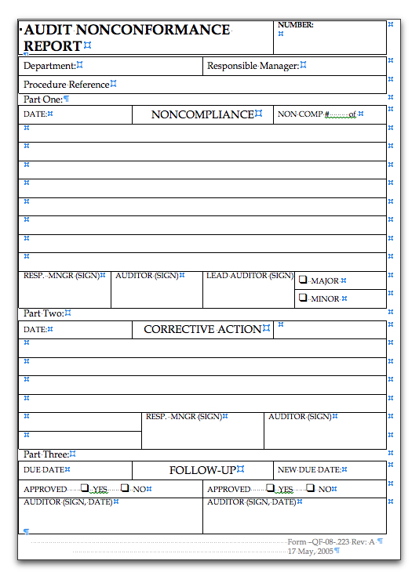
Simple Nonconformance Report Form

Slide 189
Sample Audit Summary Sheet

Slide 190
The Closing Meeting
Opening Remarks & Thanks
Attendee List - Pass around for signatures
Review Audit Objective & Scope
Restrictions/Limitations
Tell of GOOD Things You Saw
Review of of Findings
  Listing of and Description of
  PROBLEMS Identified
Clarifications
Agreement and Q & A
Summary (including agreements)
Closing & Thank You!
Save Audit findings as Quality Records.

Slide 191
Nonconformance Reports
Notes:
Nonconformance Reports

Slide 192
Writing Nonconformance Reports
Be Specific
  Where
  What
    Name
    Number
  Why
    Per System
    Per Requirement
Be Correct - Check Your Facts!
Notes:
Writing Nonconformance Reports

Slide 193
Summary Content
Number of Nonconformances
Nonconformance Location(s)
Activities Where None Detected
Most Frequent Type of Violations
Recommendations

Slide 194
Audit Reports
Audit Identification & Date
Auditee Information
Objective and Scope
Audited Standard(s)
Auditor’s Names
Audit Schedule(s)
Audit Check List
Procedure References
Personnel Interviewed
Audit Findings / Observations
Agreed Nonconformance(s)
Nonconformance Reports
Corrective Actions (If Completed)
Summary
Suggestions
Approval Sign-Off
Make Copies
File Record

Slide 195
The Audit Report
LEAVE OUT
  Insignificant details
  Any points not discussed
  Ambiguous statements
  Confidential information
  Auditor’s (your) opinions

Slide 196
Corrective Action
The Auditee responds to nonconformaties using the Corrective Action Report
The Auditee is responsible for planning, implementing, and monitoring the corrective action plan

Slide 197
Corrective & Preventive Actions
Identification/Agreement of Non-conformance Detected
Root Cause Analysis
Schedule for Actions
  Solve Problem
  Implement Solution
  Evaluate Effectiveness
Re-Audit to Verify

Slide 198
Audit Follow-Up
Review Corrective Action Request
Response - When, Who, Where, & How
Response Evaluation
Completion of Action(s)
Evaluation - Limited Re-Audit
Records
Review of Documentation
Ensure corrective action taken
Provide satisfactory conclusion
Verify at next audit

Slide 199
Re-Audit Focus
Spot check related previous conforming areas
Selected areas in greater depth
Vary re-audit to meet the needs
Target nonconformance

Slide 200
Audit Records
Reference and Date(s)
Department/Operation/Activity
Scope/Objective
Auditor Name(s)
Schedule & Check List
Issued Nonconformance(s)
Summary
C.A.R. Activity
Auditor Notes

Slide 201
Being Audited - Life on The Other Side Of The Fence
Caution!
The following is meant to give you some ideas. For example, you will see references to documentation - most of which, by context, is paper documentation.
As we all know, there are vast changes taking place every day, from Microsoft’s latest “Windows 8” software experiment to 21 CFR11 compliant document management software. Some companies are cutting edge - scanners at every PC and a PC at every station and desk. Some companies are still basically paper based. Most are somewhere in between.
This said, take the ideas presented into the context of your company and systems. Some companies have travelers, for example, while others do not. Some companies keep ‘work instructions’ at each station while other companies have ‘work instructions’ which are part of the traveler package. And, of course, sometimes OJT (or education or experience or a combination thereof) takes the place of specific work instructions.
Also consider vocabulary. As an example, some companies call ‘work instructions’ ‘process sheets’.

Slide 202
Being Audited
A positive and constructive attitude toward auditing can make the exercise enjoyable for both the auditor and the auditee. Most people enjoy telling you what they know and how good they are at their job. In addition, without an air of suspicion and distrust, auditees are likely to confide concerns or suggestions that are in the company's best interest to address and not simply lay blame.
In the course of seeking conformance, concerns or nonconformances may become evident, but it is important that everyone involved understand that the intent is to verify / validate conformance. Conclusions must be based on objective evidence, observation, interview and documents.
If auditing is understood as a staff persecution or a 'witch-hunt,' then do not be surprised when (not if, but when) the members of your company respond with suspicion, distrust and even hostility. It is extremely important that management appreciate the purpose and principles of quality system auditing and that the auditors conduct themselves accordingly.
The results of an audit should indicate whether the quality system is properly implemented and maintained. These results are considered by management for action as necessary.
Notes:
One way to ensure that everyone understands and retains a good perspective on the intent of a management system audit, is to develop an audit mission statement. A two or three sentence statement that captures the positive and constructive intent of your company's audit program can help keep the auditor and auditee on track.
Finally, Quality System audits are not surprise audits! They are planned and everyone knows when it will happen, and what elements or departments will be audited. There should be no surprises, as this tends to foster mistrust towards the audit process, and a feeling of "them versus us" between your company and the auditors.

Slide 203
What is Controlled Documentation?
A controlled document is a document which, if changed, effects some part of the process or product. These can be ‘procedures’, process documents, product or part drawings (prints) or other ‘similar’ documents. Forms are typically controlled documents.
  Typically there will be one or more list(s) of master documents.
  If a controlled document is changed, a record of the change has to be made. This means there must be a History of All Changes.
  If a document is changed, people who use it must know about the change. This means there has to be a distribution list or other effective way to let everyone who uses it know the document has changed (read Communicate the changes).
  Every employee must know how to check to see if documentation they are using is the most current version.
Notes:
This is something everyone should know with respect to documentation they are responsible for.
Everyone MUST understand the basics of what controlled documents are all about.
Everyone should have a basic understanding of what they have to do to effect a change in a document.

Slide 204

What is an Auditor?
An auditor is a person. Really! Their job is to validate documentation. This means they look at documentation (instructions) and make sure people are following the documentation.
Auditors go from company to company validating documentation and asking people about their documentation.
Auditors are just people who ask questions about how you do your job.
NOT an Auditor!
Notes:
This really addresses outside auditors, or fears thereof, more than internal audits. I include this slide for those of you who are preparing folks for their ‘first’ external audit. Many people have a real fear of auditors. Even some who have experienced many audits. For some people it’s like taking a test. As we all know, there are some ‘good’ test takers, and some ‘bad’ test takers. Ensure that everyone is as ‘relaxed’ as possible.
At one larger client, during the registration audit, 2 people became so upset whilst being interviewed that they broke down and had to be taken to the local hospital. No kidding. And it wasn’t an evil auditor. They were just very scared people. I try to tell folks to remember that they do their jobs every day and since the3 auditor can only ask questions about what they do, and not what others do, it’s an easy test. Heck, they do the same stuff every day for the most part.
This is, of course, easy to tell someone. That doesn’t mean they’ll take it to heart, but it may help alleviate some apprehension.

Slide 205
What Will The Auditors Do?
The auditors will look at written procedures and policies (verification).
The auditors will then look at how people in the company do things. They will look to make sure each person is following written procedures and policies (validation).
They will look at records to ensure everyone is properly completing paperwork (Examples would be SPC charts and check lists which need to be initialed and dated).
They will look to make sure everyone is properly trained to do their job.
Notes:
The auditors are looking to se what people are doing and, as stated above, it’s pretty simple stuff. After a registration audit, I have heard every time, from many people, the same thing:
“Is that all there is to it?”
If you’re prepared, when the ‘test’ is over - Yes. Yes. Yes. That’s all there is to it.

Slide 206
Who Will Be Audited?
Absolutely Everyone whose job affects quality is subject to the audit. Which is to say Everyone!
And the farther up the corporate tree you go, the more difficult the audit is. This is because as you go up the tree (eventually to the plant manager), job duties and responsibilities increase.
  Corporate Personnel
  Plant Manager
  Departmental managers
  Supervisors
  Engineers
  Technical personnel
  Hourly employees

Slide 207
The Audit Team
When you are visited by an auditor, he/she will NOT be alone. At the very minimum, there will be:
  The Auditor
  A Company “Escort” - This will be someone from within your company who knows the area and the specification well. The escort will try to provide structure to the audit and will try to help out when he/she can.
  The Area Supervisor - The area supervisor or other person directly responsible for the area will be present.
Remember - YOU ARE NOT ALONE!
Notes:
One very important thing to remember here is to keep the size of the ‘gang’ as small as possible. During audits at some companies, ‘gangs’ tend to develop. You have at least 3 people to begin with, but then someone will drift over and sorta stand there - just to listen in, of course. Then another, and then - well, you get the idea. Next thing you know you have a ‘gang’.
Then the questions start. Someone asks something like “Would it be OK if I keep mine in a file drawer…?” The question is from one of the ‘listeners’ who just ‘dropped by to listen’. Next thing you know there’s a near riot. People talking to each other, etc.
The situation is often tense enough without disruptions and a ‘gang’. Let the auditor do his/her job. Keep the group small and keep on the agenda.

Slide 208
Types of Audits
Internal Audit
  An audit of internal systems and/or procedures. An internal audit is most often performed by people how directly work for the company. Many companies hire outside firms (see third party below) to perform the audits.
External Audit
  Customer Audits
    Customer audits are those where a customer (or a customer representative) performs the audit. A customer audit is not ‘objective’ because the customer is intimately involved with your company (the supplier to the customer). This involvement can BIAS the audit.
‘Third Party’ Audits
  Third party audits are like those you think of when you think of bank audits. Banks (and other financial institutions) must hire a company or person to audit their books and procedures. The company or person hired to do the audit cannot have an ‘interest’ in the business it is auditing. This is known as an ‘Independent Audit’. This is the type of audit the registration audit is!
Notes:
You can use this slide to explain to your employees what the different types of audits are - assuming you plan to prep everyone. Some companies have been through many, many audits and explanations may not be necessary. But if your company has never gone through a major audit before, you might want to prep them with some ‘general’ information.

Slide 209
The Reason For Audits
Everyone is familiar with the idea of audits. One place we are all aware of audits is in the banking industry. For years, the government has required banks to submit to periodic audits by government agencies and/or external companies who specialize in auditing. Few people want to put their money in a bank where there are no controls such as periodic audits. If there are no audits, you have no way of knowing if your bank is using your money well. If the bank is not ‘using your money well’ the bank could easily fail - then you could lose all of your money.
Audits in manufacturing industries are not new. Customer audits have been going on for years. But only recently has the idea of third party audits become reality. This is in large part due to the adoption in Europe of ISO 9001 and other international standards.
The intent of third party audits is to provide assurance that a company complies with a standard or specification.
Many people say that third party audits will eliminate customer audits. This has not been the case up to now in part because customers still see the need to ensure compliance to their specific requirements. Even TS 16949, which is specific to Automotive Industry, does not eliminate customer audits.
Notes:
Another ‘audit prep’ slide - The Reason For Audits

Slide 210
What Will Happen If...
If an auditor finds a problem, s/he will let the person being audited know immediately that a possible problem may exist. In NO case will the auditor ‘find a problem’ and not discuss it with the auditee ‘on the spot’. They always tell the auditee the suspected problem and they will ask the auditee (or other company official present) to sign a statement of fact of what was found (statement of objective evidence). The auditee should know that signing the statement is NOT an admission of a problem. It is an agreement of facts found. Whether or not it is a problem is discussed during end-of-day and final review meetings.
If an auditor leaves your area and says nothing about a possible problem, you can be sure no problem(s) were found. Auditors do NOT report findings to management without discussing it with the personnel involved FIRST. There are no tricks. Nothing is ‘hidden’ until later.
Notes:
These are a few things I like to cover in ‘prep’ sessions. These help reinforce the idea that this is not all a secret plot to ‘Get Them’ by management or anyone else. Let them know everything is open and nothing is ‘hidden’ to be ;’sprung’ on them later.

Slide 211
Things Everyone Must Know
Know what documentation affects YOU!
  You must know what documentation applies to your job and know how to check to make sure you are using the ‘latest’ version. This should have been explained to you when you were trained to do the job. If you are not sure what documentation applies to you, ASK YOUR SUPERVISOR or TRAINER before the audit.
Know what Training you have had. If you do not know, ASK YOUR SUPERVISOR NOW! Don’t wait until the audit!
You must follow all documentation that applies to you. If it says you do something a certain way, you must do it that way.
You must complete all forms. If you are supposed to initial and date when you do something, the auditors will check to ensure you complete the form the way you are supposed to.
How do you know if your equipment is in calibration? Know how to read a calibration label.
Notes:
Things Everyone Must Know

Slide 212
Things to Do
Be patient. Wait for the auditor to ask a question.
Listen closely before answering any question(s). If you are not sure you understand the question, ask the auditor to repeat it. If you still do not understand the question, tell the auditor you do not understand it. The auditor will try to better explain him/herself. Never answer a question you do not understand!
Never say “Sometimes I....”. When you do something differently because of different circumstances, explain exactly! “When ------ happens, I...., and when +++++ happens, I ....”. Be specific.
Always tell the Truth. Don’t ever try to hide something. You may think you are helping someone - you are not. One lie can destroy confidence. Just like in a marriage, if one spouse lies to the other and the other finds out, the relationship may be in real danger. One lie could ruin the entire audit.
Notes:
During ‘prep’ sessions I really like to give these as minimum pointers. Each topic above I have a story for, but I’d really have a long essay one some of them.
One I will include is that sometimes an auditor will ask a question, get an answer, and then just stare at the person. Within 10 to 30 seconds that person will start talking again - about something. About anything. This is because they see the auditor looking at them and since the auditor is not saying anything the auditor must be waiting for more ‘information’. It’s a very old auditor ‘trick’. If they need more ‘clarification’ wait for them to ask for it. Watch out, or you’ll find the auditee rambling on forever.

Slide 213
Things NOT to Do
If you do not know the answer to a question, tell the auditor that you do not know the answer. Don’t attempt to ‘fake it’. If the auditor tries to explain again and you still do not understand the question, tell him/her again that you do not understand the question. The Escort will attempt to help if this happens.
Do NOT try to hide from the auditor. All the auditor wants is to ask you about your job and how to do it. You know your job. You can tell the auditor about as easily as you can tell anyone else.
Do NOT try to answer a question for another person. If the question is not about the job you are doing and you know who does that job, tell the auditor who they should ask if you know.
Do NOT try to answer a question about another job. The only question an auditor is supposed to ask is about YOUR job. If the auditor asks you a question about someone else’s job, you should answer “That is not my job.” The GDL escort or the other GDL person with the auditor must take the lead from this point.

Slide 214
General Things To Know and Do
Auditors are NOT trying to test your memory. If you have to look something up in your documentation, tell the auditor. The auditor will then tell you whether to look up the information or not.
Only answer the auditor’s question. Do NOT volunteer information. Do NOT try to ‘help’ the auditor with additional information.
Answer with the shortest, simplest answer you can think of. If you can answer with a Yes or No, that’s all you should do.
Don’t try to explain things unless the auditor asks you to. The auditor will ask questions to help him/her understand. Your job is to only answer questions asked.
Do not tell stories or speculate what ‘may’ happen.
If there is any documentation which you are using that you think or know is not correct, contact your supervisor immediately! Before the audit!

Slide 215
Some Typical Questions to Expect
What is ISO 9001 (or TS 16949)?
Who is the Management Representative?
What is the quality policy? What does the quality policy mean to you?
Does your company do a good job meeting the quality policy objectives?
How do you know whether you are doing your job well or not?
How do you know what to do? Tell me about your job and your duties. What are your quality responsibilities? Tell me how your job affects the quality of your product.
What is the name of your process? Which are your inputs? And your outputs?
What are controlled documents? What documentation do you follow (are you responsible for)? Where is it? How do you know you are using the most recent version? If your documentation says you should do something a specific way and someone else tells you to do it differently, what do you do?
How do you know if your equipment is in calibration? What do you do if it is not? Can you explain what this calibration label tells you?
Do you ever have problems come up? How do you handle them?
When you find nonconforming product, what do you do?
Which are the quality objectives of your process? What is the current status?

Slide 216
Managers Should Think About...
Work Instructions
  Does Every Job Have Relevant Work Instructions?
  Are Work Instructions Controlled?
  Is Each Signed & Dated?
  Who is the Keeper of a Master List & Where is it Kept?
Hand Revisions
  Have Any Work Instructions, Visual Aids, or Other Process Documentation Been Updated By Hand?
  If So, Are They Signed and Dated?
Equipment PMs
  Are All Equipment PMs Up To Date and to a Schedule?
Measurement & Test Equipment
  Is All Measurement and Test Equipment Calibrated and properly Labeled?
Defective Material
  Is Defective Material Identified and Segregated?
  Is A Defective Material HOLD Area Identified?
  Is DMR Material Dispositioned in a Timely Manner?

Slide 217
Some Last Things to Think About
Employee Training
  Do You Know the Training Requirements Of Each Job Position?
  Is Each Employee Trained?
  Where Are Training Records Kept?
  Are Training Records Up To Date?
SPC
  Are People Keeping SPC Charts Trained in SPC?
  Are SPC Charts Current and Being Utilized?
  Are Trends Identified and is Corrective Action Taken?
Work Areas
  Are Work Areas Clean, Organized and Orderly?
Baskets, Boxes, Racks, Shelves & Other Containers
  Is Each Properly Labeled (Identified)?
  Are They Where They Are Supposed To Be?

Slide 218
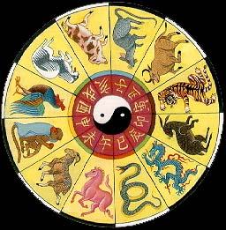
Good Luck!

Slide 219
Trainer’s Qualifications
My name is Marc Smith. I have been working with ISO 9001 and numerous business standards for over 25 years.
While much of my experience is in implementing business standards, I have been performing audits and training since 1990.
I am semi-retired but still enjoy helping companies in their projects and training.

Slide 220
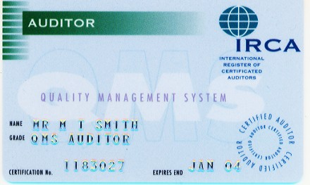
IRCA Certification

Slide 221
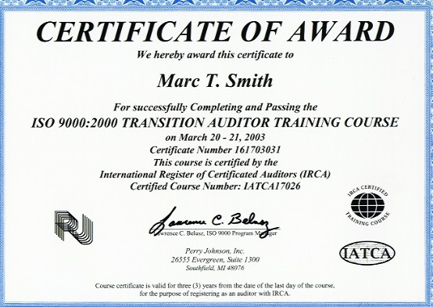
ISO 9000:2000 Transition Training Certificate

Slide 222
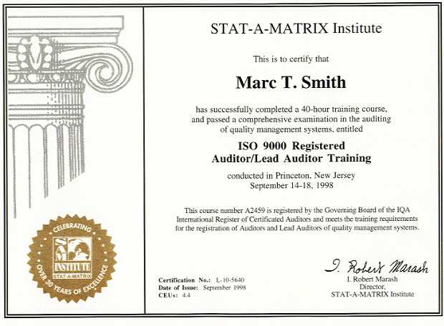
Lead Auditor Training Certificate

Slide 223
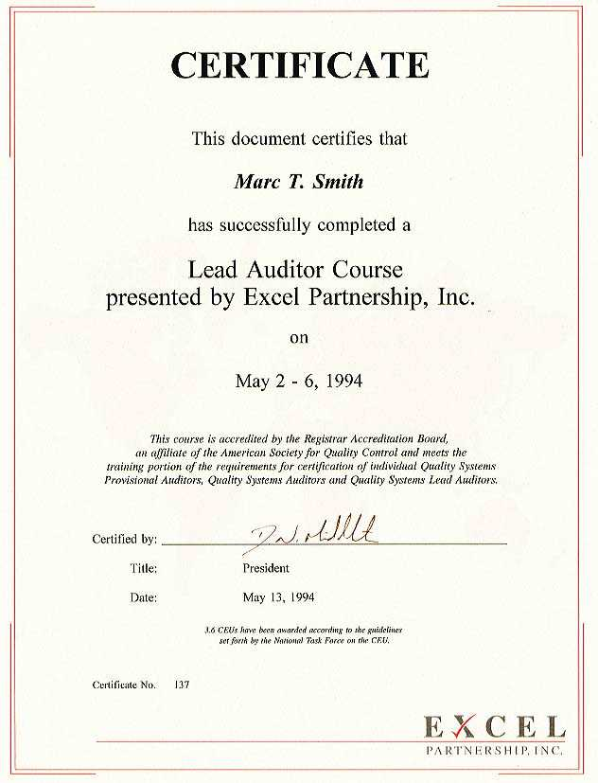
First Lead Auditor Training Certificate

