Slide 1
Standard Auditor Observations and Questions
Area
Date
Responsible Mgr.
Process Documentation
Documents of External Origin
Miscellaneous Documents
Handling and Storage
Measurement & Test Equipment (Calibration)
What do you do when you know process documentation is incorrect?
How do you know your documentation is the most current version?
Are there any specifications or other documents not originated within the company? If so, is the Document TYPE on the Documentation Hierarchy Matrix?
Do you have any personal ‘Cheat Sheets’ which you use to do your job? Are they ‘legal’?
Are there any ‘unofficial’ process related documents posted at work stations or on walls?
Do you have equipment or other instruction manuals? How are they ‘controlled’?
Are carriers properly stacked?
Are carriers properly labeled?
Is the ESD policy understood and followed?
Does every piece of Measurement and Test equipment have an ‘appropriate’ label?
Are there any hand written labels / specs / instructions on equipment?
Process Equipment I
Process Equipment II
Communication
Look for hand written settings, instructions or other documentation on equipment?
Is Preventive Maintenance identified & performed?
Can it be explained what gages or other measurement instruments on production equipment should be calibrated or why calibration is not necessary?
Are there any stickers, pointers or written settings on any of gages or controls? If so, are they ‘legal’?
For every ‘job’ there are inputs and outputs. Inputs are typically from other people and often from other ‘departments’. Can you identify your inputs and outputs?
Are you communicating problems you find with the appropriate person and department?
Nonconforming Product
Housekeeping
Is nonconforming product isolated from the immediate production area?
Is the local system for Nonconforming Product understood and followed?
Can you explain why some shelves are labeled and some are not?
Are all labeled shelves correctly labeled?
Are work areas neat and orderly?

Slide 2
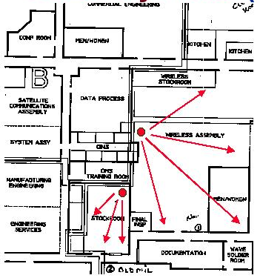
Standard Auditor Observations and Questions
Places to Check for Documents
Drawers
Book shelves
Storage shelves
Walls
On manufacturing equipment
On measurement and test equipment
Work areas / benches
A word about Order...
When the auditors come in they will be looking for ORDER. In short, a place for everything and everything in its place. This means much more than you may think! The theory among auditors is that the more orderly a place is the more ‘in control’ the place is.
And - that is generally a truism! It’s a good idea!
Ensure the entire area is checked! Check the map!

