Slide 1
fundamentals of quality system

Slide 2
Documenting good business practices in a form of a process flow
Serve as a guide if someone else needs to perform the task
Notes:
Our QMS is designed so that we would be able to identify the flow and repeat the process (Repeatability). It aid us in repeating the process so that we would be able to deliver equal or better products to our customers under optimum conditions.

Slide 3
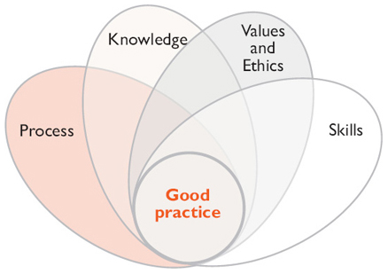
Good practices includes
Notes:
Explain the picture…

Slide 4
Product
Requirements
Standard Requirements
Quality Management System
Supporting Documents
Work Instructions
Quality Policy
Regulatory Requirements
To be able to supply products that meet specification requirements, QMS was created.
Notes:
The system is for us to use. It is explained in a way that it is clear so that everybody can comprehend. It specifies all the requirements, best practices that serves as our guideline. Not a dead end for everything, it is open for continuous improvements…

Slide 5
QMS processes are designed to improve over time. It is subject to change to improve our process.
Over Time
Notes:
Of course everything is not perfect in the beginning. We always have changes along the way. Continuous improvement causes us to think about upstream process not downstream direction.

Slide 6
Quality does not exist without U
Quality is for everyone
Notes:
Quality commitment involves everybody in this company, no exemption. The organization spends money on quality because the organization believe that quality is important. Of course it requires teamwork…

Slide 7
Notes:
Our processes wont work without us, it needs you and me to work hand in hand. Given the bad times that we are facing, quality shall not be taken for as a secondary item.

Slide 8
Our customers expect us to deliver products that consistently meet product specifications and regulatory requirements.
Notes:
To be able to retain our customers we have to be committed to quality as specified in our quality policy.

