Slide 1
The 8-D Methodology
Team Oriented Problem Solving
TOPS
A Philosophy and A Part Of
Continuous Improvement

Slide 2

Don’t Let This Happen To YOU!

Slide 3
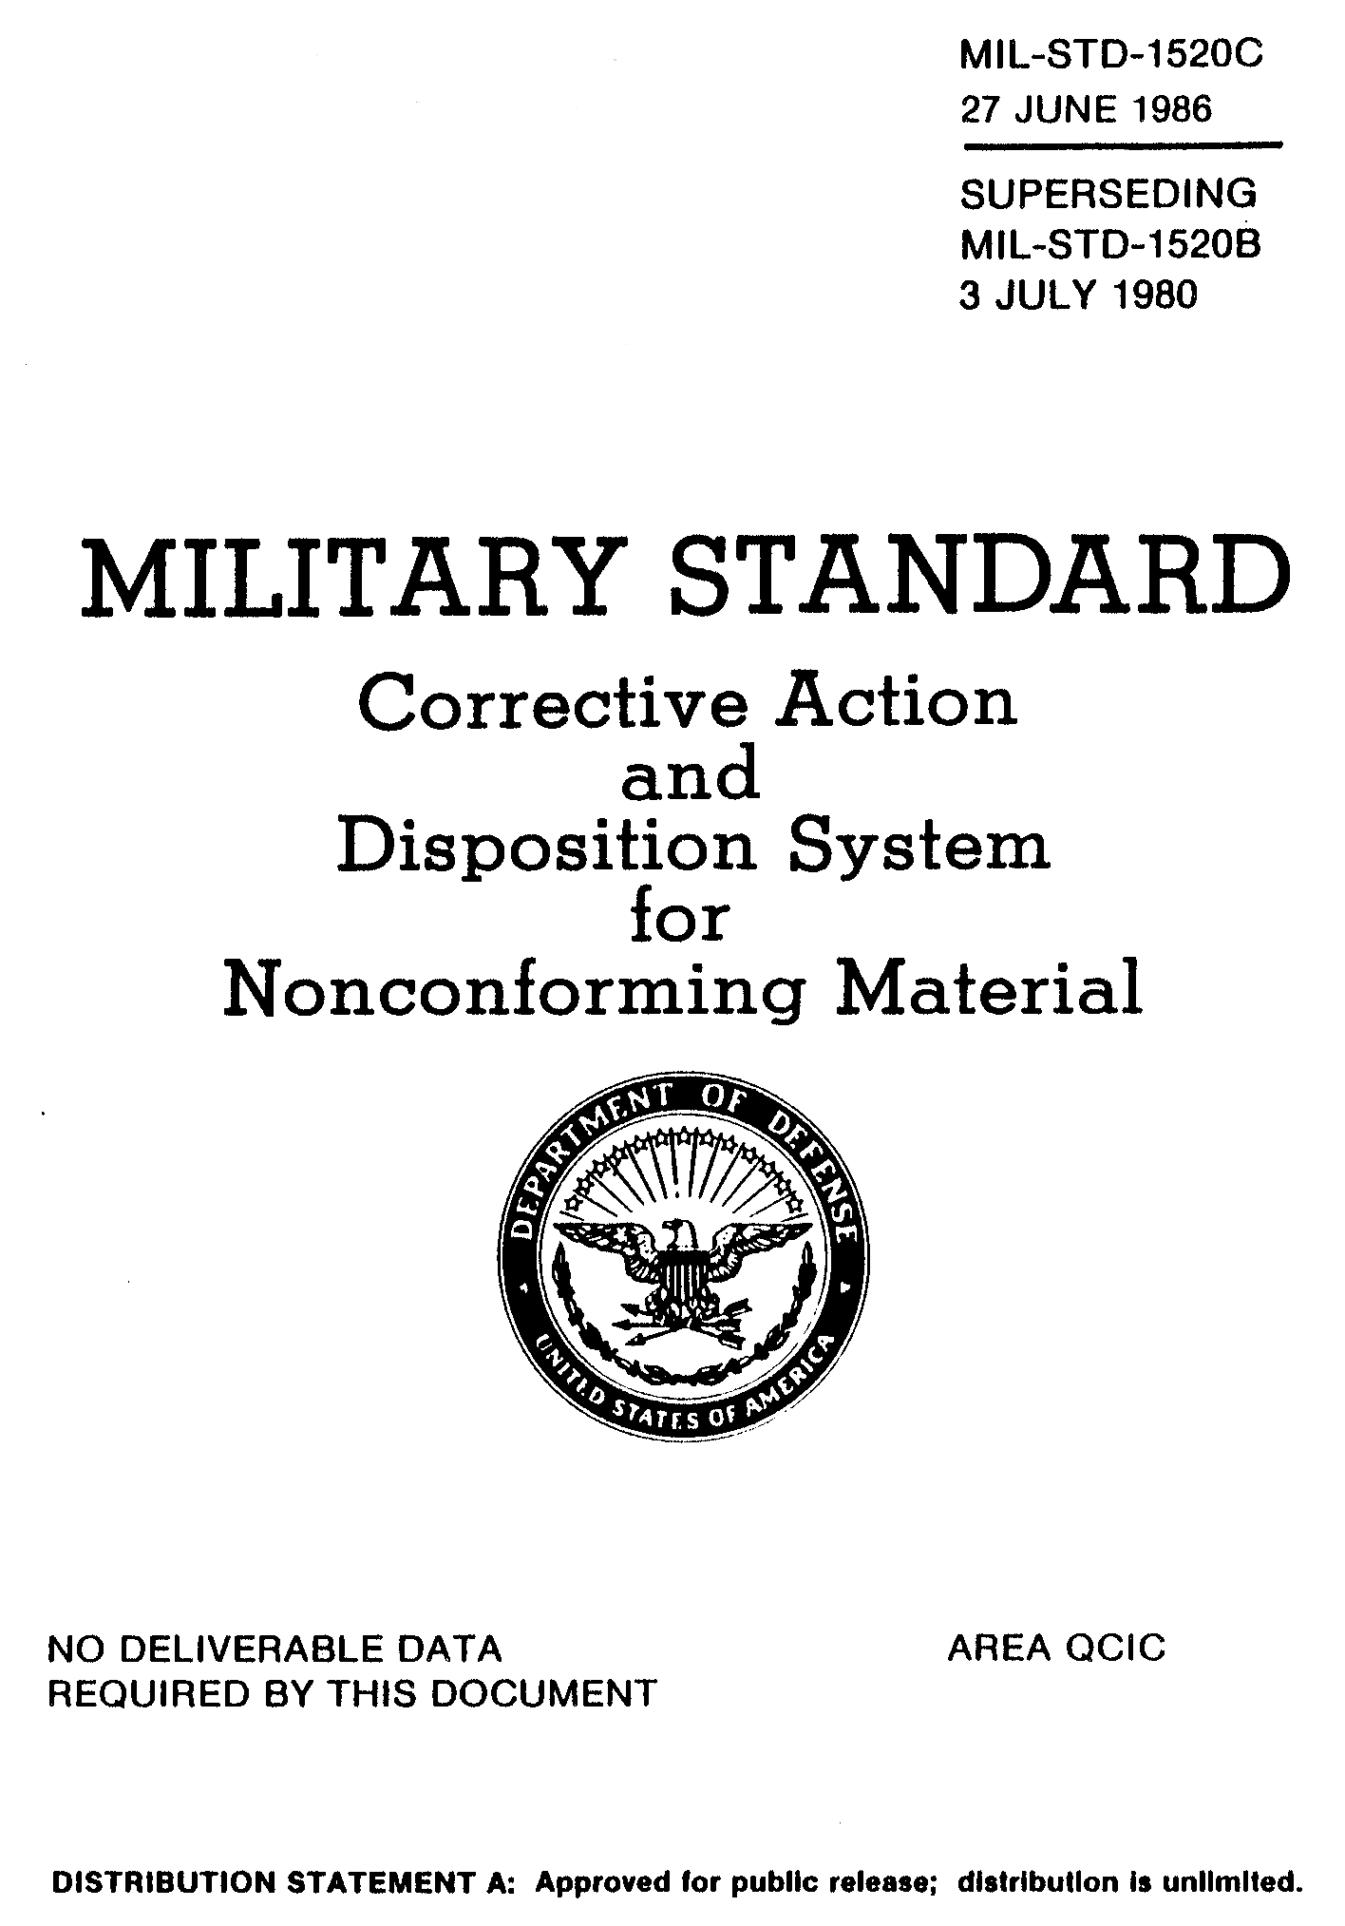
Origins: Mil-Std 1520
The origins of the 8-D system actually goes back many years.
The US Government first ‘standardized’ the system in Mil-Std-1520 “Corrective Action and Disposition System for Nonconforming Material”
Mil-Std-1520 - First released: 1974
Last Revision was C of 1986
Canceled in 1995
Notes:
While Ford has made the 8-D system popular in automotive manufacturing, it is not a new system or, by any means, a Ford system. From Mil-Std-1520C:
1. Scope
1.1 Purpose. This standard sets forth the requirements for a cost-effective corrective action and disposition systems for nonconforming material. It defines requirements relative to the interface between the contractor and the contract administration office on nonconforming material. This standard sets forth the DOD contracting activity requirements for a properly constituted Material Review Board. The primary purposes of the corrective action and disposition system are to identify and correct causes of non-conformances, prevent the recurrence of wasteful nonconforming material, reduce the cost of manufacturing inefficiency, and foster quality and productivity improvement.

Slide 4
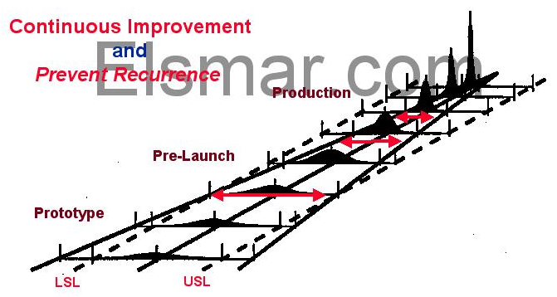
The Target & Goal
Notes:
The ultimate goals of 8-D Problem Solving are:
Preventing Recurrence
and
Continuous Improvement
Through the Use of Data

Slide 5
The 8-D System
Awareness
of Problem
4.
Identify
Potential
Cause(s)
5.
Choose/Verify
Corrective Actions
1.
Use Team
Approach
Select Likely
Causes
Implement
Permanent
Corrective Actions
6.
Describe
the Problem
Is the Potential Cause a Root Cause?
2.
Prevent
Recurrence
No
7.
Implement and
Verify Interim
(Containment)
Action(s)
Yes
Congratulate
Your Team
3.
8.
Identify Possible
Solutions
Notes:
The ‘D’ in 8-D stands for Disciplines
In the early part of this course, we will talk a lot about Teams. Teams are important. Why do you think this is so?
Normally people in a company have skills, experience and abilities which complement each other. A company as a whole is complex - a set of systems with different functional experts in different areas. The areas complement each other and many have interactions. Quality affects manufacturing. Design affects quality. Quality affects design.
The 8-Disciplines methodology requires a team effort to ensure that there is communication between ‘interested parties’ and that interactions are identified and effects assessed.

Slide 6
Typical Investigation Time Line
Initiate
Containment Actions
Withdraw
Containment Actions
Problem Solving Efforts
Symptom
Appears
Internal
and/or
External
D1
Establish Team
Second
Assessment
Internal Group
D4
Verify Permanent
Corrective Actions
Investigation
D3
D5
D6
D7
D0
D2
First
Assessment
Internal
Individual
Third Assessment
Internal Group
with
Internal / External
Customer Involvement
Implement Permanent
Corrective Actions
This process can stop or loop back upon its self at any point in the process.
Notes:
While the sequence above appears clear, some things will be happening concurrently.
Important terms / concepts to understand:
Containment
Escape Point
Escape Path
Interim Corrective Action
Root Cause
Permanent Corrective Action
Prevent Recurrence

Slide 7
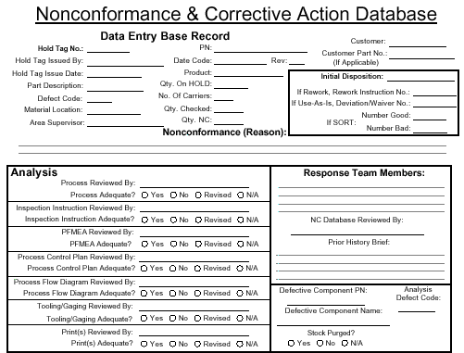
A Nonconformance Database
This nonconformance database was written for an automotive manufacturer as is rather evident by the documentation addressed (circled in red).
For other companies, it is a matter of looking at your documentation and system(s) and aligning appropriate documents.
Notes:
This is the ‘front end’ of the database. The ‘standard’ 8-D fields are not shown here. See NC_DBASE.pdf for the complete record.

Slide 8
Analysis vs. Action
The ‘disciplines’ which make up the 8-D process are divided into Analysis and Action steps.
Analysis Steps
  D2 Problem Description Analysis - A method to organize information about the Symptom into a Problem Description through the use of repeated WHYs.
  D4 Root Cause Analysis - A process to arrive at Root cause paths.
Action Steps
  D3 Containment - An interim Verified action that will prevent the Symptom from reaching the customer.
  D5 Choose Corrective Action - The best corrective action which, when implemented in D6, permanently eliminates the Root Cause of the problem.
  D6 Implement Corrective Action - The best corrective action from D5 that is introduced into the process and Validated over time.
  D7 System Preventive Action - Actions which address the system that allowed the problem to occur.

Slide 9
Process Tools
Past
Present
Future
Problem Solving / Analysis
Decision Making /
Concerns Analysis
Planning and
Problem Prevention
D0
D1
Use Team Approach
Describe The Problem
D2
D3
Containment (Interim) Actions
Root Cause
Analysis
D4
Implement Permanent Corrective Action
Choose/Verify Corrective Action(s)
D5
D6
Congratulate the Team
D8
D7
Prevent Recurrence Action

Slide 10
Process Tools
Problem Solving
  A systematic process which describes, analyzes and identifies Root Causes of a problem. It is used to solve ‘past’ actions that are now causing unwanted effects. Generally it takes more time, energy and resources to correct a problem than to prevent it. This tool is used in D2 and D4 for describing a problem and finding its Root Cause.
Decision Making
  A process used to select the best of various options. It addresses ‘present’ situations where the correct decision needs to be made the first time in order to implement appropriate actions. The tool is used at steps D3 and D5 for determining which interim and permanent corrective actions to implement.
Planning and Problem Prevention
  A process which ‘looks into the future’ to anticipate what might go wrong with a plan. The process requires team members to develop plans to prevent problems from happening or causing serious damage if they do happen. Generally, Planning and Problem Prevention provides the most cost effective way of avoiding problems. This tool is used in D6 and D7 for implementing permanent corrective actions and preventing recurrence.
Concerns Analysis
  A process which breaks down complex issues into manageable concerns, prioritizes them and assigns the proper process tools. Like Decision Making, it deals with ‘present’ situations and helps to step back from a long list of ‘To Do’ activities and assess the situation from a broader perspective. Most often used at D0 and D1 by management to help assemble a team, define its goals and objectives.

Slide 11
Recommended Statistical Courses
Basic Business
Advanced
Business
Office, Staff, &
Management
Selected Staff, &
Management
Statistical
Process Control
Measurement
System Analysis
Design of
Experiment
Production Floor,
Production Staff &
Management,
All of Quality
& Engineering
Production Staff &
Management,
All of Quality
& Engineering
Specific Production
Staff,
Quality Engineers&
QA Manager
& Product
Engineering

Slide 12
Statistical Tools

Slide 13
Statistical Tools 1
Statistical Process Control
1. Cause and Effects Diagram
2. Operational Definitions
Lay Engineering Specs
3. Data Collection/Log/Check Sheet
4. Pareto Diagram
5. Histogram
Dot Plot
Stem and Leaf Plot
Box and Whisker Plot
6. Control Chart
  X-bar R Chart
  X-bar and s Chart
  Median and R Chart
  p Chart
  c Chart
  u Chart
  np Chart
  Run Chart (chart of individuals)
7. Scatter Diagram
  Pie Chart
  Bar Chart
  Stacked Bar Chart
  Pictorial Graph
  Trend Chart
  Time-line Chart
  Process Flow Chart
Ongoing Control - Monitoring
Statistical Process Control Charts
Quality Performance Indicators
Histograms
Check Sheets
Log Sheets
Notes:
There are many, many analysis tools. The intent of this course is to focus on several which are more specific to an 8-D problem solving task:
Information Database
Decision Making Work Sheet
Is / Is Not
You will find that the many other analysis tools, and solution tools, will be important, nay invaluable, however the applicability of any one tool will depend upon the specific problem being analyzed as well as the available expertise. For example, not all companies have an employee who is versed in Design of Experiments or FMEAs.
Unfortunately, it is well beyond the scope of this course to attempt to train all of these methodologies.

Slide 14
Statistical Tools 2
Quality Performance Indicators
Verification, Prevention and Investigation
Plant Trend Charts
Warranty Charts
Engineering Specification Testing
Fleet Testing
Test Track
Burn-In Results
Process Capability/Potential Studies
Statistical Process Control Charts
Quality Performance Indicators
Histograms
Check Sheets
Log Sheets
Design Of Experiments
Regression Analysis
Process Flow Chart
Taguchi (screening) Analysis
Contingency and Forecasting
Failure Modes and Effects Analysis
Design of Experiments
Regression Analysis
Reliability Studies

Slide 15
Universe, Populations & Samples
Universe:
The collection of all elements.
Population:
The set of objects of interest.
Sample:
A subset of objects taken from the population.
Randam Sample:
All possible samples of the same size have an equal chance of occuring.

Slide 16
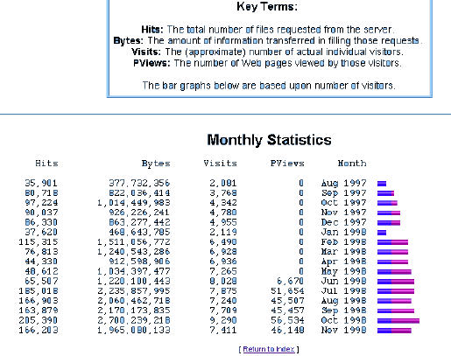
Interpreting Statistics

Slide 17
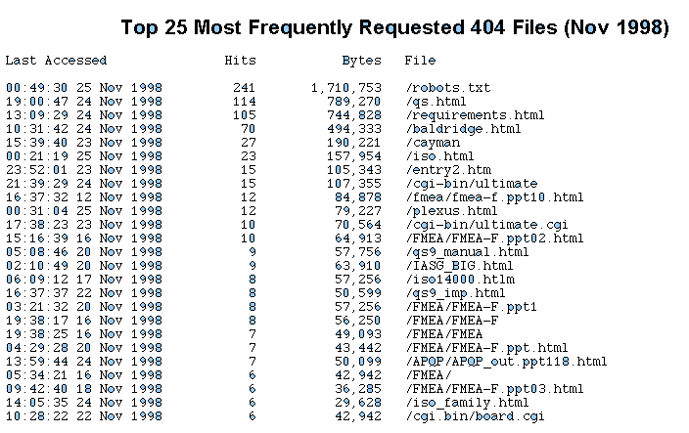
Interpreting Statistics

Slide 18
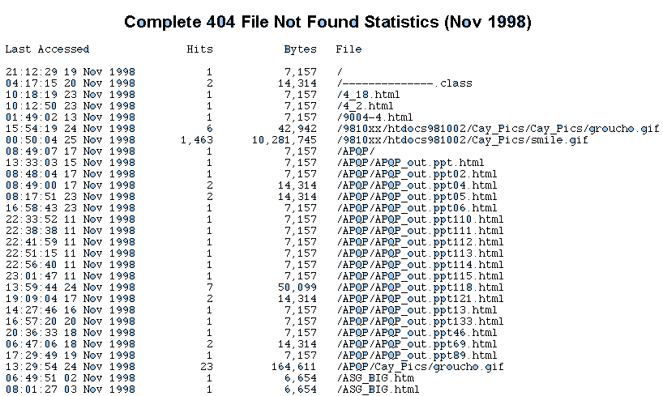
Interpreting Statistics

Slide 20

Normal Distribution (Bell Curve)
This is a pattern which repeats itself endlessly not only with pieces of pie but in manufactured products and in nature. There is always an inherent Variability. Sometimes it’s a matter of finding a measurement device sensitive enough to measure it.
Measurements may be in volts, millimeters, amperes, hours, minutes, inches or one of many other units of measure.
It you take a sample of a population (such as height) and you chart their distribution, you will end up with a curve that looks like a bell.
A Distribution which looks like a bell is a Normal Distribution. Normal Distributions are the most common type of distribution found in nature - but they are not the ONLY type of distribution.
1.59
1.73
1.87
2.01
1.66
1.94
Heights of men in the military:
Average height: 1.80 meters
Shortest: 1.59 meters
Tallest 2.01 meters
Sixty-eight percent are between 1.73 and 1.87 meters.
Ninety-five per cent are between 1.66 and 1.94 meters.

Slide 21
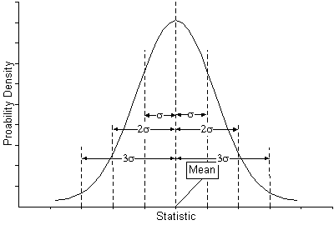
Standard Deviation - A Measure of Dispersion
Notes:
To better understand Dispersion, Cp and Cpk, tune your browser to:
http://16949.com/ubb/Forum10/HTML/000001.html
http://www.16949.com/pdf_files/Cp.swf, or
http://www.16949.com/pdf_files/Cp.gif
and
http://www.16949.com/pdf_files/Cpk.swf, or
http://www.16949.com/pdf_files/Cpk.gif
Also interesting is:
http://www.16949.com/pdf_files/ProcessLoop.swf / .gif
**Files with the .swf extension are Flash files

Slide 22
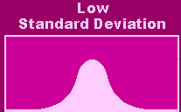
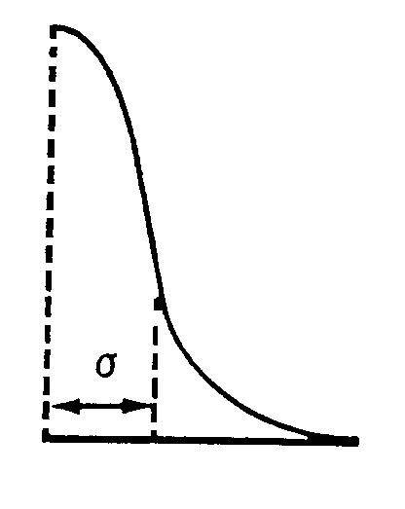
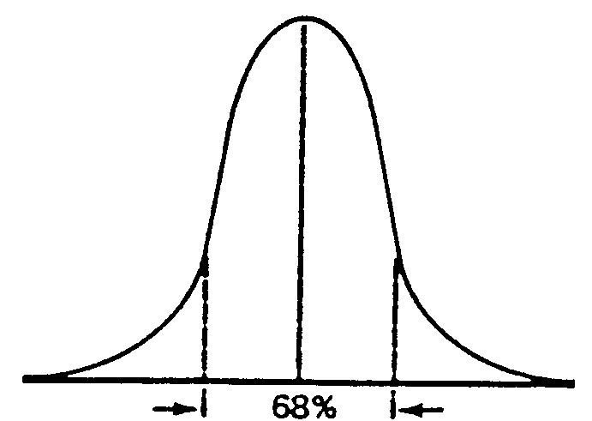
Basic Terms
X = X-Bar = Average
σ = sigma = Standard Deviation
If we measure 1 Standard Deviation on each side of the center of the curve , 68% of the Area will be between the lines drawn through these points.
The Human Proportions table tells us the Standard Deviation (σ - dispersion) of men’s heights is 0.07 meters, so by simple addition and subtraction we know that 68% of the men are between 1.73 and 1.87 meters.
This is X-Bar. It tells us the Average of a group of numbers (in this case average height). X-Bar is the middle of the curve where we have the largest percentage of men.
σ is the Greek letter Sigma. It is the distance from the center of the curve to the point where the curve stops curving downward and starts curving outward. We’re interested in points at 1, 2 and 3 Standard Deviations from the Mean (the center).
Mean
1.8 + 0.07 = 1.87
1.8 - 0.07 = 1.73

Slide 23


Standard Deviation
The most common measure of dispersion. The standard deviation is the square root of the variance, which is the sum of squared distances between each datum and the mean, divided by the sample size minus one. For a tiny sample of three values (1,2,15), the mean is:
(1 + 2 + 15)/3 = 6
and the variance is
((1 - 6)^2 + (2 - 6)^2 + (15 - 6)^2) / (3 - 1) = 61
The standard deviation (σ) is not a very helpful measure of spread for distributions in general. Its usefulness is due to its intimate connection with a special type of distribution, namely to the normal distribution.
The standard deviation is more sensitive to a few extreme observations than is the mean. A skewed distribution with a few values in the 'long tail' will have large standard deviation and it will not provide much helpful information in such cases.
X = X-Bar = Mean
σ = sigma = Standard Deviation
Mean
σ = 0.070
Mean
σ = 0.80
Finding the Standard Deviation

Slide 26
D0
Problem Identified
Houston! We’ve Got A Problem!

Slide 27
Where Was The Problem Identified?
Supplier
Here?
In Transit
Or Here?
Or Here?
Or Here?
Company
Receiving / Inventory
In-Process
Inventory / Shipping
Or Here?
In Transit
Or Here?
Or Here?
Customer
Or Here?
Notes:
There are many places where a problem can be identified.

Slide 28
Typical Top Level Operations Flowchart
Support Processes
Management
Processes
Results / Forecasts
Business Plan
Mgmnt Mtgs.
Quality
Systems
Internal Audits
Procedures &
Standards
Document
Control
Training
Facilities
Processes
Material
Stocking
Control of Test
Equipment
Personnel
Processes
Corrective
Action
Financial
Processes
Design
Engineering
Supplier
Approval
Data Security
Customer
Complaints
Customer
Services
Preventative
Maintenance
Account
Management
Sales /
Marketing
Order
Receipt
Order to
MFG.
Procure
Material
Build
Product
Ship
Product
Bill
Customer
Collect
Money
Mrkting Process
Sales Process
Quote Process
Credit Approval
Order Review
Gen. Doc.
Acknowl. Order
Notify Mfg.
Verify Inputs
Plan the Job
Release for Purch 7
Mfg.
Review Reqmts
Make vs. Buy
Select Supplier
Issue RFQ
Place Orders
Eval. Incoming Matls
Material Dispo.
Autorize Supp. pay
Review Doc. Pack.
Kit Materials
Set up Equip.
Mfg. per Route Card
Package
Send to Finish goods
Confirm Date
Create Pack. Docs.
Create / Dist Invoice
Sched. Carrier
Generate Ship. Docs.
Pass to shipper
File Paperwork
Mail Invoice
Receive Payments
Resolve Disputes
Notes:
What systems are involved?

Slide 30
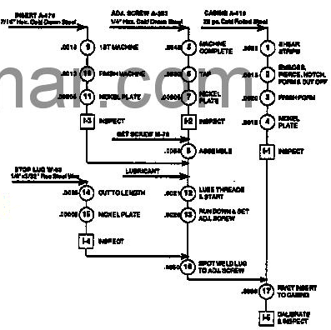
Early Process Flow Diagram
Inspection Points
Inspection Frequency
Instrument
Measurement Scale
Sample Preparation
Inspection/Test Method
Inspector
Method of Analysis

Slide 31
Where Was The Problem Discovered?
Manufacturing Entity
‘Receiving’
Machine or Cell 2
Machine or Cell 3
‘Pack
& Ship’
Internal or External
Customer
Machine or Cell 1
‘Segmented = By machine or ‘cell’
‘Receiving’
Device, Technology or Family = a flow of a ‘technology’ or ‘device’
‘Pack
& Ship’

Slide 32
Where Did The Problem Escape?
Manufacturing Entity
‘Receiving’
Machine or Cell 1
Machine or Cell 2
Machine or Cell 3
‘Pack
& Ship’
Are There Multiple Escape Points?
What Is The Escape Root Cause?

Slide 33
White Space Issues
Receiving
MOD 1
MOD 2
Assembly
Final Pack
Ship
Control Plan & FMEA
Ctrl Plan & FMEA
Ctrl Plan & FMEA
Ctrl Plan & FMEA
Responsibility
=
MOD
Responsibility
=
MOD
Responsibility
=
ASSY
Control Plan & FMEA
Responsibility
=
Materials?
SQA?
White Space Issue
Customer
Warehouse

Slide 34
Asking Why. How Far? Where Do I Look?
General Management Practices
Process
Flow
Diagram
FMEA
Control
Issues
Control
Plan
Design
Rules
M&TE
Needs
Materials
Planning
Materials
Practices
Training
Needs
Manufacturing
Planning
Manufacturing
Practices
Training
Practices

Slide 35
Design Block Diagram Example
If the product function is complex, break it down into smaller sub-systems. Identify Primary vs. Secondary functions.
System
Body
Sub-System
Doors
Exterior
Window
Interior
Door Inner Panel
Sealing with Strip
Component
Glass
Latch / Lock

Slide 37
Failure Modes In Measurement Systems
Linearity
Accuracy
Repeatability
Reproducibility
Correlation for duplicate gages
Gages may be needed prior to gage sign-off at subcontractor plant or any in-house pilot runs
Material
Inspector
Methods
Sample Collection
Training
Test Method
Sample Preparation
Parallax
Workmanship
Practice
Reproducibility
Samples
Ergonomics
Standards
Measurement
Discrimination
Vibration
Bias
Temperature
Repeatability
Calibration
Lighting
These are some of the variables in a measurement system. What others can you think of?
Linearity
Humidity
Instrument
Environment

Slide 38
Process Variation
Distinguishing between the types of causes is critical because the appropriate managerial actions are quite different for each. Without this distinction, management will never be able to tell real improvement from mere adjustment of the process or tampering.
In practice, the most important difference to grasp first is the difference between special cause variation and common cause variation.
The strategy for special causes is simple: Get timely data. Investigate immediately when the data signals a special cause is/was present. Find out what was different or special about that point. Seek to prevent bad causes from recurring. Seek to keep good causes happening.
The strategy for improving a common cause system is more subtle. In a common cause situation, all the data are relevant, not just the most recent or offending figure. If you have data each month for the past two years, you will need to look at all of that data.

Slide 39
Distributions From Variation
Sometimes you can look at two slices of pie and tell which is bigger. Sometimes you cannot.
Home Experiment: Slice a pie up into what you think are equal sized pieces and line them up according to size. Many look the same. If we want to arrange the pieces according to size, we need another way to tell how big each piece is. A weight scale will do quite well. Now - lets look at what we would find if we weighed each piece.
There are big and little pieces, but you can see that the number of pieces in each step of the graph (weight group) varies from the largest piece to the smallest piece in a fairly regular and symmetrical pattern. This is the Distribution of the weights. The curve is what we would expect if the Distribution was a ‘Normal’ distribution.
Imagine doing this with 100 pies!

Slide 40
Process Variation
All variation is caused. There are specific reasons why your weight fluctuates every day, why sales go up, and why Maria performs better than Robert. Management must recognize that variations in production or quality within manufacturing or service processes can be viewed as "special cause" variations, which are best removed by team members operating the process and "common cause" variations, which require management action to change some inherent feature of the process. There are four main types of causes.
Common causes are the myriad of ever-present factors (e.g., process inputs or conditions) that contribute in varying degrees to relatively small, apparently random shifts in outcomes day after day, week after week, month after month. The collective effect of all common causes is often referred to as system variation because it defines the amount of variation inherent in the system.
Special causes are factors that sporadically induce variation over and above that inherent in the system. Frequently, special cause variation appears as an extreme point or some specific, identifiable pattern in data. Special causes are often referred to as assignable causes because the variation they produce can be tracked down and assigned to an identifiable source. (In contrast, it is usually difficult, if not impossible, to link common cause variation to any particular source.) Special Cause variation results from events which are occurring outside the process. For example, a relatively major change in temperature or humidity could cause significant variation (points outside control limits) in the process.

Slide 41
Causes of Variation
Special (Assignable) Causes of Variation
Special causes are problems that arise in a periodic fashion. They are somewhat unpredictable and can be dealt with at the machine or operator level. Examples of special causes are operator error, broken tools, and machine setting drift. This type of variation is not critical and only represents a small fraction of the variation found in a process.
Common Causes of Variation
Common causes are problems inherent in the system itself. They are always present and effect the output of the process. Examples of common causes of variation are poor training, inappropriate production methods, and poor workstation design.
As we can see, common causes of variation are more critical on the manufacturing process than special causes. In fact Dr. Deming suggests that about 80 to 85% of all the problems encountered in production processes are caused by common causes, while only 15 to 20% are caused by special causes.
Notes:
Common Causes
When all variation in a system is due to common causes, the result is a stable system said to be in statistical control. The practical value of having a stable system is that the process output is predictable within a range or band. For example, if a stable order entry system handles 30 to 60 orders a day, it will rarely slip to fewer than 30 or rise to more than 60.
Special (Assignable) Causes
If some variation is due to special causes, the system is said to be unstable since you cannot predict when the next special cause will strike and, therefore, cannot predict the range of variation. If a system is unstable and subject to special cause variation, its capability might sporadically (and unpredictably) drop sharply below or rise sharply.

Slide 42
Facts About Causes of Variation
Special Causes of Variation
Accounts for 5-15% of quality problems.
Is due to a factor that has "slipped" into the process causing unstable or unpredictable variation.
Are unpredictable variations that are abnormal to the process including human error, equipment failure, defective/changed raw materials, acid spills, power failures, etc.; failure to remove them can result is corrosion, scale, metal fatigue, lower equipment efficiency, increased maintenance costs, unsafe working conditions, wasted chemicals, increased down-time (plant shut-down...), etc.
Removal of all special causes of variation yields a process that is in statistical control.
Correctable by local personnel.
Common Causes of Variation
Account for 85-95% of quality problems
Are due to the many small sources of variation "engineered" into the process of the "system”.
Are naturally caused and are always present in the process because they are linked to the system's base ability to perform; it is the predictable and stable inherent variability resulting from the process operating as it was designed.
Standard deviation, s, is used as a measure of the inherent process variability; it helps describe the well-known normal distribution curve.
Correctable only by management; typically requires the repair/replacement of a system's component, or the system itself.

Slide 43
Tampering - Process Variation
Tampering is additional variation caused by unnecessary adjustments made in an attempt to compensate for common cause variation.
Tampering with a process occurs when we respond to variation In the process (such as by “adjusting” the process) when the process has not shifted. In other words, it is when we treat variation due to common causes as variation due to special causes. This is also called “responding to a false alarm,” since a false alarm is when we think that the process has shifted when it really hasn’t.
In practice, tampering generally occurs when we attempt to control the process to limits that are within the natural control limits defined by common cause variation. We try to control the process to specifications, or goals. These limits are defined externally to the process, rather than being based on the statistics of the process.
Notes:
Deming showed how tampering actually increases variation. It can easily be seen that when we react to these false alarms, we take action on the process by shifting its location. Over time, this results in process output that varies much more than if the process had just been left alone.
Rather than using the suggested control limits defined at ±3 standard deviations from the center line, we instead choose to use limits that are tighter (or narrower) than these (sometimes called Warning Limits). We might do this based on the faulty notion that this will improve the performance of the chart, since it is more likely that subgroups will plot outside of these limits. For example, using limits defined at ±2 standard deviations from the center line would produce narrower control limits than the ±3 standard deviation limits. However, you can use probability theory to show that the chance of being outside of a ±3 standard deviation control limit for a Normally-distributed statistic is 0.27% if the process has not shifted. On average, you would see a false alarm associated with these limits once every 370 subgroups (=1/0.0027). Using ±2 standard deviation control limits, the chance of being outside the limits when the process has not shifted is 4.6%, corresponding to false alarms every 22 subgroups!

Slide 44
Structural Variation
Structural Variation is regular, systematic changes in output. Typical examples include seasonal patterns and long-term trends.
Notes:
Structural Variation is of special note here. Some folks break out variation into four categories:
Special Cause
Common Cause
Tampering
Structural Variation
You can consider both Structural and Tampering variation as Common Cause variation. For example, the semi-conductor industry, as well as many other industries, have ‘clean rooms’ or other climate and interference controlled (noise, vibration, temperature, humidity, air particle level, etc.) facilities. By not operating in air conditioning during the summer, management has built into the system a significant source of pollution / interference.

Slide 45
Problem vs. Symptom
At this point it is important to distinguish between a problem and a symptom. A symptom, for example, could be a split in a seam.
Generally, there are a series of problems associated with a process that causes a symptom (in this case the seam split). A symptom often illustrates a ‘gap’ between the desired quality (of the seam) and its actual quality. The seam split because of a problem in the process or in the design.
Every company has its own internal system for appraising symptoms and problems. Sometimes a symptom occurs where 1 person can evaluate the problem and address it. Other times the symptom is significant and requires a team to investigate and remove the cause.

Slide 46
When An 8-D Is Necessary
Using ‘Good Judgment’ is the first step in deciding when to start an 8-D.
Often, however, an 8-D is a customer requirement in response to a problem: Feedback from the customer that there is a concern with the product. Sometimes the concern shows up as a Symptom that has been detected by the customer.
Ideally, a measurable will indicate when an 8-D should be started. When an undesirable trend in a process develops, corrective action can be taken to reduce the cause of the variation before a symptom occurs in the process and escapes to the customer.
If the undesirable trend triggers questions, a decision must be made whether the symptom can be fixed by an individual or whether the symptom requires further analysis. Further analysis typically indicates it’s time to assemble an 8-D problem solving team.

Slide 47
When An 8-D Is Necessary
At this point, each of you (in your thoughts) is wanting the instructor to provide a black & white explanation of when a formal 8-D is required. Unfortunately, the answer is that the only time an 8-D is ‘required’ is when a customer requires it.
Each company provides an internal threshold. It is typically somewhat subjective. There is no ‘absolute’ in so far as when or how far. Many companies use a Review Board. But - each has it’s own path.

Slide 48
When An 8-D Is Necessary
There are typically several assessment points in a company’s evaluation of a symptom.
Each assessment is a decision point - first by one or more individuals, then by ‘official’ groups.
At each point, ‘reason’ is used to decide whether a ‘full’ 8-D is necessary.
Symptom
Appears
Internal
and/or
External
Second
Assessment
Internal Group
First
Assessment
Internal
Individual
Third Assessment
Internal Group
with
Internal / External
Customer Involvement

Slide 49
Verification vs. Validation
Verification and Validation are often not well understood. Verification and Validation work together as a sort of ‘before’ (Verification) and ‘after’ (Validation) proof.
  Verification provides ‘insurance’ at a point in time that the action will do what it is intended to do without causing another problem. Predictive.
  Validation provides measurable ‘evidence’ over time that the action worked properly.

Slide 50
Investigative Questions
10-10-321 NOW Offers You
50% Off On All Calls.
What does this statement tell you?
What information does it really contain?
What questions does it bring to mind?

Slide 51
Investigative Questions
What other details might you want to know about?
What was the program before?
10-10-321 NOW Offers You
50% Off On All Calls.
50% off of what?
All calls everywhere?
What ‘conditions’ apply?
Time of day? Day of week? Is this a 30 day ‘teaser’?

Slide 52
D1
Use Team Approach

Slide 53
The 8-D System
Awareness
of Problem
4.
Identify
Potential
Cause(s)
5.
Choose / Verify
Corrective Actions
1.
Use Team
Approach
Select Likely
Causes
Implement
Permanent
Corrective Actions
6.
Describe
the Problem
Is the Potential Cause a Root Cause?
2.
Prevent
Recurrence
No
7.
Implement and
Verify Interim
(Containment)
Action(s)
Yes
Congratulate
Your Team
3.
8.
Identify Possible
Solutions

Slide 54
Team Approach
When a problem cannot be solved quickly by an individual, it is necessary to form a Team. The team will engage in the investigation and resolution of the problem. Many factors are critical to establish a group and to ensure that the group can work effectively together. Using a team approach is not just a step in the problem solving process, but an overriding framework for decision making.
It is necessary to reevaluate team membership continually.
Model for Effective Teamwork:
  Structure
  Goals
  Roles
  Procedures
  Interpersonal Relationships
Notes:
Why teams? Why cross-functional teams?
Cross-functional teams minimize visible layers of supervision originating solely from any specific functional group - Engineering, Manufacturing, Quality, etc.
A Team is a small group of folks with the process / product knowledge, allocated time, authority and skill(s) in the required technical disciplines to solve the problem and implement corrective actions. The group must have a designated champion.
Team members must be empowered with the potential to ‘change the rules’.

Slide 55
Establishing A Team (Flow)
Select
Champion
1. Recognition of Common Cause vs. Special
Cause Relationship
2. Common Policy / Goal But
Different Measures At Different Organizational
Levels
Select Team Members
Select Leader
Verify Cross-Functional Team
Representation & Expertise
Begin Investigation
Notes:
Common causes are the myriad of ever-present factors (e.g., process inputs or conditions) that contribute in varying degrees to relatively small, apparently random shifts in outcomes day after day, week after week, month after month. The collective effect of all common causes is often referred to as system variation because it defines the amount of variation inherent in the system.
Special causes are factors that sporadically induce variation over and above that inherent in the system. Frequently, special cause variation appears as an extreme point or some specific, identifiable pattern in data. Special causes are often referred to as assignable causes because the variation they produce can be tracked down and assigned to an identifiable source. (In contrast, it is usually difficult, if not impossible, to link common cause variation to any particular source.) Special Cause variation results from events which are occurring outside the process. For example, a relatively major change in temperature or humidity could cause significant variation (points outside control limits) in the process.

Slide 56
The Team - Basics
What is a Team?
  Two or more individuals who coordinate activities to accomplish a common task or goal.
Maintaining Focus
  A separate team for each product or project.
Brainstorm
  Brainstorming (the Team) is necessary as the intent is to discover many possible possibilities.

Slide 57
Brainstorming
What is Brainstorming?
Brainstorming is a method for developing creative solutions to problems. It works by focusing on a problem, and then deliberately coming up with as many deliberately unusual solutions as possible and by pushing the ideas as far as possible.
One approach to brainstorming is to 'seed' the session with a word pulled randomly from a dictionary. This word as a starting point in the process of generating ideas.
During the brainstorming session there is no criticism of ideas - the idea is to open up as many possibilities as possible, and break down preconceptions about the limits of the problem.
Once this has been done the results of the brainstorming session can be analyzed and the best solutions can be explored either using further brainstorming or more conventional solutions.

Slide 58
How To Brainstorm
The following rules are important to brainstorming successfully:
A leader should take control of the session, initially defining the problem to be solved with any criteria that must be met, and then keeping the session on course. He or she should encourage an enthusiastic, uncritical attitude among brainstormers and encourage participation by all members of the team. The session should be announced as lasting a fixed length of time, and the leader should ensure that no train of thought is followed for too long. The leader should try to keep the brainstorming on subject, and should try to steer it towards the development of some practical solutions.
Participants in the brainstorming process should come from as wide a range of disciplines with as broad a range of experience as possible. This brings many more creative ideas to the session.
Brainstormers should be encouraged to have fun brainstorming, coming up with as many ideas as possible, from solidly practical ones to wildly impractical ones in an environment where creativity is welcomed.
Ideas must not be criticised or evaluated during the brainstorming session. Criticism introduces an element of risk for a group member in putting forward an idea. This stifles creativity and cripples the free running nature of a good brainstorming session.
Brainstormers should not only come up with new ideas in a brainstorming session, but should also 'spark off' from associations with other people's ideas and develop other peoples ideas.
A record should be kept of the session either as notes or a tape recording. This should be studied subsequently for evaluation. It can also be helpful to jot down ideas on a board which can be seen by all brainstormers.

Slide 59
Individual vs. Group Brainstorming
Brainstorming can either be carried out by individuals or groups:
Individual brainstorming tends to produce a wider range of ideas than group brainstorming, but tends not to develop the ideas as effectively, perhaps as individuals on their own run up against problems they cannot solve. Individuals are free to explore ideas in their own time without any fear of criticism, and without being dominated by other group members.
Group brainstorming develops ideas more deeply and effectively, as when difficulties in the development of an idea by one person are reached, another person's creativity and experience can be used to break them down. Group brainstorming tends to produce fewer ideas (as time is spent developing ideas in depth) and can lead to the suppression of creative but quiet people by loud and uncreative ones.
Individual and group brainstorming can be mixed, perhaps by defining a problem, and then letting team members initially come up with a wide range of possibly shallow solutions. These solutions could then be enhanced and developed by group brainstorming.

Slide 60
Define Scope Of Team
Select team members and functions
Define roles and responsibilities
Identify external customer needs, expectations and requirements
Identify internal customer needs, expectations and requirements
Complete preliminary studies
Identify costs, timing and constraints
Identify documentation process and method
Develop investigation plan

Slide 61
Natural Work Group vs. Team
Two Types of Team Structures

Slide 62
Team Structure
Size
  Four to 10 members. Larger teams become less effective and have minimal commitment to the problem solving effort. Larger teams should assess whether a steering committee and/or subgroups should be established.
Support Needed
  ‘Appropriate’ levels of the organization must be represented.
Environment
  Meeting locations are critical to good teamwork. A site should be quiet and not disruptive to team members. A site near the work area permits easy data collection and customer interaction is beneficial.

Slide 63
Team Organization
Cross-functional
  Design Engineering (Typically the leader)
  Quality Assurance
  Purchasing
  Manufacturing Engineering
  Material Control
  Sales/Marketing
  Etc.
Participation appropriate for phase being conducted
Resources - Team defines ‘Needs’
*Should* involve customer or subcontractor participation (not always feasible)

Slide 64
Decision Making Criteria / Model
One person makes the decision
One person consults the group, then makes the final decision
Team or group makes decision based upon majority rule or consensus
Notes:
The decision making model should be chosen at the beginning of the team formation. Because of potential political and internal power ‘camps’, it is often best for the champion to define which decision making model will be used.

Slide 65
Roles In A Team
Several roles need to be established for the team. These roles are: Leader, Champion, Record Keeper (Recorder), Participants and (if needed) Facilitator.
Leader
Group member who ensures the group performs its duties and responsibilities. Spokesperson, calls meetings, establishes meeting time/duration and sets/directs agenda. Day-to-day authority, responsible for overall coordination and assists the team in setting goals and objectives.
Record Keeper
Writes and publishes minutes.
Participants
Respect each others ideas.
Keep an open mind.
Be receptive to consensus decision making.
Understand assignments and accept them willingly.
Champion
Guide, direct, motivate, train, coach, advocate to upper management.

Slide 66

Inputs To Team
Field service reports
Problems and issues reported from Internal customers
Internal evaluations using surrogate customers
Road trips (e.g.: Struts)
Management comments and/or direction
Government requirements and/or regulations
Contract review
Input from higher system level or past QFD projects
Media commentary and analysis
Customer letters and suggestions
Things gone Right/Wrong reports
Dealer comments
Fleet operator comments

Slide 67
Team Goals
For any group to come together as a team, it is critical that everyone be clear on the team’s goal(s). All team member must share that goal. If any team members have different goals or have individual goals different or separate from the stated goal, these should be communicated to the team to avoid road blocks to the success of the team.
The goal needs to be clearly specified, quantifiable, and supported by all team members. The goal should be challenging, but still be attainable. By writing (documenting) the team’s goal, all individuals on the team and the advisor to the team will ‘stick to’ and understand the goal.

Slide 68
Basic Team Rules
Team must develop their own ground rules
  Once developed, everyone must live by them
  Ground Rules are an aid to “self-management”
  Team can modify or enhance the rules as they continue to meet
Determine if there should be a meeting
Decide who should attend
Provide advance notices
Maintain meeting minutes or records
Establish ground rules
Provide and Follow an agenda
Evaluate meetings
Allow NO interruptions

Slide 69
Team Meeting Responsibility
Clarify
Participate
Listen
Summarize
Stay on track
Manage time
Test for consensus
Evaluate meeting process

Slide 70

Team-to-Team Communication
Manage by using a Team Captain or Champion
Understanding of ‘How We Work As A Team’
Should have a Focus Person & Distributed Minutes
Customer teams
Internal teams
Supplier teams
Sub-Teams
Subcontractors should be encouraged to embrace ISO 9001 or APQP and QS 9000

Slide 71
Successful Teams
Are management directed and focused
Build their own identity
Are accountable and use measurements
Have corporate champions
Fit into the organization
Are cross-functional
Some Teams just “Do Not Work”

Slide 72
Team Check List
Notes:
Personally, I am a big fan of check lists. Every time you fly on an aeroplane, you should be thankful for check lists.

Slide 73
D2
Describe The Problem

Slide 74
The 8-D System
Awareness
of Problem
4.
Identify
Potential
Cause(s)
5.
Choose / Verify
Corrective Actions
1.
Use Team
Approach
Select Likely
Causes
Implement
Permanent
Corrective Actions
6.
Describe
the Problem
Is the Potential Cause a Root Cause?
2.
Prevent
Recurrence
No
7.
Implement and
Verify Interim
(Containment)
Action(s)
Yes
Congratulate
Your Team
3.
8.
Identify Possible
Solutions

Slide 75
Describe the Problem
Specify the internal / external customer problem by identifying in quantifiable terms the Who, What, When, Where, Why, How, How Many (5W2H) for the problem.

Slide 76
Describe the Problem
Problem definition is the basis of problem solving. The definition is used during brainstorming sessions to identify potential causes. Potential causes are those most likely causes that appear on the surface to be the source of the problem. A potential cause may be the root cause but must be supported by evidence.
Part of the problem solving process is to identify the root cause of the problem and understand why it existed in the first place. Only then can a permanent solution be chosen and implemented. to make certain the problem will never surface again. The root cause is the reason the problem exists. When it is corrected or removed from the system, the problem will disappear. It is important to improve our understanding of today's technology to make possible the planning required to achieve quality and productivity breakthroughs for tomorrow and into the future.
Notes:
If you can’t describe the problem, there is no problem.

Slide 77
Customer Complaints
Many problems arise from customer complaints. An internal customer’s complaint could involve one department complaining that they cannot use the output of another department. An external customer complaint could involve a customer complaining to a dealer that a transmission ‘shifts funny’.
Frequently the wrong problem is solved and the customer complaint is not addressed. It is very important that the customer complaint be clearly understood. The only method to ensure this is to have direct customer contact.
For internal customers, it is advisable to have representatives from the complaining organization as part of the problem solving team. In many cases this approach is the only way a problem can truly be solved.
External customer complaints typically require direct interviews to understand why the customer is not satisfied. It is not unusual for a customer complaint to be misrepresented by a company reporting system that classifies problems in prearranged standard categories.

Slide 78
Operational Definition of the Problem
It is important that the problem be described in terms that have the same meaning to everyone. This is best achieved through an operational definition. An operational definition consists of verifiable criteria that have the same meaning to the production workers, manager, customer, engineer, buyer, technician, team members, etc., and are used for past, present and future comparisons and analysis.
Sometimes problems are mistakenly described in terms of symptoms:
  Machine is down due to electrical problem. No backup machine or alternative available.
  The scrap rate has increased from “X” date from 3% to 22%.
  Customer warranty claims on “X” engine component is 12%.
  Failure of durability tests of a transmission component at 50,000 miles will delay launch.

Slide 79
Symptoms vs. Causes
It is not uncommon for problems to be reported as symptoms. More examples are: noise, won’t work, no power, machine down, broken tool, head froze up, contaminated, rough surface, porosity, shortage of parts, rattles, quality problem, worn out, line stopped, not to specification, labour problem, management problem, too much variation, etc.
The problem solving team must use a systematic approach to define the real problem in as much detail as possible. A definition of the problem can best be developed using approaches that organize the facts to get a comparative analysis. These approaches do this by asking what ‘is’ against what ‘is not’. Then they draw distinctions from this comparison, testing these against the problem definition and forming a statement or description of the problem which must be resolved.

Slide 80
Problem Solving
Systematic approaches to problem solving:
  Business as a System (Business as a Process)
  Analytical problem solving
  Process flow
Problem analysis methodologies:
  5W2H
  Stratification
  Comparative analysis
  Similarity analysis
Key questions --> 5W’s and 2H’s:
  Who? What? Where? When? Why? How? How Many?

Slide 81
In-Depth Analysis
An in-depth analysis is required to clearly define a problem. There are many examples where the analysis for a complete problem definition results in the solution being identified. The analysis starts with preparation (or review of the existing) process flow diagram to define clearly the work process and alternative paths. Team preparation or review ensures that all individuals are familiar with the process. After the flow diagram is reviewed, there are three principle parts of the problem analysis we discussed earlier:
  5W2H
  Stratification
  Comparative/Similarity Analysis
First, quantify the 5W2H elements. In various problem analysis situations the investigators or problem solving teams must continually test to determine where they are located in the circle of circumstances. If a decision is made, what are the alternatives?

Slide 82
5W - 2H Analysis
It is sometimes difficult to define the problem and sort out real differences. The first, most important step, however, it to determine that the customer complaint is fully understood.
5W2H :
  Who? Identity customers complaining
  What? Identity the problem adequately and accurately
  When? Timing - When did the problem start?
  Where? Location - Where is it occurring?
  Why? Identify known explanations
  How? In what mode or situation did the problem occur?
  How Many? Magnitude - Quantify the problem
To reduce the risk of making wrong decisions, consideration and analysis of potential problems in advance will provide contingency actions to maintain control and protect the customer.
5
W
2
H

Slide 83
5W - 2H Analysis
  Who? - Identity individuals associated with the problem. Characterize customers who are complaining. Which operators are having difficulty?
  What? - Describe the problem adequately. Does the severity of the problem vary? Are operational definitions clear (e.g. defects)? Is the measurement system repeatable and accurate?
  When? - Identify the time the problem started and its prevalence in earlier time periods. Do all production shifts experience the same frequency of the problem? What time of year does the problem occur?
  Where? - If a defect occurs on a part, where is the defect located? A location check sheet may help. What is the geographic distribution of customer complaints?
  Why? - Any known explanation(s) contributing to the problem should be stated.
  How? - In what mode or situation did the problem occur? What procedures were used?
  How Many? - What is the extent of the problem? Is the process in statistical control?
5
W
2
H

Slide 84
Stratification Analysis
Stratification Analysis determines the extent of the problem for relevant factors.
  Is the problem the same for all shifts?
  Do all machines, spindles, fixtures have the same problem?
  Do customers in various age groups or parts of the country have similar problems?
The important stratification factors will vary with each problem, but most problems will have several factors. Check sheets can be used to collect data. Essentially this analysis seeks to develop a pareto diagram for the important factors. The hope is that the extent of the problem will not be the same across all factors. The differences can then lead to identifying root cause.
When the 5W2H and Stratification Analysis are performed, it is important to consider a number of indicators. For example, a customer problem identified by warranty claims may also be reflected by various in-plant indicators. Sometimes, customer surveys may be able to define the problem more clearly. In some cases analysis of the problem can be expedited by correlating different problem indicators to identify the problem clearly.

Slide 85
Describe the Problem
It has been said that there are no new problems, only different manifestations of old problems. In problem definition, it is often useful to quantify the problem in similar situations. The criteria to match similar situations will vary with the type of problem. Identifying effective matches and evaluating the presence of the problem provides useful information to generate potential causes and possible problem solutions. If the similarity analysis identifies a comparable situation where the problem does not exist, the analysis can focus on the differences in where the problem is occurring and where it is not occurring.
Once the 3 types of analysis have been completed, it is sometimes possible to divide the problem into separate problems. It is easier to address these smaller problems because fewer root causes are involved. In the ideal case, a single root cause would be responsible for each problem. If the problem is separated, different teams may be required to address each problem.
All three elements of the problem definition are not used for every problem. However, collectively the different analyses provide a comprehensible description. You are developing a ‘specification’ of the problem.

Slide 86
Describe the Problem Flow
Establish a Database
For The Problem Description
Contact the Customer to Ensure
Correct Problem Description
Prepare (Review) Process Flow
Diagram For All Product Stages
Have the Extent and Distribution
of the Problem been Established
for All Stratification Factors?
Return
to D1
No (Action Plan)
Collect Current and Historical Data As
Needed to Further Quantify the Problem
Ask: Who, What, When,
Where, How, and How Much?
Can the Problem be Subdivided?
Prepare a Comparative Analysis
for All Similar Situations
Describe the Problem in Terms
of an Operational Definition
Implement Interim Corrective Actions

Slide 87
Root Cause Analysis
Symptom
A Drop In Average Weekly Hours
Worked By Third Shift Employees
WHY?
The Employees Are Arriving Late
WHY?
Initial
Problem
Descriptions
Traffic Jam
On I-29
Buses
Late
Not
Enough
Parking
Bad Weather
Road
Construction

Slide 88
Investigative / Tracking Charts
Pareto - Used To Assess The ‘WHY’s and for Tracking
Paynter Chart - Used To Track Progress

Slide 89
Is / Is Not Questions
NOTE: Every Question May Not Apply!

Slide 90
Is / Is Not Example

Slide 91

Timing Plan
Depends upon
  Product complexity
  Customer expectations
Team plan for
  Training
  Event
  Action
Framework for tracking
Basis for status reporting
Prepare a timing chart using available project or similar software
Do NOT Under Estimate the Importance of Timing!

Slide 92
Describe the Problem Phases
Phase I
State the symptom, extent and consequence of the problem.
Prepare / Review process flow diagram.
Start an Action Plan to define the problem. Identify Who will do What by When.
Phase II
Identify Who, What, Where, When, Why, How and How Much.
Qualify the extent of the problem to help identify relevant stratification factors.
Evaluate similar situations where the problem might be expected to occur.
Use all available indicators. Be creative about these.
Subdivide the problem into natural problem groups.

Slide 93
Describe the Problem Questions
Questions
What Type of Problem Is It?
Field complaint
Quality improvement
Manufacturing improvement
Component design
Labour / Personnel
Supplier / Vendor
Cost improvement
Solution implementation
Cross functional
Research
Safety
Other Questions
Can you list all of the resources and documents which might help you specify the problem more exactly?
Do you have more than 1 problem? Can this situation be separated into smaller parts?
Is / Is Not
Is there any evidence this problem surfaced before?

Slide 94
Describe the Problem - 5W-2H
Who, What, When, Where, Why, How, How Many
  What is the extent of the problem?
  Has the problem been increasing, decreasing or remaining constant?
  Is the process stable?
  What indicators are available to quantify the problem?
  Can you determine the severity of the problem? Can you determine the various ‘costs’ of the problem? Can you express the cost in percentages, dollars, pieces, etc.?
  Do we have the physical evidence on the problem in hand?
  Have all sources of problem indicators been identified and are they being utilized?
  Have failed parts been analyzed in detail?

Slide 95
Customer Terms / Symptoms
  Who is the customer?
  Is there more than 1 customer? If so, which customer first identified the problem?
  To whom was the problem reported in the customer’s organization?
  What is the problem definition in customer terms?
  What is the problem definition in YOUR terms?
  Have we verified the problem with on-site visits with the customer?

Slide 96
Understanding Your Processes and Systems
Use a Process Flow Chart!
Because:
You want to understand your current process.
You are looking for opportunities to improve.
You want to illustrate a potential solution.
You have improved a process and want to document the new process.

Slide 97
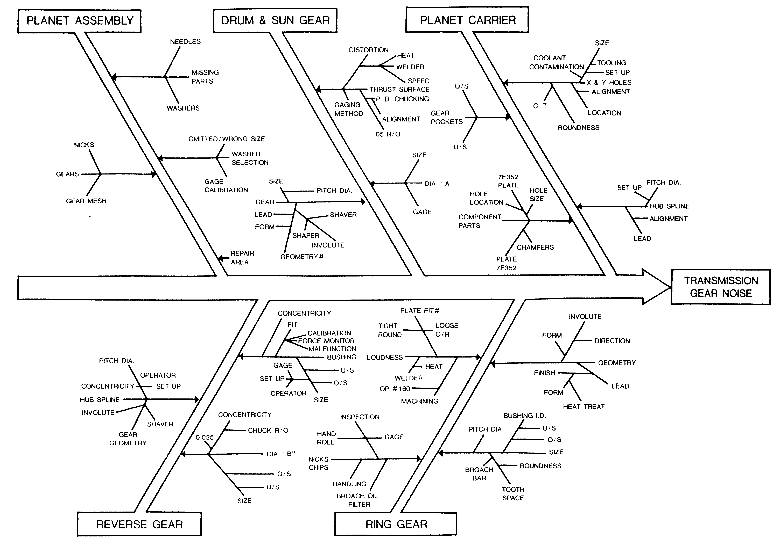
Production Cause and Effects Diagram
Notes:
This is an example of a somewhat detailed cause and effect diagram.

Slide 98
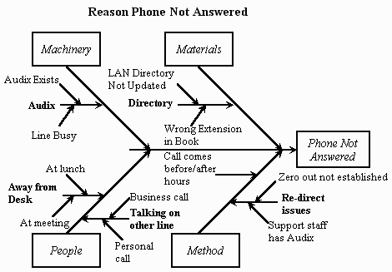
Service Cause and Effects Diagram
Notes:
Also see: http://lorien.ncl.ac.uk/ming/spc/spc6.htm

Slide 99
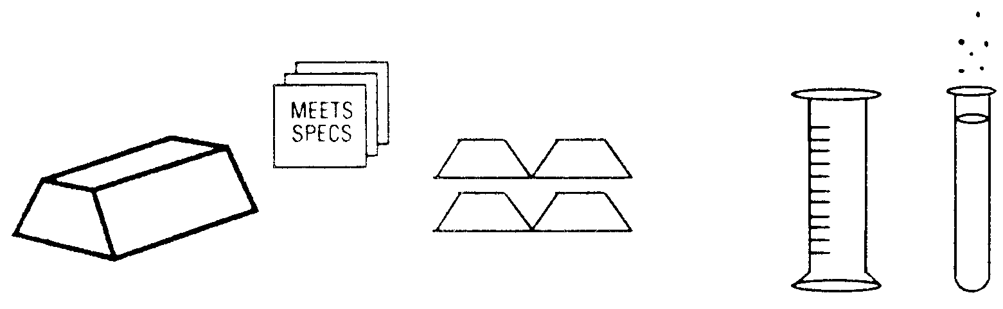
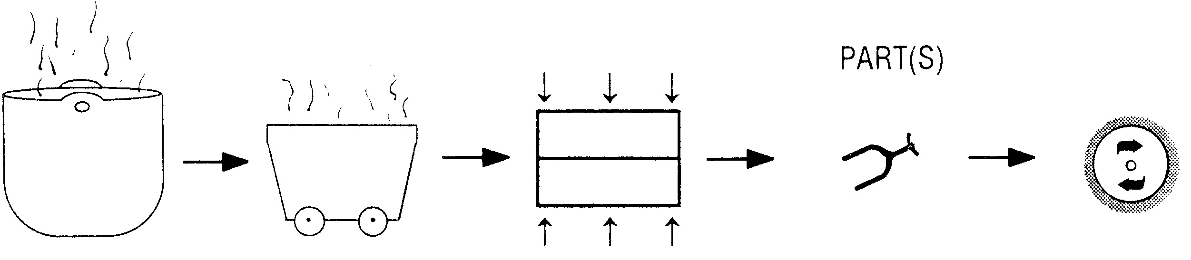
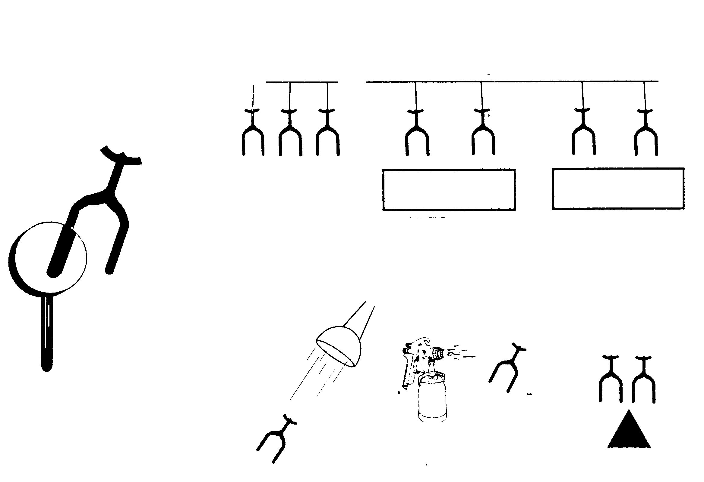
Flow Charting
Die Cast Production
Purchased
Storage
QC
Molding
Buffing
Zinc Ingots
Warehouse
Statistical Sampling Inspection
Electric Furnace
Molten Metal Carriers
Die Cast Machines
Remove Coping Line & Burrs
Nickel-Chrome Plate
Rack & Pre-Plate
Brass Plate
Plating Process
Electro-Dip Clean
Finishing Department
Or
Electro-Plate (Liquid Process)
Painting Process

Slide 100
Creating a Process Flow Chart
1. Identify the process or task you want to analyze. Defining the scope of the process is important because it will keep the improvement effort from becoming unmanageable.
2. Ask the people most familiar with the process to help construct the chart.
3. Agree on the starting point and ending point. Defining the scope of the process to be charted is very important, otherwise the task can become unwieldy.
4. Agree on the level of detail you will use. It’s better to start out with less detail, increasing the detail only as needed to accomplish your purpose.

Slide 101
Creating a Process Flow Chart
5. Look for areas for improvement
Is the process standardized, or are the people doing the work in different ways?
Are steps repeated or out of sequence?
Are there steps that do not ad value to the output?
Are there steps where errors occur frequently?
Are there rework loops?
6. Identify the sequence and the steps taken to carry out the process.
7. Construct the process flow chart either from left to right or from top to bottom, using the standard symbols and connecting the steps with arrows.
8. Analyze the results.
Where are the rework loops?
Are there process steps that don’t add value to the output?
Where are the differences between the current and the desired situation?

Slide 102
Early Process Flow Diagram
Inspection Points
Inspection Frequency
Instrument
Measurement Scale
Sample Preparation
Inspection/Test Method
Inspector
Method of Analysis

Slide 103
GM Example Process Flow Chart

Slide 104
Basic Flow Chart Example
Start
Manufactured Parts
Receive Raw Materials
Receive Parts
Purchased Parts
Bad
Bad
Inspect
Disposition
Bad
Inspect
Bad
Move to Production
Move to Production
Process Material
Bad
Inspect

Slide 105
Basic Flow Chart Example
Assemble
Functional Test
Bad
Disposition
Package
Ship

Slide 106
Control Plan Example (GM)
This form is on course disk

Slide 107
FMEAs - Predicting Failure & Problems
How It Works
What Its Made Of
How Its Made
System
Design
Process
Components, Subsystems, Main Systems
Components, Subsystems, Main Systems
Manpower, Machine, Method, Material, Measurement, Environment
Focus:
Minimize failure effects on the System.
Objective/Goal:
Maximize System quality, reliability, cost and maintainability.
Focus:
Minimize failure effects on the Design.
Objective/Goal:
Maximize Design quality, reliability, cost and maintainability.
Focus:
Minimize process failures effects on the Total Process.
Objective/Goal:
Maximize Total Process quality, reliability, cost, productivity and maintainability.
Machines
Tools, Work Stations, Production Lines, Operator Training, Processes, Gauges

Slide 108
Describe The Problem Check List

Slide 109
D3
Containment

Slide 110
The 8-D System
Awareness
of Problem
4.
Identify
Potential
Cause(s)
5.
Choose / Verify
Corrective Actions
1.
Use Team
Approach
Select Likely
Causes
Implement
Permanent
Corrective Actions
6.
Describe
the Problem
Is the Potential Cause a Root Cause?
2.
Prevent
Recurrence
No
7.
Implement and
Verify Interim
(Containment)
Action(s)
Yes
Congratulate
Your Team
3.
8.
Identify Possible
Solutions

Slide 111
Implement and Verify
Interim (Containment) Actions
Define and Implement containment actions to isolate the effect of the problem from any internal / external customer until corrective action is implemented.
Verify the effectiveness of the containment action.

Slide 112
Contain Symptom Flow
Immediate Containment
with Current
Information and
Problem Description
Choose
Verify Before
Implement
Stop Defect at Each
Point in the Process
Back to the Source
Certify parts and Confirm
Customer Dissatisfaction
No Longer Exists
Determine
Escape Point
Should an existing ‘check’ (control)
have caught the defect?
Validate that Action
Taken is Fully Effective
Validate After Implementation
Notes:
What you do to ensure that product shipped from the point at which you know of the problem is 'Conforming' [HOLD EVERYTHING!!!! - What have we got here?] (often 100% inspection/test for the specific defect and then you 'certify' [as per the SS requirement, but typical outside the sector as well - can you say SORT?] each shipment for an agreed upon time period - which depends upon the problem identified, etc., as I'm sure you know). This is what you ship to the customer within X hours (not always considering reality). The intent here with the stated hours is to avoid interrupting a customer's manufacturing schedule.
Identify part number and determine what has been shipped, when, what is in the hands of customers (in their stock - requires close contact with a customer 'point of contact'), what is enroute, etc.
Determine when the 'event' occurred (like lot number).
Isolate in-house and warehoused suspect product.
Determine earliest and latest. Start wide and narrow down as you go. Eg. Did test fail? When? Is this a 'standard' that went bad? In the case of a test instrument calibration, when was the last calibration? Can you test interim product to see if stuff in between is OK or where the calibration went far enough out as to allow nonconforming product to be 'passed' and shipped. What shipped product lots are 'suspect' and 'what's in the pipeline'?
Close communication with customers to ensure 'timely' update on possible (suspect) lots or known 'contaminated' lots.
The customer has to have knowledge of lots - what may they have shipped that was assembled with your suspect component.

Slide 113
Containment Actions Objective
Define and Implement containment actions to isolate the effect of the problem from internal and external customers until corrective action is implemented.
Verify the effectiveness of the containment action(s).

Slide 114
Containment Actions
The main objective of this part of the problem solving process is to isolate the effects of the problem by implementing containment actions. A problem may be poor quality, marginal product design, or a process or system that is unpredictable. A containment action may be stopping production of a known source of a problem, or not shipping any parts or assemblies until the source of the problem is identified.
Once a problem has been described, immediate actions are to be taken to isolate the problem from the customer. In many cases the customer must be notified of the problem. These actions are typically ‘Band-aid’ fixes. Common containment actions include:
  100% sorting of components
  Cars inspected before shipment
  Parts purchased from a supplier rather than manufactured in-house
  Tooling changed more frequently
  Single source

Slide 115
Containment Actions
Unfortunately, most containment actions will add significant cost
($)
to the product. However, it is important to protect the customer from the problem until permanent corrective actions can be verified and implemented.
Most interim actions are ‘temporary short term’ actions taken until a permanent corrective action is defined, implemented and verified. The danger of many interim corrective actions is that they are considered to be a permanent solution to the problem. It must be remembered that they are typically ‘band-aids’. It is a mistake to view containment actions as a solution to the problem. Containment actions typically address the effect. They should be considered ‘immediate first-aid’ to be reviewed and removed as quickly as possible.

Slide 116
Containment Actions
Containment actions can and often should proceed in parallel with the root cause determination investigation. During the period in which containment actions are taking place, many useful things must be pursued as a first step in finding the root cause. These things include:
  Establishing an investigative plan
  Obtaining baseline data
  Initiating an on-going control system
  Developing a follow-up and communications system
  Correcting products already produced
  Start systematic investigations
  Conduct special studies and statistical experiments
  Understand the problem Review experiences and data with current trends
  Forecast the future

Slide 117
Typical 8-D Time Line
Initiate Containment Actions
Withdraw Containment Actions
Problem Solving Efforts
Symptom
Appears
Internal
and/or
External
Establish Team
Second
Assessment
Internal Group
Implement Permanent
Corrective Actions
First
Assessment
Internal
Individual
Third Assessment
Internal Group
with
Internal / External
Customer Involvement
Verify Permanent
Corrective Actions
This process can stop or loop back upon its self at any point in the process.

Slide 118
Containment Actions
A design test on data collection (i.e. check sheets, control charts, etc.) can be used to evaluate the effectiveness of the actions. The process can be monitored using control charts and histograms. An action plan should define who, what and when clearly to coordinate the interim fixes.
Individuals should be encouraged to gain knowledge about the entire process. Ask - What would be the effect of:
  Incorporating robust engineering designs
  Establishing manufacturing feasibility
  Determining how one operation or dimension affects another
  Centering the process
  Over adjusting and / or under adjusting a machine or process
  Improving machine set-up
  Changing tools
  Improving maintenance, etc.
Well engineered management systems, practices and procedures need to be coupled with effective training programs. Together these can provide the best protection to prevent recurrence of the problem by new technologies, new methods, new employees, job rotation or improvement of individual skills.

Slide 119
Containment Actions Flow
Identify Containment
Action(s)
Establish an Action Plan
Has the Effect been Isolated from
Internal and External Customers?
No
Yes
Implement and Verify Actions On
A Test Basis (Collect data)
Yes
Is The Effect Controlled?
Continue 8-D
No

Slide 120
Verifying Containment Actions - Pilot Runs
Run Pilot Tests
Artificially simulate the solution to allow actual process or field variation.
Field test the solution using pilot customer groups.
Verify carefully that another problem is not generated by the solution.
Monitor Results
Quantify changes in key indicators.
Stress the customer / user evaluation.

Slide 121
Containment Actions Verification Questions
Have all alternatives been evaluated?
Are responsibilities clear and defined?
Is the required support available?
When will the actions be completed?
Have you ensured that implementation of the interim solution will not create other problems?
Will all interim actions last until long-range actions can be implemented?
Is the action plan coordinated with customers?
Have tests been done to evaluate the effectiveness of the interim actions?
Is data being collected to ensure actions remain effective?

Slide 122
Contain Symptom Check List

Slide 123
D4
Define Root Cause(s)

Slide 124
The 8-D System
Awareness
of Problem
4.
Identify
Potential
Cause(s)
5.
Choose / Verify
Corrective Actions
1.
Use Team
Approach
Select Likely
Causes
Implement
Permanent
Corrective Actions
6.
Describe
the Problem
Is the Potential Cause a Root Cause?
2.
Prevent
Recurrence
No
7.
Implement and
Verify Interim
(Containment)
Action(s)
Yes
Congratulate
Your Team
3.
8.
Identify Possible
Solutions

Slide 125
Define and Verify Root Cause(s)
Identify all potential causes which could explain why the problem occurred.
Isolate and verify the root cause by testing each potential cause against the problem description and test data. Identify alternate corrective actions to eliminate root cause.

Slide 126
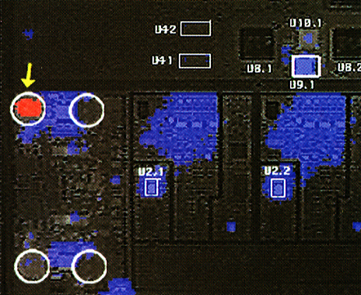
Root Cause Of A Failure
Is this THE Root Cause?
Device High Temperature Causes Output Voltage Spike
-
Cause of Component
Failure Down Stream
Failed
Component
CCA Thermal Map
(powered)

Slide 127
Two Root Causes
Root Cause of Event (Occur or Occurrence)
What system allowed for the event to occur?
Root Cause of Escape
What system allowed for the event to escape without detection?

Slide 128
Initial Data Evaluation
Change Induced vs. Unidentified (New)
Gradual vs. Abrupt vs. Periodic

Slide 129
Initial Data Evaluation
Gradual Change
‘Normal’ Quality
Level
Actual
Point of
Change
Today
Time
Abrupt Change
Actual
Point of
Change
Today
Time

Slide 130
Initial Data Evaluation
Periodic (Cyclical?) Change
‘Normal’ Quality
Level
Actual
Point of
Change
Today
Time

Slide 131
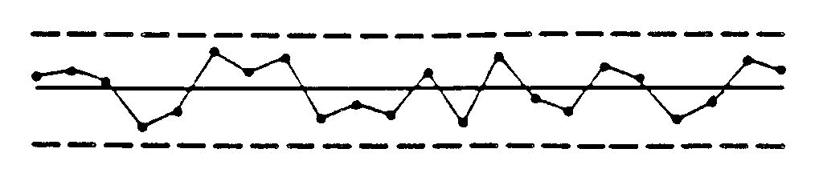
Interpreting Control Charts
Control Charts provide information as to whether a process is being influenced by Chance causes or Special causes. A process is said to be in Statistical Control when all Special causes of variation have been removed and only Common causes remain. This is evidenced on a Control Chart by the absence of points beyond the Control Limits and by the absence of Non-Random Patterns or Trends within the Control Limits. A process in Statistical Control indicates that production is representative of the best the process can achieve with the materials, tools and equipment provided. Further process improvement can only be made by reducing variation due to Common causes, which generally means management taking action to improve the system.
Upper Control Limit
Average
Lower Control Limit
A. Most points are near the center line.
B. A few points are near the control limit.
C. No points (or only a ‘rare’ point) are beyond the Control Limits.

Slide 132
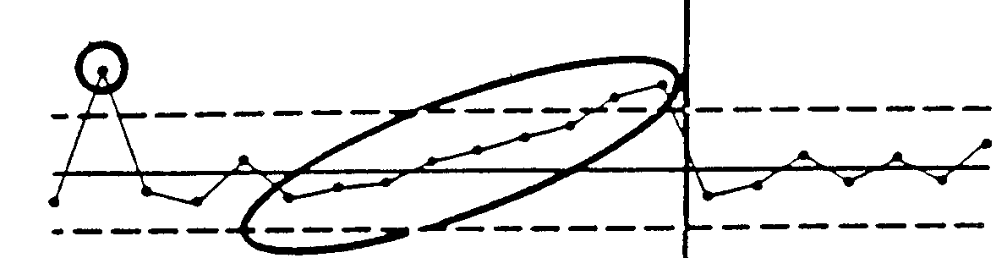
Interpreting Control Charts
When Special causes of variation are affecting a process and making it unstable and unreliable, the process is said to be Out Of Control. Special causes of variation can be identified and eliminated thus improving the capability of the process and quality of the product. Generally, Special causes can be eliminated by action from someone directly connected with the process.
The following are some of the more common Out Of Control patterns:
Change To Machine Made
Tool Broke
Tool Wear?
Upper Control Limit
Average
Lower Control Limit
A. Most points are near the center line.

Slide 133
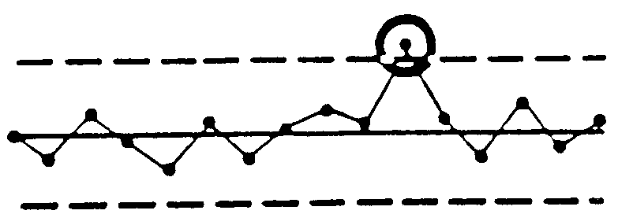
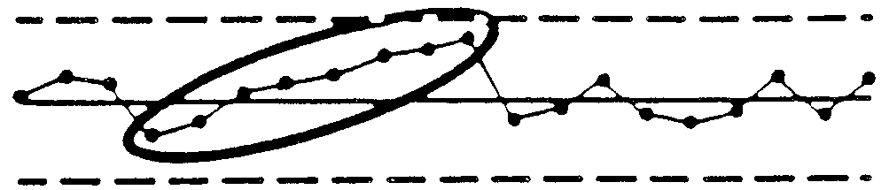
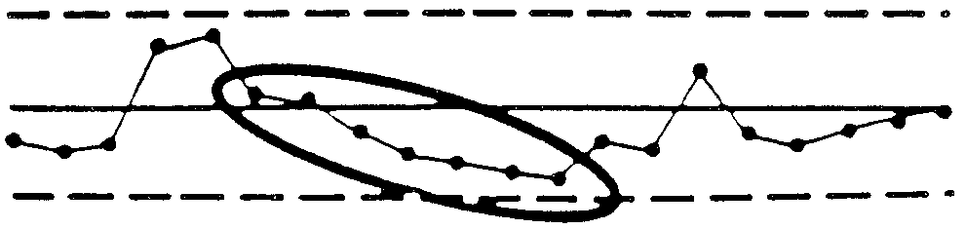
Interpreting Control Charts
Points Outside of Limits
Upper Control Limit
Average
Lower Control Limit
Trends
A Run of 7 intervals up or down is a sign of an out of control trend.

Slide 134
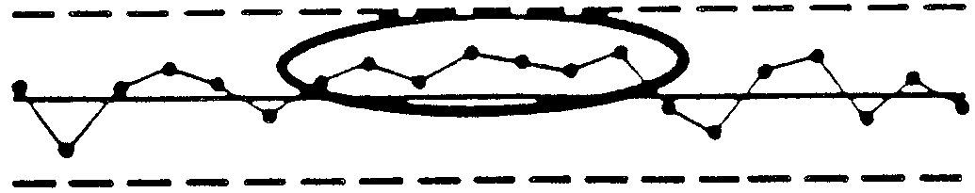
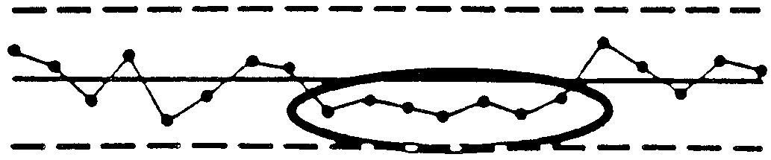
Interpreting Control Charts
Run Of 7 ABOVE the Line
A Run of 7 successive points above or below the center line is an out of control condition.
Run Of 7 BELOW the line

Slide 135
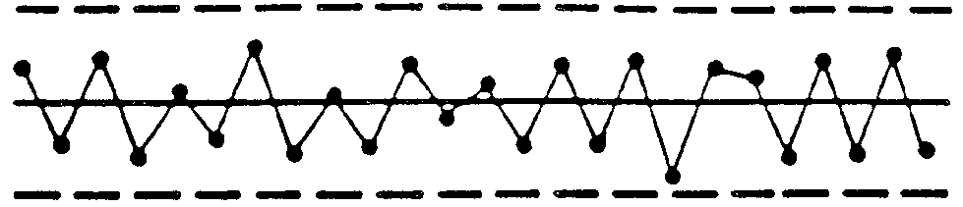
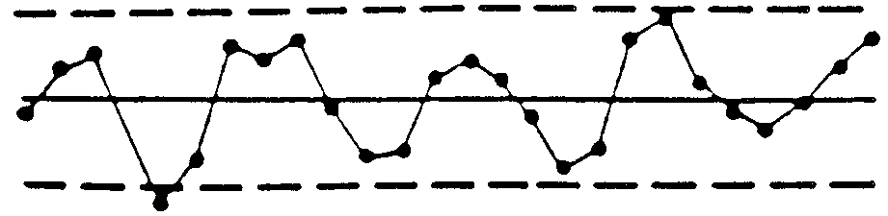
Interpreting Control Charts
Systematic Variables
Predictable, Repeatable Patterns
Cycles

Slide 136
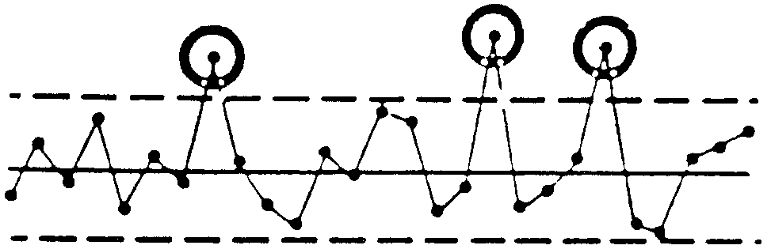
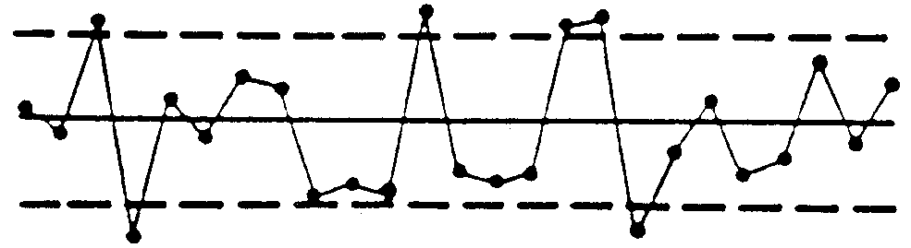
Interpreting Control Charts
Freaks
Sudden, Unpredictable
Instability
Large Fluctuations, Erratic Up and Down Movements

Slide 137
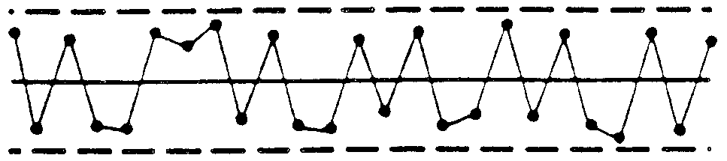
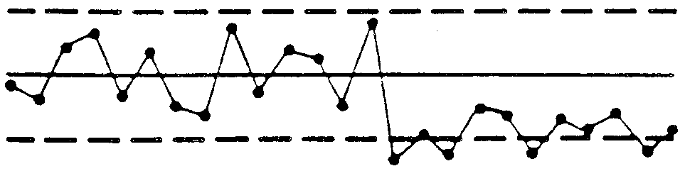
Interpreting Control Charts
Mixtures
Unusual Number of Points Near Control Limits (Different Machines?)
Sudden Shift in Level
Typically Indicates a Change in the System or Process

Slide 138
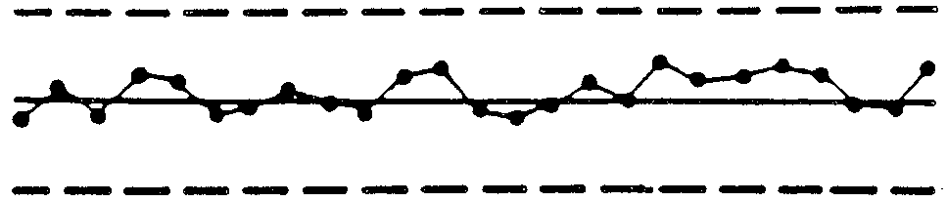
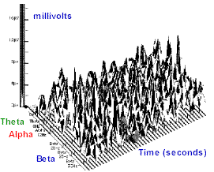
Interpreting Control Charts
Stratification
Constant, Small Fluctuations Near the Center of the Chart

Slide 139
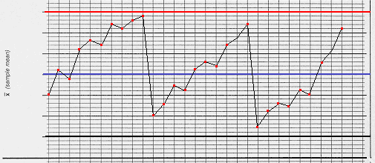
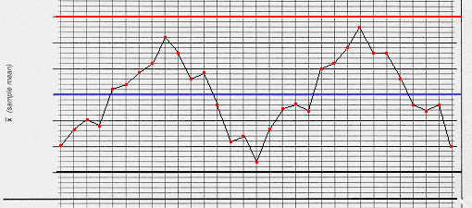
Interpreting Control Charts
Drift
Sharp Breaks. Various Possible Causes
Cyclical
Possible Environmental (Seasonal?) Fluctuations

Slide 140
Control Chart Analysis Reaction
There is a wide range of non-random patterns that require action. When the presence of a special cause is suspected, the following actions should be taken (subject to local instructions).
1. CHECK
Check that all calculations and plots have been accurately completed, including those for control limits and means. When using variable charts, check that the pair (x bar, and R bar) are consistent. When satisfied that the data is accurate, act immediately.
2. INVESTIGATE
Investigate the process operation to determine the cause.
Use tools such as:
Brainstorming
Cause and Effect
Pareto Analysis
Your investigation should cover issues such as:
The method and tools for measurement
The staff involved (to identify any training needs
Time series, such as staff changes on particular days of the week
Changes in material
Machine wear and maintenance
Mixed samples from different people or machines
Incorrect data, mistakenly or otherwise
Changes in the environment (humidity etc.)

Slide 141
Control Chart Analysis Reaction
3.ACT
Decide on appropriate action and implement it.
Identify on the control chart
The cause of the problem
The action taken
As far as possible,eliminate the possibility of the special cause happening again.
4. CONTINUE MONITORING
Plotting should continue against the existing limits
The effects of the process intervention should become visible. If not, it should be investigated.
Where control chart analysis highlights an improvement in performance, the effect should be researched in order that:
Its operation can become integral to the process
Its application can be applied to other processes where appropriate
Control limits should be recalculated when out of control periods for which special causes have been found have been eliminated from the process.
The control limits are recalculated excluding the data plotted for the out of control period. A suitable sample size is also necessary.
On completion of the recalculation, you will need to check that all plots lie within the new limits
Systematic Variables

Slide 142
Define and Verify Root Cause(s)
An investigation into all identified potential causes is necessary for effective problem solving. A cause and effects diagram can be used to brainstorm all potential causes of the described problem. The team should decide on what C&E diagram(s) is to be used: 5M, Process Flow and/or stratification. The more detailed the C&E diagram, the higher the chances the root cause will be included on the C&E diagram. An effective C&E diagram will include input from all team members and will be discussed in detail.
Any existing data should be reviewed for clues to potential causes. Further data collection may be required to investigate additional causes.
If the problem has not previously been seen, a timeline analysis should provide significant data. The timeline will identify events occurring about the time the problem developed. If enough documentation is available, potential causes can be further identified. For example, if a new operator was put on a process or if a new supplier began supplying parts. Investigation into the events occurring at the same time the problem was discovered could lead to several important potential causes.
“What Changed?” “When?” are important questions.

Slide 143
Define and Verify Root Cause(s)
A technique used extensively in analytical problem solving is a comparison analysis. This analysis looks at what ‘is’ and what ‘is not’ in the problem description.
Potential causes can be discovered by conducting a survey. By surveying the customer who has witnessed the problem, more potential causes can be highlighted.
Asking ‘Why’ repeatedly is effective in driving the process toward root cause and generating more complete understanding of the cause and effect.

Slide 144
Define and Verify Root Cause(s)
Once the problem has been described and the potential causes identified, the team should be evaluated. Are the right members on the team to investigate the potential causes? Are technical advisors required to assist in any special studies? Do new team members need to be added? Is the authority to pursue the analysis of the potential causes well defined? All these questions must be answered to ensure the team will be successful in investigating the potential causes and determining the root cause.
The cause and effect diagram is used to identify the potential causes to be investigated. What is the probability that a potential cause could be responsible for the problem? Identify all potential causes that could have been present and may have caused the problem.
Once all potential causes have been agreed upon, choose several potential causes to investigate. If only one potential cause is investigated, a lot of time may be lost if that potential cause proves not to be the culprit. To expedite a solution, investigate several potential causes at the same time (Parallel actions on several potential causes).

Slide 145
Define and Verify Root Cause(s)
If the problem is a manufacturing process, begin to establish a stable process. Once the process is stable, definition of the potential cause will be clarified.
If design causes are identified, screening experiments may help identify the key variables which are affected by subsequent processes. Design changes may be appropriate.
Four or five potential causes should be identified to investigate. Identifying several potential causes forces the team to address multiple possibilities rather than searching endlessly for a single cause. An implicit part of problem analysis is investigating potential causes in parallel rather that in series.
Problem Solution
Discovery of Root Cause
Potential
Cause 1
Potential
Cause 3
Potential
Cause 2

Slide 146
Hypothesis Generation
Data
Collection
Design
Preparation
Analysis
Interpretation
Collect Data
To determine importance of potential causes.

Slide 147
Six Steps Of Investigation
State how the potential cause could have resulted in the described problem.
Establish what type of data can most easily prove or disprove the potential cause. Develop a plan on how the study will be conducted. Identify the actions on an action plan.
Prepare the required materials to conduct the study. Training may also be required.
Collect the required data.
Analyze the data. Use simple statistical tools emphasizing graphical illustrations of the data.
State conclusions. Outline conclusions from the study. Does the data establish the potential cause as being the reason for the problem?

Slide 148
Define and Verify Root Cause(s)
After the cause and effect diagram has been completed, data needs to be collected to determine which potential causes are important. Pareto diagrams and check sheets are very effective in establishing the importance of the potential causes.
Many folks are under the mistaken belief that data oriented problem solving can be accomplished by collecting data on a problem, analyzing the results and deciding the correct solution. Once data is collected and analyzed, new questions often arise so another data collection and analysis iteration is necessary. In addition, many problems can have more than 1 root cause. Data collected investigating one potential cause may not address other important potential causes. Thus, several potential causes need to be studied using the data collection and analysis process.
Iteration 1
Design
Preparation
Data
Collection
Analysis
Interpretation
New Question
Iteration 2
Design
Preparation
Data
Collection
Analysis
Interpretation

Slide 149
Define and Verify Root Cause(s)
Once the data has been collected and analyzed, new potential causes often surface. These potential causes should be pursued as soon as possible since they are suggested by the data.
The data collection for this step in the problem solving process can be as simple as check sheets or as sophisticated as design of experiments. The data analysis can rely heavily on simple graphical techniques such as histograms, pareto charts, control charts, stem-and-leaf and dot plots. By using graphical tools, quick comprehension by all participants as well as accurately communicated information will result. Comparison plots and stratified graphs are helpful in assessing stratification factors. To evaluate the relationship between characteristics, a scatter plot would be an effective tool.

Slide 150
Identify Alternate Solutions
Generate a Cause & Effects diagram.
Survey the customer.
Identify similar problem(s) previously solved.
Avoid implementing the interim actions for permanent actions /solutions.
Consider new and current technology for the solution.
Incorporate the solution into future products.

Slide 151
Define and Verify Root Cause(s)
After the root causes of a problem are identified, investigate methods to fix the problem. Evaluate several approaches to solve the problem. A thorough analysis of different approaches to eliminate a root cause is a critical part of the problem solving process.
The first approach to generate alternate solutions is to develop a cause and effect diagram. The team should brainstorm solutions. One alternative is to redesign the part or the manufacturing process. This approach should eliminate an opportunity for a problem to recur.
Communicate closely with the customer. How the root cause is eliminated might impact the customer in some unforeseen way. Customers should have a chance to input their needs into the problem solution.

Slide 152
Define and Verify Root Cause(s)
If similar problems have been previously identified and solved, assess those solutions. As part of every investigation, identify similarly engineered parts or plant processes that may have experienced this problem. Again, these could be a source of alternative solutions.
Avoid ‘band-aid’ fixes - this will help prevent future recurrence of the problem. Sometimes due to cost and/or product life a compromise is to implement interim actions permanently. However, this is considered the least acceptable solution.
As part of investigating problem solutions, the team should look at new and current technology around an engineered part and/or the manufacturing process. New alternatives could come from advances in these areas. In some cases a thorough understanding of the current design and/or manufacturing processes produce efficient solutions. The team should remember that the solution needs to be incorporated in future products.

Slide 153
Define and Verify Root Cause(s)
Construct / Review Process Flow
Consider All Variation Sources
Collect The Appropriate Data / Information
Analyze Data
Determine Critical Differences Between
Problem/Non-Problem Areas
(Critical Analysis)
Does The Data Identify The
Potential Cause As A Root Cause?
Develop A Cause & Effects Diagram
To Identify All Potential Causes
Identify Alternate Solutions
Establish An Analysis Time Line
Implement The Solution(s)
On A Prototype Basis
List Potential Causes
Is The Problem Level Reduced?
Analyze Potential Causes
For Most Likely Root Cause
Is The Problem Eliminated?
Determine What Data Would Identify
The Potential Cause As A Root Cause

Slide 154
Identify Potential Causes - Cause & Effects Diagram
Define the ‘effects’ for cause and effect diagram(s).
Prepare a 5M, Process or Stratification cause & effects diagram for each effect (you may want to use a combination).
Team members should each assume their activity causes the problem and ask themselves “How could what I do possibly generate the problem?”
Prepare a time line analysis if the problem was not always present. Identify what changed when.
Perform a comparison analysis to determine if the same or a similar problem existed in related products or processes. Identify past solutions and root causes which may be appropriate for the current problem.
Identify the top few potential causes. Develop a plan for investigating each cause and update the action plan.
Evaluate a potential cause against the problem description. Does a mechanism exist so that the potential cause could result in the problem?

Slide 155
Analyze Potential Causes - Validate Root Cause
Analyze Potential Causes
Use the iterative process to analyze each potential cause.
  Hypothesis generation: How does the potential cause result in the problem?
  Design: What type of data can most easily prove/disprove the hypothesis?
  Preparation: Obtain materials and prepare a check list.
  Data Collection: Collect the data.
  Analysis: Use simple, graphical methods to display data.
  Interpretation: Is the hypothesis true?
Investigate several potential causes independently.
Use an action plan to manage the analysis process for each potential cause being studied.
Validate Root Causes
Clearly state root cause(s) and identify data which suggests a conclusion.
Verify root cause factors are present in the product and/or process.
Conduct with / without study to verify root cause. Can you generate the problem?

Slide 156
Potential Causes - Some Questions
Have you identified all sources of variation on the flow diagram?
Have all sources of information been used to define the cause of the problem?
Do you have the physical evidence of the problem?
Can you establish a relationship between the problem and the process?
Do you continually challenge the potential root causes with the question ‘why’ followed with ‘because’ to construct alternatives?
What are the is / is not distinctions?
Is this a unique situation or is the likely problem similar to a past experience?
Has a comparison analysis been completed to determine if the same or similar problem existed in related products?
What are the experiences of recent actions that may be related to this problem?
Why might this have occurred?
Why haven’t we experienced this problem before?

Slide 157
Analyze What Has Changed
Manufacturing
  New supplier(s)?
  New tool(s)?
  New operator(s)?
  Process change(s)?
  Measurement system?
  Raw material(s)?
  Vendor supplied part(s)?
  Do other plants have a similar problem?
Engineering
  Any pattern to the problem?
  Geographically?
  Time of year?
  Build date(s)?
  Did the problem exist at program sign-off?
  Was it conditionally signed off?
  Did the problem exist during pre-production prototypes, functionals?

Slide 158
Data and Root Causes
What data is available to indicate changes in the process?
Does data exist to document the customer’s problem?
If the potential cause is the root cause, how does it explain all we know about the problem?
What is the likelihood that each potential cause could explain the described problem?
What is the concern that the potential cause is actually occurring?
What actions have been taken to the potential causes to assure their presence?

Slide 159
Product - Process Assumptions
Assumptions:
  Features
  Design
  Process concepts
  Technical innovations
  Advanced materials
  Reliability assessments
  New technology
Document assumptions as part of project plan
Utilize as inputs to plan
Consider alternate paths in case assumptions do not play out

Slide 160
Errors 1
Almost all errors are caused by human error.
Forgetfulness - Sometimes we forget things when we are not concentrating. Example: A person forgets to set his/her alarm clock at night. Safeguard: Establish a routine which includes checking before going to bed.
Errors due to misunderstanding - Sometimes we make mistakes when we jump to the wrong conclusion before we’re familiar with the situation. Example: A person used to a stick shift pushes the brake petal in an automatic thinking it is the clutch. Safeguards: Training, checking in advance, standardizing work procedures.
Errors in identification - Sometimes we misjudge a situation because we view it too quickly or are too far away to se it clearly. For example, a $1 bill is mistaken for a $10 bill. Safeguards: Training, attentiveness, vigilance.

Slide 161
Errors 2
Errors made by amateurs - Sometimes we make mistakes through lack of experience. Example: A new worker does not know the operation or is just barely familiar with it. Safeguards: Training, skill building, work standardization.
Willful errors - Sometimes errors occur when we decide that we can ignore the rules under certain circumstances. Example: Crossing a street against a red light because we see no cars. Safeguards: Basic education, experience.
Inadvertent errors - Sometimes we are ‘absent minded’ and make mistakes without knowing how they happened. Example: Someone lost in thought tries to cross the street without even noticing whether the light is red or not. Safeguards: Attentiveness, discipline, work standardization.
Errors due to slowness - Sometimes we make mistakes when our actions are slowed down by delays in judgment. Example: A person learning to drive is slow to step on the brake. Safeguards: Skill building, work standardization.

Slide 162
Errors 3
Errors due to lack of standards - Some errors occur when there are not suitable instructions or work standards. Example: A measurement may be left to an individual’s discretion. Safeguards: Work standardization, work instructions.
Surprise errors - Errors sometimes occur when equipment runs differently than expected. Example: A Machine malfunction without warning. Safeguards: Total Productive Maintenance, work standardization.
Intentional errors - Some people make mistakes deliberately. Crimes and sabotage are examples. Safeguards: Fundamental education, discipline.
Mistakes happen for many reasons, but almost all can be prevented if we take time to identify when and why they happen and then take steps to prevent them by using Poka-Yoke methods with consideration to other available safeguards.

Slide 163
Process Failure Causes
1. Omitted processing
2. Processing errors
3. Errors setting up work pieces
4. Missing parts
5. Wrong parts
6. Processing wrong work piece
7. Mis-operation
8. Adjustment error
9. Equipment not set up properly
10. Tools and/or fixtures improperly prepared
11. Poor control procedures
12. Improper equipment maintenance
13. Bad recipe
14. Fatigue
15. Lack of Safety
16. Hardware failure
17. Failure to enforce controls
18. Environment
19. Stress connections
20. Poor FMEA(s).

Slide 164
Process Control Examples
1. Standardized work instructions/procedures
2. Fixtures and jigs
3. Mechanical interference interfaces
4. Mechanical counters
5. Mechanical sensors
6. Electrical/Electronic sensors
7. Job sheets or Process packages
8. Bar coding with software integration and control
9. Marking
10. Training and related educational safeguards
11. Visual Checks
12. Gage studies
13. Preventive maintenance
14. Automation (Real Time Control)
Controls can be process controls such as fixture fool-proofing or SPC, or can be post-process inspection / testing.
Inspection / testing may occur at the subject operation or at subsequent operation(s) that can detect the subject failure mode.

Slide 165
The Poka-Yoke System
      Is Zero Defects a Reality?

Slide 166
We have Quality Problems!
In American manufacturing, this statement leads to an unsatisfactory resolution to the problem. “We have Quality Problems” shifts the concerns from the undetermined true source (operation & process) to an area where the root cause never occurred (Quality Control) and the true cause is addressed and corrected through high cost inspection methods.
Notes:
It has been my experience that...
When difficulties in product arise, Quality Control usually finds it, analyses it, and reports the results to management. This process is fine, it is Quality’s Job to do this. What ends up happening in some situations is Quality ends up owning the Problem. The use of Statistics helps to keep the Problem alive.
Although SPC is a good tool for identifying problems it does very little to prevent them from happening. We see week after week of process and product monitoring with small improvements being made but not major jumps. What could be missing?
What we see happening is a Fire. Quality confirms the fire, monitors its progress and everyone tries to put out the fires. Juran termed this sporadic problem solving. we use containment practices, but what truly ends up happening, is we all stand around and watch it burn.

Slide 167
We Have a Quality Problem!
If we review the manufacturing structure and the functioning elements to which the product is going to be exposed to, we will be able to determine possible root causes to the problems prior to production. This is known as Quality Planning and if done properly can eliminate the need for the Quality Control.
(Man, Material, Machine, Method, or Measurement)
Notes:
This is more in line with what Juran termed Chronic Problem Solving. We need to change the present situation and use a team approach. Quality is not the means to the end, it is simply a point in the process. To find the real problem, we need the Process and Operation Experts, we must look at the whole manufacturing structure and develop a team focus.

Slide 168
Section One
Shingo And The Manufacturing Structure

Slide 169
Poka Yoke Defined
Shigeo Shingo defines Poka Yoke as:
Poka
  “Inadvertent Mistake That Anyone Can Make”
Yoke
  “To Prevent or Proof”
Notes:
Shigeo Shingo, a Japanese Industrial Engineer, contributed many concepts to modern Management and Manufacturing practices. Some of these included the creation of:
Zero Quality Control “Shipping No defects”
Sequence Inspection “Checking previous work, Prior to starting your task”
Source Inspection “Checking ones own work”
Poka Yoke “Mistake Proofing”
SMED (Single Minute Exchanges of Dies)
Although he did not create the concepts of Sequence and Source Inspection, Shingo developed a structure of knowing which to use when.

Slide 170
Process vs. Operation
Manufacturing is a network of two structures. Problems Occur When They Disagree!
Process
Operation
Notes:
To obtain the proper base of Shingo’s work, we must adopt the Japanese mind set of manufacturing which differs (Thank GOD) from Frederick W. Taylor.
Japanese view manufacturing as a network consisting of two interrelated structures.
The Process Structure: the flow by which raw materials are converted into finished goods. Within the process structure, there are four categories to which a process goes through.
The Operation Structure: the actions performed on materials. Three categories can be occurring within the operation structure. Preparation and After Preparation adjustments, Principal Operations, Marginal Allowances.

Slide 171
Operation & Process
Operation
Some People Know How to Drive a Car! Driving is an Operation.
Process
Some People Know How to Repair a Car! Repairing is a Process.
Notes:
Most People Know How to Drive a Car!
Abilities and Tasks differs:
Race car driver
Truck Driver
Sunday Driver
Abilities and Task Differ:
Designers
Repairers
Builders

Slide 172
Categories of the Process Function
A Process is the flow by which raw materials are converted into finished goods.
Processes fall into one of the following categories:
  Work: Assembly, disassembly, alter shape or quality
  Inspection: Comparison with a standard
  Transportation: A change of location
  Delay: Time during which no work, transportation or inspection takes place
    Process Delays :Lot does not move until last item finished in process
    Lot Delays: lot delayed in order to maintain 100, 99, 98 ... 2,1,0

Slide 173
Categories of the Operation Function
An Operation is an action performed on material within the process.
Operations fall into one of the following categories:
  Preparation/Adjustments Phase:(setup, tool change, adjustments)
  Principal Operations Phase: Operations repeated in each cycle (hole punch, drill, sheer)
    Main Operations (stamping, cutting)
    Incidental Operations (movement of press, movement of people)
  Marginal Allowances:
    Fatigue
    Hygiene (wash hands, etc.)
    Operations (shut-down to produce rush order, meetings)
    Work place (breaks, cleaning, maintenance)

Slide 174
5 Elements of Production
Why?
Objects
of
Production
Agents
of
Production
Method
What?
Who?
Space
Time
How?
Where?
When?
Notes:
Objects of Production: The Product
Materials, Semifinished & Finished Goods
Agents of Production: The people in charge of Product, The Machines, Tools, and other equipment assisting them.
Man, Machines, Tools, Jigs, Gagging
Methods: Means by which actions are performed
Work Instructions, Procedures, Manuals
Space: Where actions are performed and the locations to and from which objects are transported.
Processing system, Balanced Load and Capacity, Processing Condition
Time: The timing of work or how long action take.
Time and Timing

Slide 175
Defining The 5 Elements
Objects of Production: Materials: Raw, Finished, Semi-finished, In-process
Agents of Production: People, Machines, Tools, Jigs, Machine Tools, Incidental Devices, Inspection Equipment, The Environment, etc.
Methods: Processing System, Load & Capacity Balance, Processing Conditions
Space: Left to Right, Front to Back, Top to Bottom
Time: Process Time, Production Time, Task Time

Slide 176
Changes in the Elements
When Changes Occur, Balance Must be Achieved Again
When a change occurs in the Objects of Production:
Methods or the means of action may change (How)
Space or size and location may change (Where)
Time (overall start to finish) or Timing (task start to finish) may change (When)
When Changes Occur
When a change occurs in the Agents of Production:

Slide 177
4 Process Phenomena's
Delays

Slide 178
Shigeo Shingo’s Five Questions
A Problem (or Delay) Occurs ask
Why? Describe.
Why? Describe.
Why? Describe.
Why? Describe.
Why? Response!
Notes:
Shigeo Shingo
Mr. Shingo distinguished himself as one of the world's leading experts in improving manufacturing processes. He has been described as an "engineering genius" who assisted in the creation of, and wrote about, many of the features of the revolutionary just-in-time manufacturing methods, systems, and processes which make up the renowned Toyota Production System and related production systems.
The Shingo Prize is named for the Japanese industrial engineer, Shigeo Shingo. His greatness was in his ability to understand exactly why products are manufactured the way they are, and then transform that understanding into a workable system for low-cost, high-quality production. Mr. Shingo died peacefully November 14, 1990 at the age of 81.

Slide 179
Section Two
Is There a Difference Between An Error and a Defect?

Slide 180
Reasons Why We Don’t Need Poka Yoke
Workers Possess Divine Infallibility
Implementation Costs are High
The World is not a Dynamic Environment
It is Cheaper to Hirer Sorters
Quality Control & Production Would Have Nothing To Do
We are All Too Busy
We use SPC for Improvements

Slide 181
Separating Error From Defect
Humans Make Errors (Cause), Defects Arise Because Errors Are Made (Effect).
It is Impossible to Eliminate Errors From Tasks Performed by Humans.
Errors Will Not Turn into Defects if Feedback and Action Takes Place at The Error Stage.
Changing Occurrences can reduce Reoccurrence
Notes:
Humans make errors (Cause), defects arise because errors are made (Effect).
It isiImpossible to eliminate defects from tasks performed by humans.
Yet errors will not turn into defects if feedback and action takes place at the error stage.
The difference between Occurrence and Reoccurrence
The Paint Story “What Did You Learn”
The Hammer Story “ Hurts More The Second Time”
My Brother & His Stuck Car
The Paint Bucket was an Occurrence, I bring the Paint Can Down with me.
The Hammer is an on going Reoccurrence, I need to buy an Automatic Nail Gun.
My Brother is another story.

Slide 182
Causes of Defects
Process Defects
  Process Failure
    Operational or Procedure Failures
  Process Error
    Incorrect or Imprecise
Product Defects
  Incomplete Product
  Substandard Product

Slide 183
Levels of Defects
Level 1: Defects Shipped out of Factory (Taylor Methods)
Level 2: Defects Kept within Factory (Sheward Methods)
Level 3: Defects Reduced (Juran/Demming Methods)
Level 4: Defects Kept within Production Stage (Juran/Demming Methods)
Level 5: Defects Not Produced (Shingo Methods)

Slide 184
Section Three
Inspection
Taylor’s Plan
Shewhart, Demming & Juran’s Plan
Shingo’s Plan

Slide 185
Inspection Philosophies
Kaizen
Continuous Improvement
}Shewart
}Taylor
Sporadic Problem
Solving Methods
(Judgment Inspection)
}3 Wise Men
Chronic Problem
Solving Methods
(Informative Inspection)
}Shingo
Zero Defect
(Source Inspection &)
(Poka Yoke Introduced)
Time

Slide 186
3 Methods of Inspection
Judgment Inspection (Taylor’s)
  Inspection That Discovers Defects
Informative Inspection (Shewhart’s)
  Inspection That Reduces Defects
Source Inspection (Shingo’s)
  Inspection That Eliminates Defects

Slide 187
Judgment Inspection
Attribute Inspection of Product Which Discovers Defects at the End of the Process
  Rework Costs
  Process Costs of Nonconformaties
  Scrap Costs
  No Information about Process
Process 1
Defects found at the end of Process
Process 2
Inspection
Good
Bad

Slide 188
SPC Inspection
Inspection of Product Which Reduces Defects at the End of Process Using Inner Process Checks
  Inspection Costs
  Delay Costs
  Extra Equipment Costs
  Scrap Cost Reduced
  Information (Grading or Variable Data) Gained about Process
Process 1
Process 2
Inspection

Slide 189
Source & Sequential Inspection
Inspection Built into the Operation using Poka Yoke Devices to Detect Errors Before They Become Defects
  Pushes Defect Detection Up-front. Cost Reduced
  Nonconforming Materials are not processed.
  Eliminates need for SPC
  Minimal Cost of Poka Yoke Devices
  Reduces Steps in Process
Process 1
Process 2
Defects
Poka Inc..

Slide 190
Section Four
Efficiency & Waste

Slide 191
Production Efficiency & Waste
Melody
  Flow Production
Rhythm
  Tack Time (Level Production)
Harmony
  Standard Operation Man, Machine, Material, Method, Measurement
Any Element Missing or Incomplete: We Have Noise.
(Waste)

Slide 192
Types of Waste
Stock Inefficiency
Excess Stock Parts & Materials
Transportation Inefficiencies
Inefficient worker movement
inefficient results from looking for things
Selection inefficient
Defective production

Slide 193
Cost Contributing to Waste
Materials
Processing
Depreciation
Repairs
Transportation
Recalls
Replacement
Advertising

Slide 194
Section 5
Shingo’s Method

Slide 195
Shingo’s Method
A Poka Yoke System uses Poka Yoke Devices Built into Source or Sequential Inspection Methods.
Properly Implemented, the System Can Achieve:
  Zero Defects
  Zero Waste
  Zero Delays

Slide 196
Poka Yoke Devices, Systems & Inspection
Poka Yoke Systems
Control Systems
  Halt the operations, and require feedback and action before process can resume.
Warning Systems
  Uses signals to warn the operator that the operations needs feedback and action
SQC systems have fairly long periods of time between check stages and feedback execution

Slide 197
Poka Yoke Devices, Systems & Inspection
        Poka Yoke Devices
Are Built within the Process
In General Have Low Cost
Have the Capacity for 100% Inspection
Remember SQC is performed outside the process which adds cost and allows defects to escape the system.

Slide 198
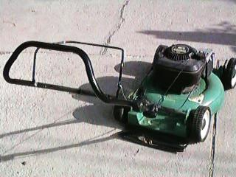

Every Day Examples
Computer Files
Microsoft: File type identified by file name suffix. If one does not add the correct suffix, the program the file is from will not recognize it.
Macintosh Poka Yoke (1984): File type and creator application are identified and embedded in the first part of every file. File name plays NO part in recognition by the originating program.
Computer Floppy Drives
Microsoft: Disk must be inserted and ejected by hand. It is possible to eject a disk while it is being written to.
Macintosh Poka Yoke (1984): Disk drive grabs disk as it is being inserted and draws it in and seats it. Disk cannot be manually ejected. You must drag the ‘desktop’ icon for the disk to the ‘Trash’. The drive then ejects the disk as long as there are no disk operations taking place.
Warning lights alert the driver of potential problems. These devices employ a warning method instead of a control method.
New lawn mowers are required to have a safety bar on the handle that must be pulled back in order to start the engine. If you let go of the safety bar, the mower blade stops in 3 seconds or less. This is an adaptation of the "dead man switch" from railroad locomotives.

Slide 199
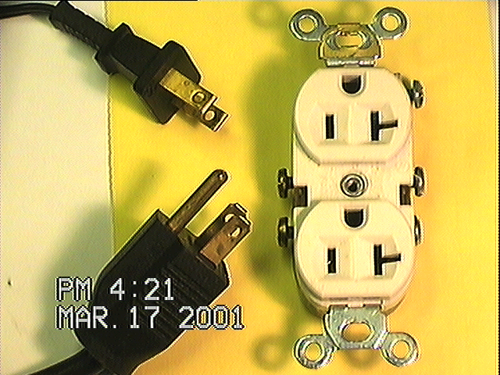
Electrical Polarity Poka Yokes
Interference Fit
Poka Yoke
Orientation
Poka Yoke

Slide 200
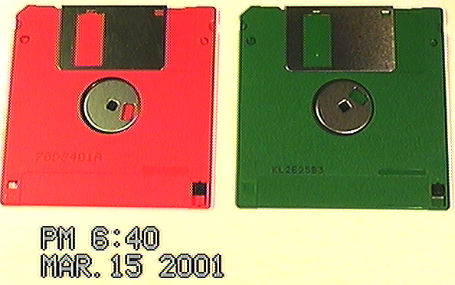
Floppy Disk Poke-Yokes
Floppy disks have many poka-yokes built in. One example is you cannot insert the disk into the drive completely if the disk is upside down. This is because of the corner notch [#1].
720k disks have no hole [#2] while HD disks have hole (mechanism senses)[#3].
1
Spring loaded shutter mechanism - Do you remember the old 5.25 inch floppies from the early to mid-1980’s? Failsafe disk surface protection [#4].
Slide Tab to protect against erasure. Mechanism senses [#5].
1
4
4
6
6
6
3
5
2
5
‘Precision’ alignment. Disk alignment holes and notches [#6] ensure the disk is properly aligned and also provides a ‘focus’ area for manufacturing.

Slide 201
Poka Yoke Devices, Systems & Inspection
Inspection with Poka Yoke
Source Inspection (ZQC)
  Built into process
  Leads to a zero defect Systems
Self Check Informative Inspections (SQC)
  Built inside or outside immediate process
  Reduces defects to a minimum
Successive Check Informative Inspection (SQC)
  Built inside or outside sequential process
  Reduces defects to a minimum

Slide 202
Section 6
Tools For Assessment

Slide 203
Organizing Systems for Zero Defects
+
+
+
People
Materials
Methods
?
=
+
Machines
Information

Slide 204
Questions to Ask About Present Systems
Can we take current informative inspection systems with successive checks and improve them to get a system of informative inspections with self-check methods?
Can we take current informative inspections with self-check methods and improve them to get source inspection?
Since informative inspections tolerate the occurrence of defects, can we take these methods and improve them to get source inspection in which the errors that cause defects are detected and prevented from turning into defects.

Slide 205
D5
Choose, Implement & Verify Corrective Actions

Slide 206
The 8-D System
Awareness
of Problem
4.
Identify
Potential
Cause(s)
5.
Choose / Verify
Corrective Actions
1.
Use Team
Approach
Select Likely
Causes
Implement
Permanent
Corrective Actions
6.
Describe
the Problem
Is the Potential Cause a Root Cause?
2.
Prevent
Recurrence
No
7.
Implement and
Verify Interim
(Containment)
Action(s)
Yes
Congratulate
Your Team
3.
8.
Identify Possible
Solutions

Slide 207
Choose, Implement & Verify CA Objective
Through pre-production test programs quantitatively confirm that the selected corrective actions will resolve the problem for the customer, and will not cause any undesirable side effects.
Define contingency actions, if necessary, based upon Risk Assessment.

Slide 208
Choose, Implement & Verify Corrective Actions
By far the most critical step in the problem-solving process is to verify that the solution will in fact eliminate the problem. In addition, it is often the most difficult step. The most common method to evaluate a problem solution is to wait for implementation of the solution, then see if the problem goes away. However, too much time may be lost before conclusive information is available. Verification, where ever possible, should come before implementation.
Several approaches to verification are available. In engineering, design verification and production validation testing provides significant information. In the short term, a bench/lab test can be used to verify. In some cases dynamometer testing can provide verification. Long term one can monitor fleet response. For manufacturing, verification is by in-plant indicators. SPC can verify the elimination of the problem. Sometimes scrap rate reports and conformance audits provide information. Sometimes a designed experiment is part of verification.

Slide 209
Choose, Implement & Verify Corrective Actions
Whatever verifications you choose, a detailed verification / action plan is required to outline who will be taking what actions by when. The action plan should show what data or statistics will be collected and analyzed, who is responsible and must track actual progress and scheduled completion. The action plan is the detailed Dynamic record of all phases of the problem solving process.
Good problem solution verifies the customer is satisfied with the solution. If possible, involve the customer in choosing solutions.
All verification of the problem solution will require decision analysis. Decision analysis is part of the cost and timing consideration of the solution. Decisions affecting cost must include effects on quality, future problem recurrence and complete elimination of the problem. In addition, management and operating procedures may be involved when choosing the solution. Evaluation of any adverse effects caused by the solution are important. The FMEA will most surely be affected.

Slide 210
Choose, Implement & Verify Corrective Actions
Choose Indicators
Record Baseline Data
Alternate
Solution(s)
Define Customer
Issues
Implement Corrective
Actions using Pre-Production
Test Program
No
No
Problem Solved
& Verified?
Does Customer
Agree?
Record Verification
Data
Yes
Close Out Nonconformance
Record

Slide 211
Choose, Implement & Verify Corrective Actions
Verified Root Cause
Establish Givens / Wants for
Corrective Action (Poke Yoke)
Brainstorm Alternate Corrective Actions
Select Best Choice
Consider Risks Involved
In Selected Action
Verify Corrective Action
Before: After:
Elimination of Root Cause

Slide 212
Choose, Implement & Verify Corrective Actions
Run Pilot Tests
Artificially simulate the solution to allow actual process or field variation.
Field test the solution using pilot customer groups.
Verify carefully that another problem is not generated by the solution.
Monitor Results
Quantify changes in key indicators.
Stress the customer / user evaluation.

Slide 213
Confirmation Questions
Can you list and measure all of the indicators related to the problem?
Which of the indicators are most directly related to the problem? Can you use the indicators to measure problem severity?
Can you determine how often or at what intervals to measure the problem (hourly, shift, daily, weekly, monthly)?
If there are no changes to the indicators after taking action, can you determine what to do? Will you need to take cause, action and verification measures?
Do all indicators reflect conclusive resolution?
Has the team prioritized the customer / user evaluation after implementation?
What scientific methods are being used to verify effectiveness in the short term and to predict the outcome long term?

Slide 214
Verification Questions
Has the customer been contacted to determine a date when verification will be evaluated?
What data has been established for follow-up?
Has a time-line (project) chart been completed?
Have field tests been conducted using pilot customer groups?
Have dates been established when verification of effectiveness will be evaluated?

Slide 215
Corrective Actions Check List

Slide 216
D6
Implement Permanent Corrective Actions

Slide 217
The 8-D System
Awareness
of Problem
4.
Identify
Potential
Cause(s)
5.
Choose / Verify
Corrective Actions
1.
Use Team
Approach
Select Likely
Causes
Implement
Permanent
Corrective Actions
6.
Describe
the Problem
Is the Potential Cause a Root Cause?
2.
Prevent
Recurrence
No
7.
Implement and
Verify Interim
(Containment)
Action(s)
Yes
Congratulate
Your Team
3.
8.
Identify Possible
Solutions

Slide 218
Implement Permanent CA Objective
Objective
Define and implement the best permanent corrective actions. Choose on-going controls to ensure the root cause is eliminated. Once in production, monitor the long-term effects and implement contingency actions, if necessary.
Identify Alternative Solutions
Evaluate how other groups solved similar problems.
Use brainstorming to generate Alternate Solution C&E diagram.
Consider redesign of the part or process to eliminate the problem.
Anticipate failure of the solution. Develop contingency action(s).
Implement Solution
Use an action plan approach to implement the solution.
Test and verify contingency actions, if possible.

Slide 219
Implement Permanent Corrective Actions
Define and implement the ‘appropriate’ corrective action(s).
Choose on-going controls to ensure the root cause is eliminated.
Once in production, monitor the long term effects and implement contingency actions (if necessary).

Slide 220
Implement Permanent Corrective Actions
Once the root cause(s) have been identified, the team establishes an action plan on the permanent actions to be taken. Again, the action plan includes who will do what by when. The permanent actions are implemented to solve the problem. The question “Why did this occur?” must be answered.
Establish ongoing controls on the process to ensure the process remains in control. Once the permanent corrective actions are in place, the ongoing controls will verify the effects of the actions.
To forecast reduction of the problem, indicators such as scrap reports, etc., can be used. A statistical plan will verify the effectiveness of the actions. A systematic approach involves a plan to establish the facts using data or evidence as a requirement for making decisions. Data is obtained by investigations and experiments to test assumptions. These assumptions are identified by translating the customer concerns into understandable definitions of what the problem is and relating these definitions of the problem to product and processes. These definitions and data are used to verify solutions.

Slide 221
Implement Permanent Corrective Actions
Once permanent solutions are in place, document the changes. In addition, all customers need to be informed about what actions were taken. In most cases, some type of training is required to institute permanent corrective actions. Training may be required to implement a product design or process change. In addition, implementation of the permanent actions may need to include the effect on design or process issues. In manufacturing, maintenance personnel often need to be informed of the changes.
Another important part is to correct the obvious. This includes correcting defective parts already produced, changing product design, changing tooling, reworking defective machines and/or equipment, revising ineffective operating systems or working with and/or replacing suppliers.
Contingency actions should be identified if for some reason the permanent actions cannot be implemented. For example, in manufacturing a recommendation to single source a part may be recommended. But, if one vendor is unable to meet the increased productivity alternate action is necessary. Contingency actions based upon risk assessment are essential to the success of permanent corrective actions for customer protection and problem solution.

Slide 222
Implement Permanent Corrective Actions Flow
Establish implementation action plan with actions,
responsibilities, timing and required support.
Identify contingency actions.
Identify alternate solutions
Implement permanent
corrective actions
Remove interim actions
Establish on-going controls to ensure
the permanent action is verified.

Slide 223
Implement Permanent Corrective Actions Flow
Selected
Corrective Action
Construct Corrective Action
Implementation Plan
Review / Revise Design
& Process FMEA
Revise: QOS (FORD)
Advanced Quality Planning
Current Model Engineering Change
Identify Significant, Safety & Critical
Characteristics for Design
and Manufacturing Process
Develop or Revise Control Plans & Process
Sheets to Monitor Manufacturing Process
Validate for 30 days Using Variables
Data, SPC Charts / Paynter Charts
Remove Containment Action
Validate Through Paynter
Chart & Original Measure

Slide 224
Validation Evidence

Slide 225
Corrective Action Questions
Do the actions represent the best possible long-term solution from the customer’s viewpoint?
Do the actions make sense in relation to the cycle plan for the products?
Has an action plan been defined?
  Have responsibilities been assigned?
  Has timing been established?
  Has required support been defined?
  What indicators will be used to verify the outcome of the actions, both short-term and long-term?

Slide 226
Ongoing Controls - Questions
Ongoing Controls
Ensure the problem will not reoccur.
Seek to eliminate inspection-based controls.
Address 5M sources of variation.
Test the control system by simulating the problem
Questions
Have the corrective action plans been coordinated with customers?
What indicators will be used to determine the outcome of the actions?
What controls are in place to assure the permanent fix is verified as intended?

Slide 227
Forecast Outcome
Will actions permanently solve the problem? Can you try out the corrective actions on a small scale to test effectiveness?
Can scientific experiments be conducted to gain knowledge to predict the outcome of the effects of the implemented actions?
Do the permanent corrective actions require support from external sources to be effective?

Slide 228
Implement CA and Verify Over Time Check List

Slide 229
D7
Prevent Recurrence

Slide 230
The 8-D System
Awareness
of Problem
4.
Identify
Potential
Cause(s)
5.
Choose / Verify
Corrective Actions
1.
Use Team
Approach
Select Likely
Causes
Implement
Permanent
Corrective Actions
6.
Describe
the Problem
Is the Potential Cause a Root Cause?
2.
Prevent
Recurrence
No
7.
Implement and
Verify Interim
(Containment)
Action(s)
Yes
Congratulate
Your Team
3.
8.
Identify Possible
Solutions

Slide 231
Prevent Recurrence Objective
Modify those management systems, operating systems, practices and procedures to prevent recurrence of this problem and all similar problems.
Prepare a process flow diagram of the management / operating system that should have prevented the problem and all similar problems.
Make needed changes to the system. Address system follow-up responsibilities.
Standardize practices.
Use action plan to coordinate required actions.

Slide 232
Prevent Recurrence
Modify the management systems, operating systems, practices, and procedures to prevent recurrence of this and all similar problems.

Slide 233
Prevent Recurrence
This next step in the Problem-Solving Process is the seventh step. It is important to understand what in the process allowed the problem to occur. A cause-and-effect diagram can be used to outline the reasons the problem occurred. By asking “Because?” the C&E diagram can be constructed.
Another effective tool is a process flow diagram. The process flow of the manufacturing or engineering process can be effective in identifying where in the process the problem could have been prevented. To prevent recurrence of the problem, most of the time a change to the management system will be required. Managers must understand why their system allowed a problem develop. The same system will allow future problems to occur.

Slide 234
Prevent Recurrence
Management systems, practices and procedures need to be fully understood to be effective. Most of them are carry-overs from previous model years and organized structures. Some are outdated and need to be revised. Understanding the elements of a management system can be achieved by maintaining an up-to-date flow diagram of the system and process. Also, there should be easy to follow instructions for those who are part of the system.
Management systems, practices and procedures should provide management support for ‘Never ending improvement’ in all areas and activities. The system should encourage individuals to participate freely in the problem solving process. It should help to understand more about their job and how each individuals’ effort affects the outcome of the final product on customer satisfaction. The system should encourage everyone to learn something new. And it should recognize individual and team effort when these new skills are applied.

Slide 235
Prevent Recurrence
Changes in the management system can require documenting new standard procedures, streamlining to remove obsolete procedures and revising previous standards. Changes in the management system need to be communicated clearly to all customers.
To prevent recurrence additional training is often required. Training may be needed in statistical techniques and methodologies, new engineering or manufacturing technologies or disciplines, better process and/or project management.
If concerns develop regarding changes to the system, these issues will be addressed. A new team may need to be assigned with the authority to address the management system.

Slide 236
Prevent Recurrence Flow
Notify All Personnel of
the Resolution Actions
Establish A Process Flow of the
Management or Operating System
Make Changes Needed
To Prevent Recurrence
Standardize the
New Practices

Slide 237
Prevent Recurrence Questions
Have all affected personnel been notified of the resolution actions?
Has a process flow of the management system which will prevent this and similar problems in the future been prepared?
Have the practices been standardized?
Have action plans been written to coordinate actions?
Have changes been made to the appropriate systems?
Has the problem occurred due to a behavioral system?

Slide 238
Prevent System Problems Check List

Slide 239
D8
Congratulate Your Team

Slide 240
The 8-D System
Awareness
of Problem
4.
Identify
Potential
Cause(s)
5.
Choose / Verify
Corrective Actions
1.
Use Team
Approach
Select Likely
Causes
Implement
Permanent
Corrective Actions
6.
Describe
the Problem
Is the Potential Cause a Root Cause?
2.
Prevent
Recurrence
No
7.
Implement and
Verify Interim
(Containment)
Action(s)
Yes
Congratulate
Your Team
3.
8.
Identify Possible
Solutions

Slide 241
Congratulate the Team
Recognize the collective efforts
of the team.

Slide 242
Congratulate Your Team
The final step in a team oriented problem solving effort is to recognize the team’s collective efforts in solving the problem and show gratitude by applauding individual contributions. Management will need to determine the best way to recognize the team’s contribution to the origination. In addition, individual effort and talents need to be highlighted and rewarded.
Team oriented problem solving involves risk taking, some conflict, hard work and participation by everyone. It includes a free exchange of ideas,, individual talent, skill, experience and leadership. The team approach, when led effectively, produces a driving force of individuals motivated and committed to solving a specific problem.

Slide 243
Congratulate Your Team
The form of recognition can vary, depending upon the complexity and severity of the problem. It is important to document what was learned while solving the problem so that this information can be used by others for planning. A description of the various actions carried out, together with the analysis and results obtained through the problem solving process, provide information that can be used to prepare a case study report. Case study reports include the purpose and objective, the procedure or problem solving steps followed, the data obtained through various investigative methodologies and the analysis of data in the form of results shown by charts and graphs, conclusions and recommendations.
This final step in the problem solving process is to conclude the successful efforts of the team is to acknowledge the significance and value, in quantifiable terms, of solving the problem for the customer and for improving quality and productivity for the company.

Slide 244
Congratulate Your Team Flow
Determine the Appropriate Recognition
for All Active, Participating Team Members
Document and Communicate
The Efforts of The Team

Slide 245
Congratulate Your Team Objective & Questions
Objective
Recognize the collective efforts of the team.
Questions
Have creative solutions been taken to warrant a review for a company sponsored award?
has appreciation been shown to all the team members that contributed to the first 7-D’s?
How has the team leader identified each individual’s contribution to the problem resolution?
Was the problem and solution documented and communicated?

Slide 246
Congratulate Your Team Check List

